Slide 1
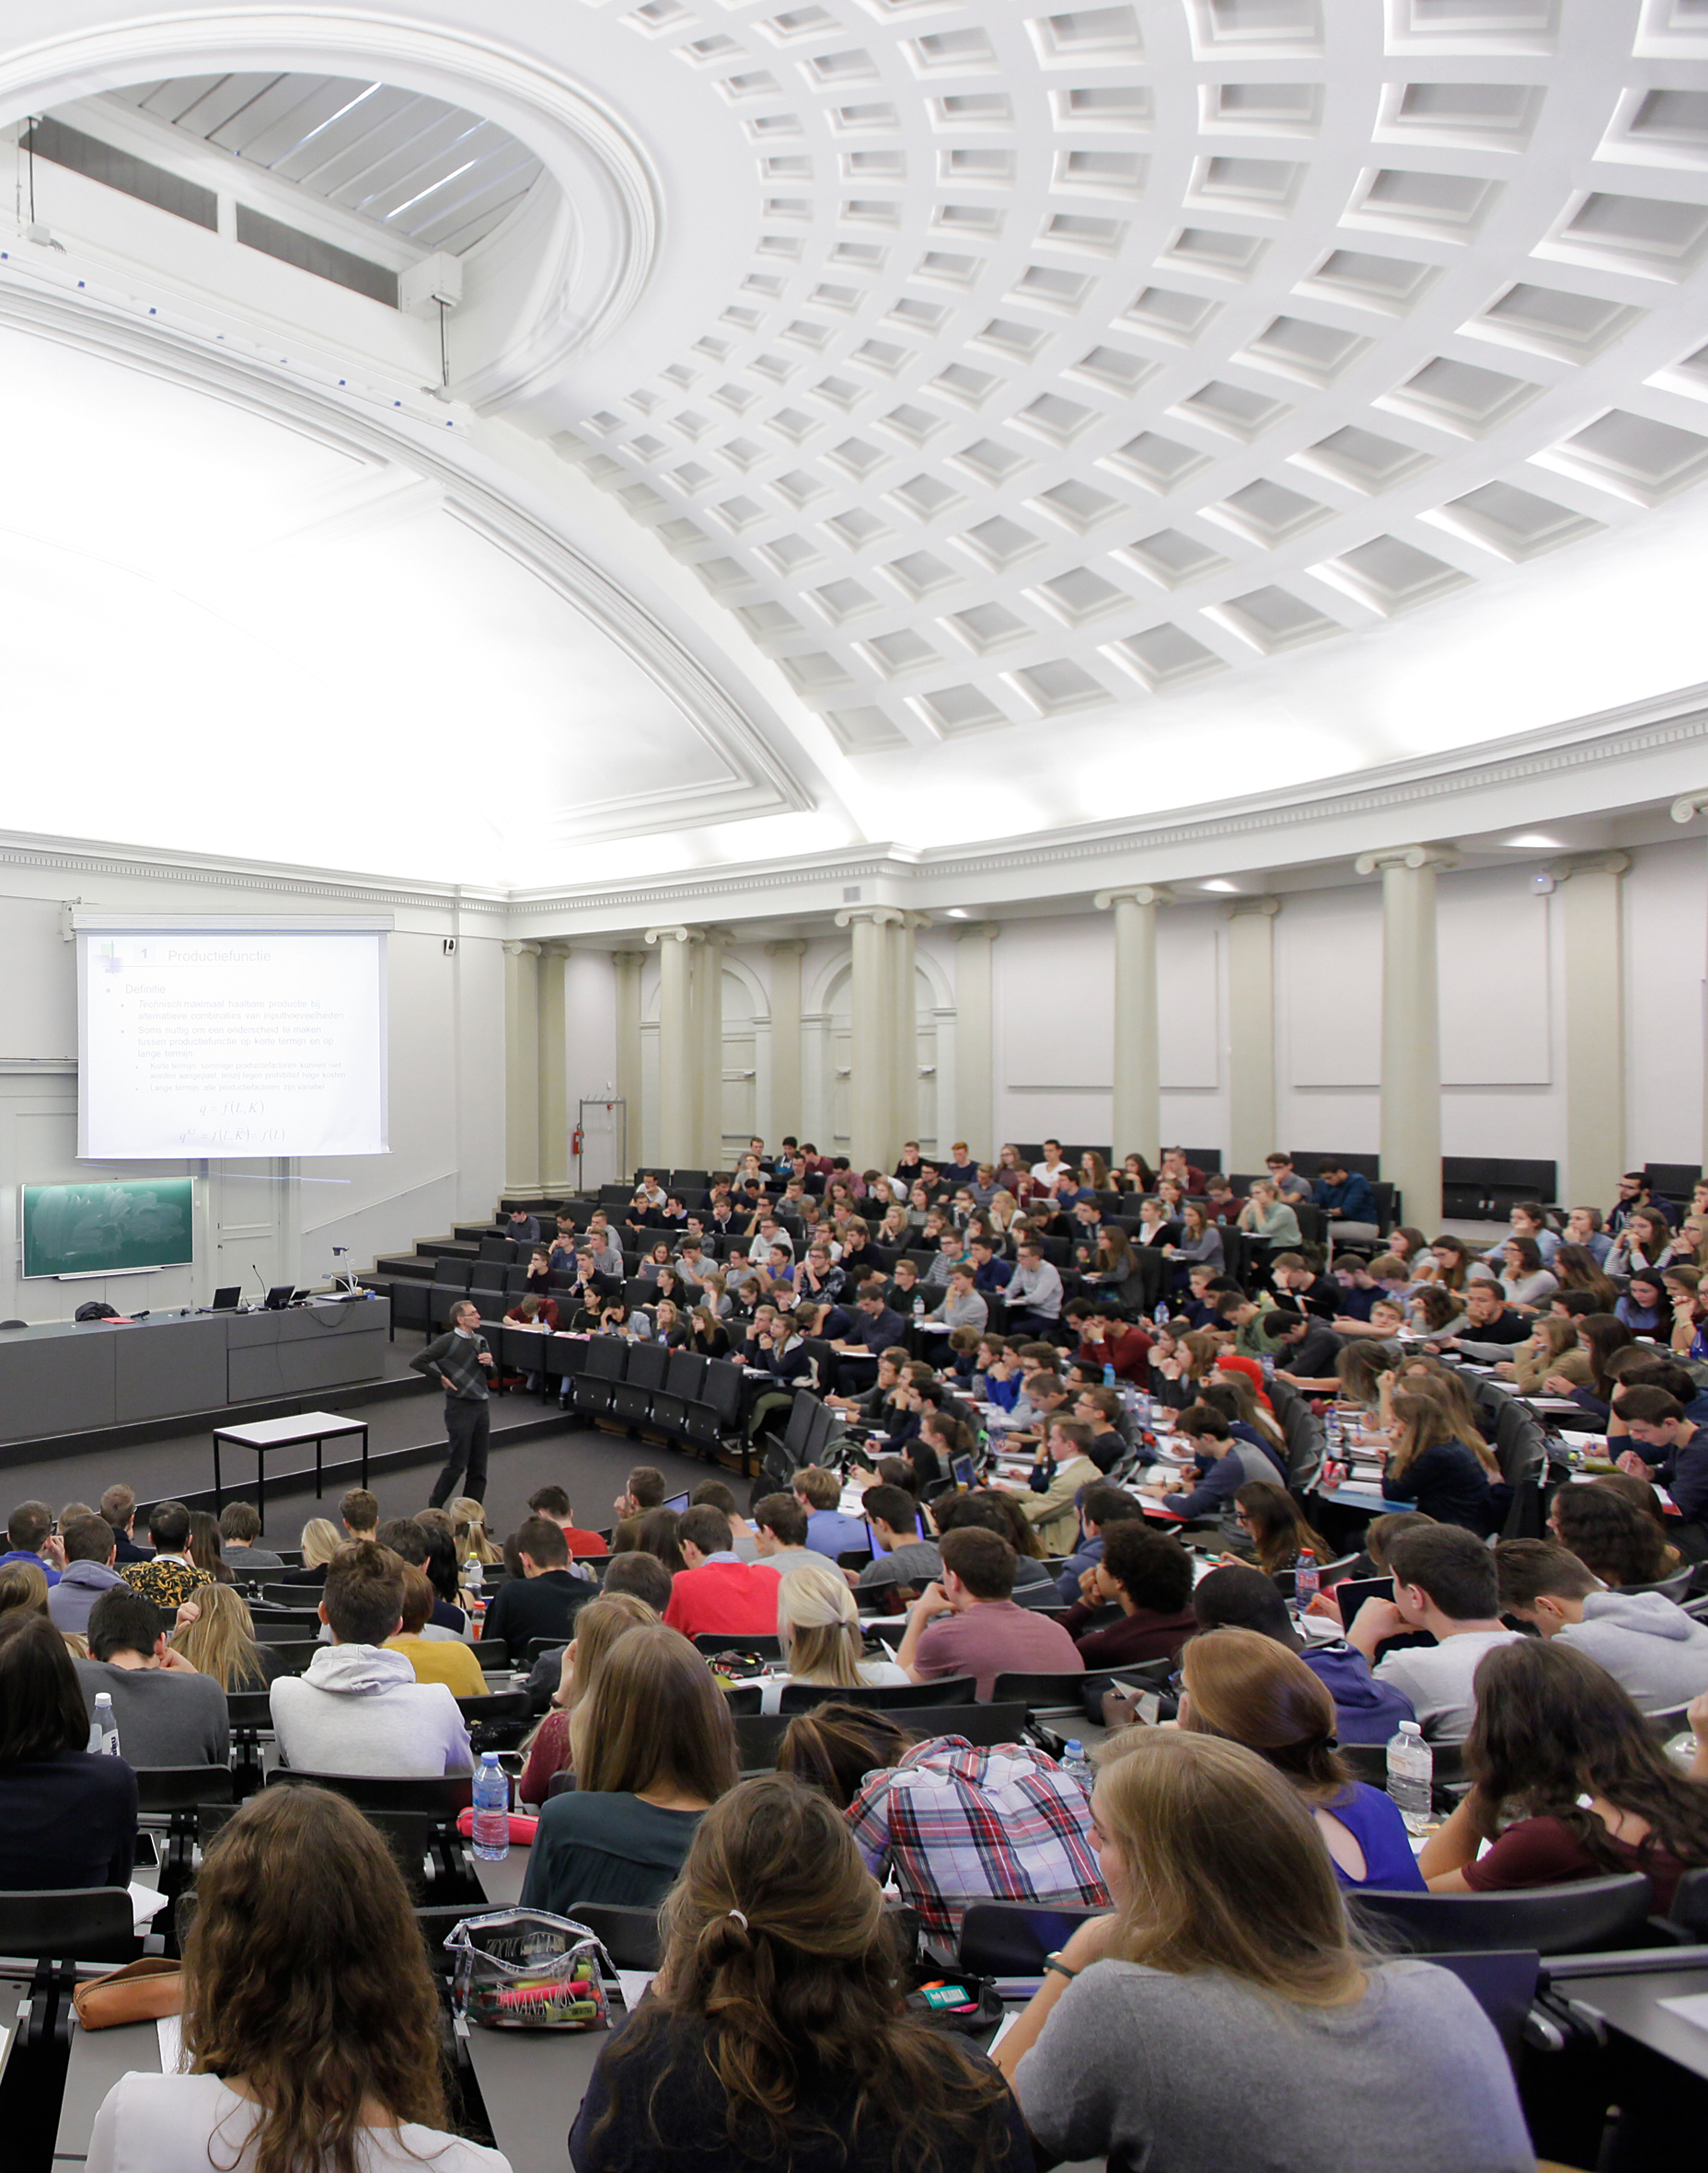
Coimbra Group 40th Anniversary Climate Symposium
24th-26th March 2025, Durham University

Slide 2
Universities as Innovators: Environmental Sustainability as a Driver of Innovation in Universities
Professor Zamorano Toro
Vice-Rector for Infrastructure and Sustainability, University of Granada

Slide 3
Presentation Outline
Sustainability as a driver of innovation
How can sustainability drive innovation in universities?
The University of Granada Sustainability Initiatives
The Environmental Sustainability Plan for Climate Change Adaptation and Mitigation of the University of Granada (PSAMUGR) 2024-2029
Final conclusion

Slide 4
Sustainability as a driver of innovation
Sustainability is not just about environmental responsibility
Sustainability is a powerful force driving innovation and transformation across multiple sectors, including business, education, and technology.
By addressing climate change, resource scarcity, and social equity, sustainability forces organizations to rethink traditional practices, develop new technologies and policies, and implement collaborative strategies.
This creates a necessity for innovation that has as result a transformation of industries, policies, and daily life for a better future.

Slide 5
How can sustainability drive innovation in universities?
Universities roles
Research
Education and awareness
Implementation of sustainable operating practices
Establishing alliances
Leadership
Innovation
Universities play a crucial paper in the design of a sustainable future

Slide 6
The University of Granada’s Sustainability Initiatives
The University of Granada has been actively engaged in environmental sustainability for years

Slide 7
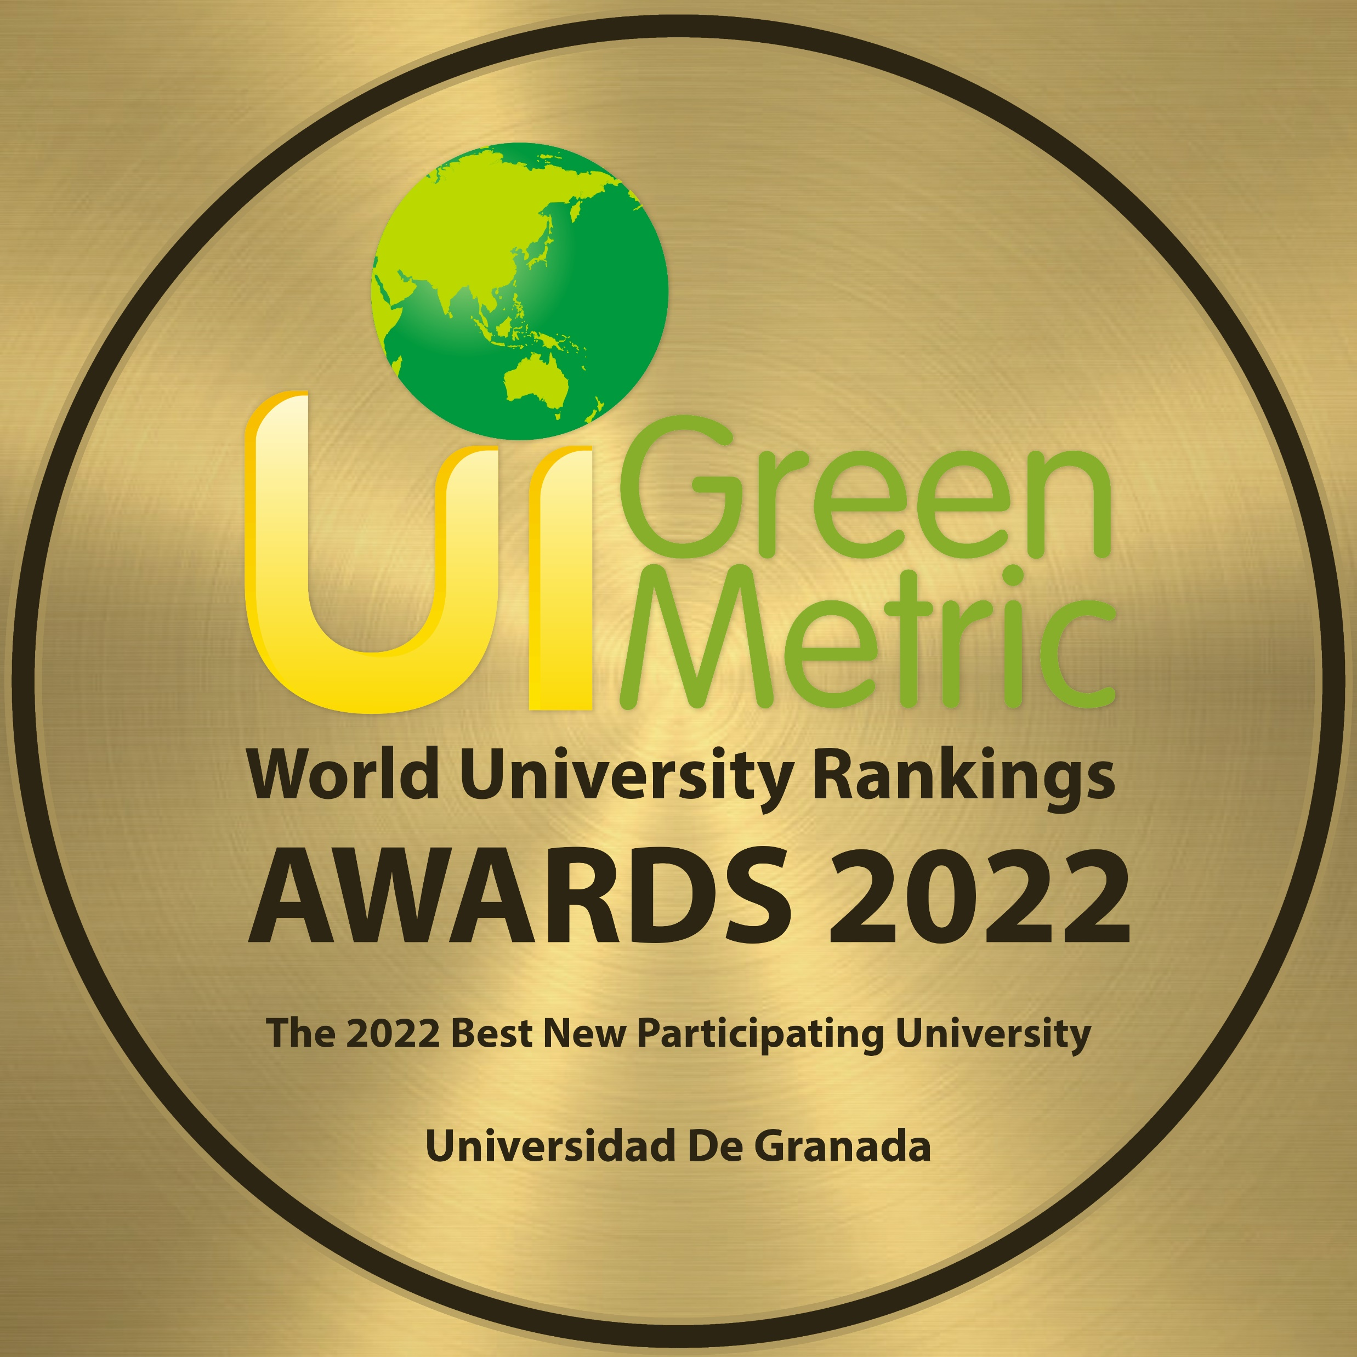
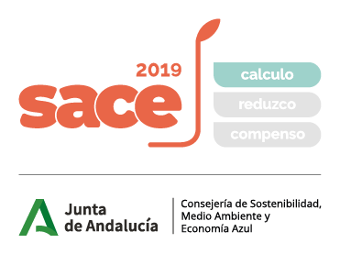
The University of Granada’s Sustainability Initiatives
76º WORLDWIDE POSITION
4º SPANISH POSITION
1º ANDALUSIA POSITION
2024
58º WORLDWIDE POSITION
1998
IMPLEMENTATION OF
THE ENVIRONMENTAL
QUALITY SERVICE
2023:
VICE-RECTORATE OF INFRASTRUCTURE
AND SUSTAINABILITY
2015 ODS
2022:
UGR STRATEGIC PLAN 2031
1996
ENVIRONMENTAL
DEGREE
2004-2008
ISO 14001
2019-2023
CO2 FOOTPRINT
2008
FIRST ACTIONS IN TERMS
OF SUSTAINABLE MOBILITY

Slide 8
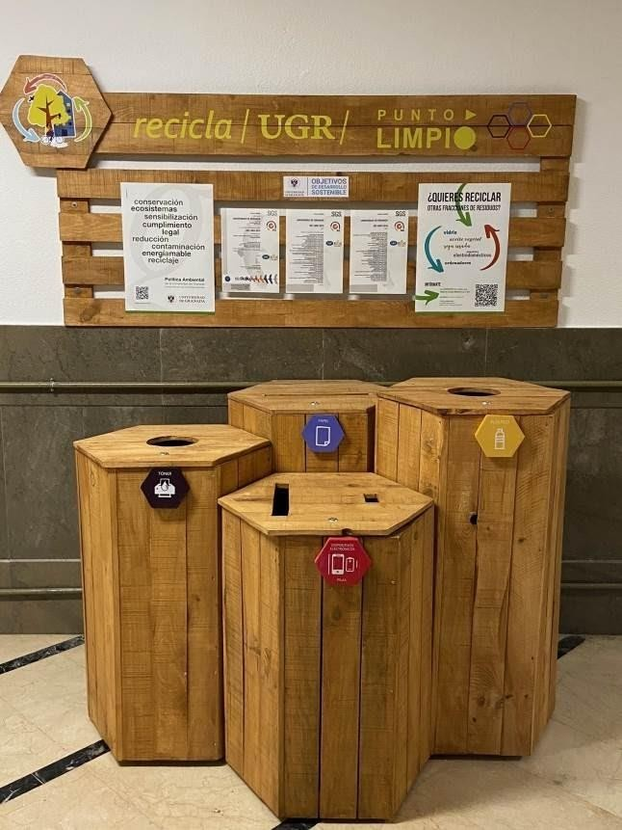
The University of Granada’s Sustainability Initiatives
58º Worldwide position in GreenMetrics ranking in 2024
Implementation of sustainable mobility measures, for example promote the use of the bicycles and public transport.
Development of a selective collection system for hazardous and urban waste
Monitoring and reducing water consumption and pollution
Expansion of green areas to offset the carbon footprint
Training programs for administrative, teaching, and research staff on environmental issues

Slide 9
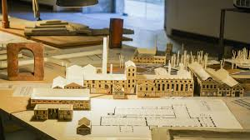
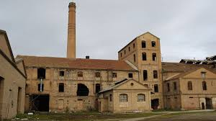
The University of Granada’s Sustainability Initiatives
Research and Innovation Leadership
LifeWood Project
UGR Sustainable Campus
Azucarera de San Isidro
LifeWatch Project

Slide 10
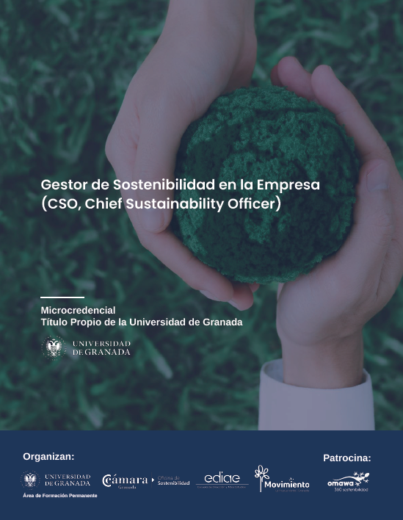
The University of Granada’s Sustainability Initiatives
Collaboration with society and companies
Teaching sustainability
Chair La Huella Verde for Sustainability and Urban Transformation
Microcredential “Chief Sustainability Office”

Slide 11
PSAMUGR 2024-2029
Environmental Sustainability Plan for Adaptation and Mitigation to Climate Change of the University of Granada
(PSAMUGR) 2024-2029
Proposed by Vice-rectorate of Infrastructure and Sustainability
Environmental Quality Service
Our roadmap aligns with European policies and aims to:
Comply with environmental regulations
Contribute to environmental improvements
Reduce costs
Promote education and awareness in sustainability
Serve as an environmental benchmark
Increase commitment and participation
Adapt to evolving environmental challenges
Enhance the university reputation

Slide 12
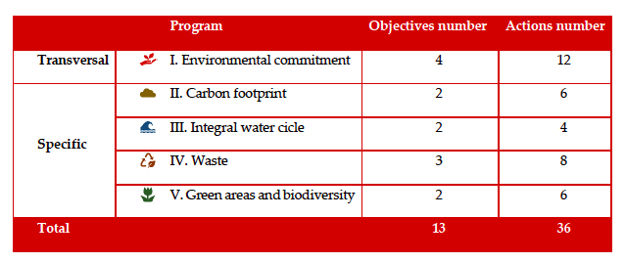
PSAMUGR 2024-2029

Slide 13
Final conclusion
Sustainability is not just a goal. It is an opportunity to redefine how universities educate, innovate, and impact the world.
By integrating sustainability into research, curricula, and operations, universities can lead the way in addressing global challenges and shaping a better future for all.

Slide 14
Thank you for your attention Universities
Professor Zamorano Toro
Vice-Rector for Infrastructure and Sustainability, University of Granada

