Slide 1


Prof Michele Acuto
Vice-President & Pro Vice-Chancellor
(Coimbra Summit, Durham, 25-26 March 2025)

Slide 2
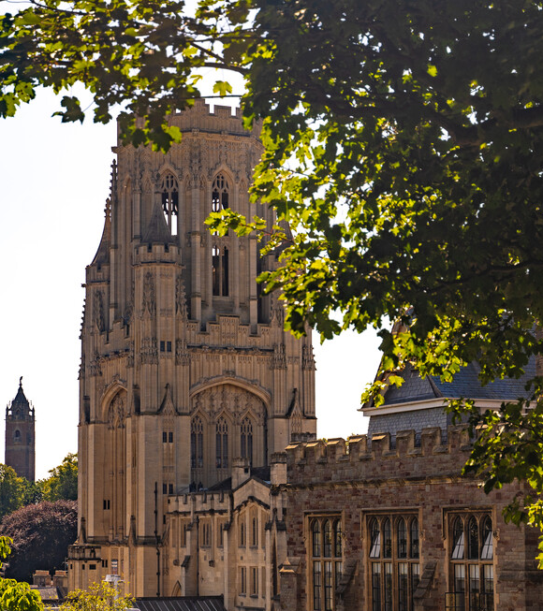
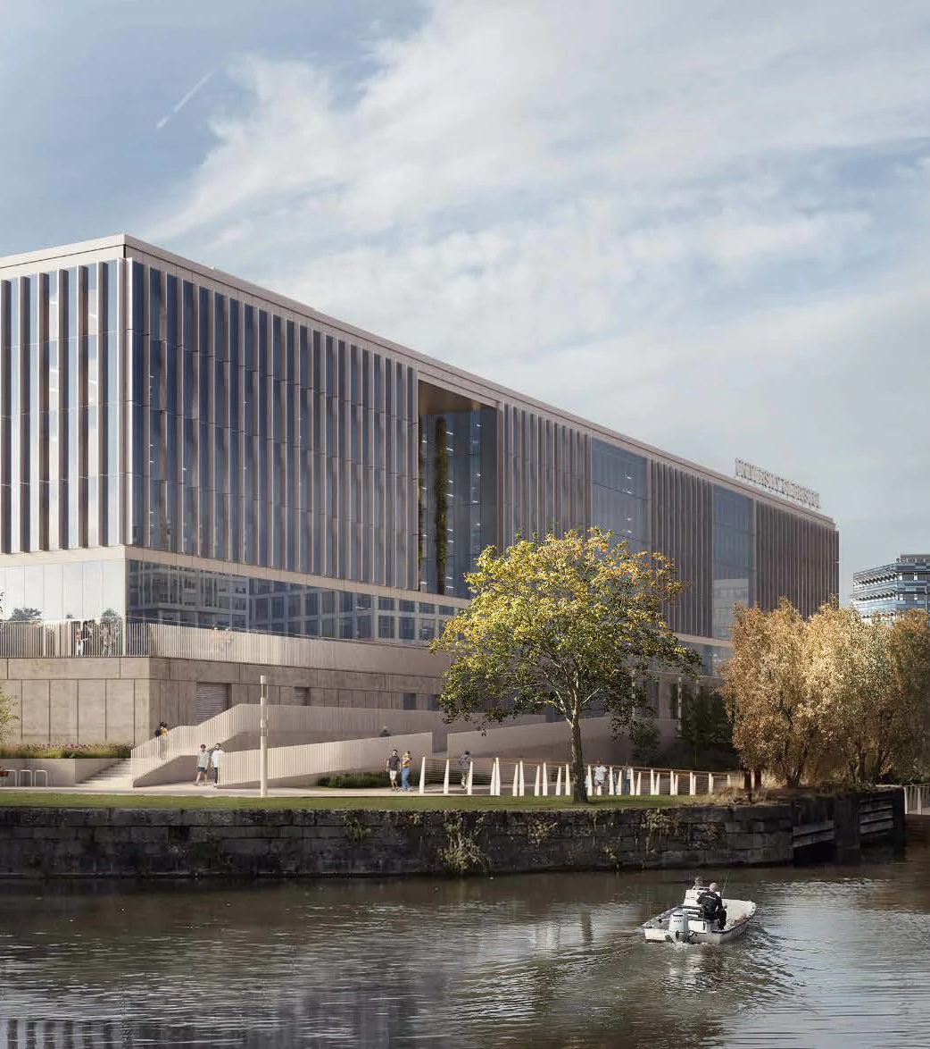

BRISTOL AT 150
From a University of Bristol to a University for Bristol (and a proactive actor in the world)
BRISTOL TEMPLE QUARTER
A once-in-a-generation redesign,
a deeply civic project,
amidst a global civic call
THE TRANSFORMATIVE POWER OF THE GLOBAL CIVIC UNIVERSITY

Slide 3
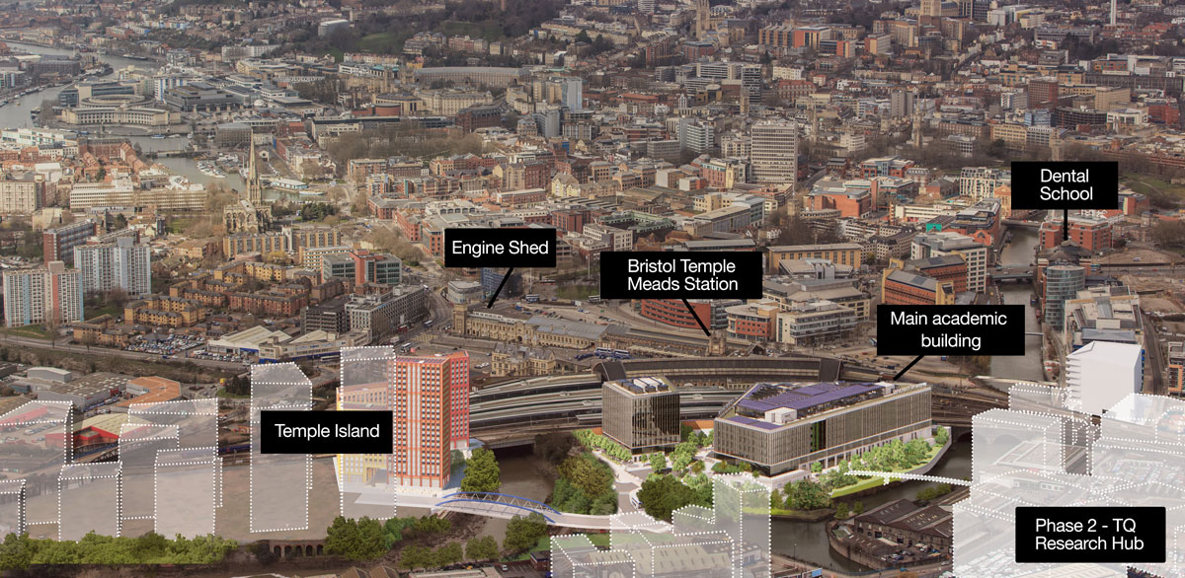
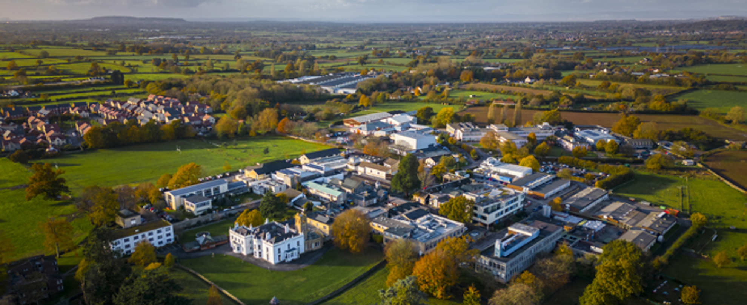
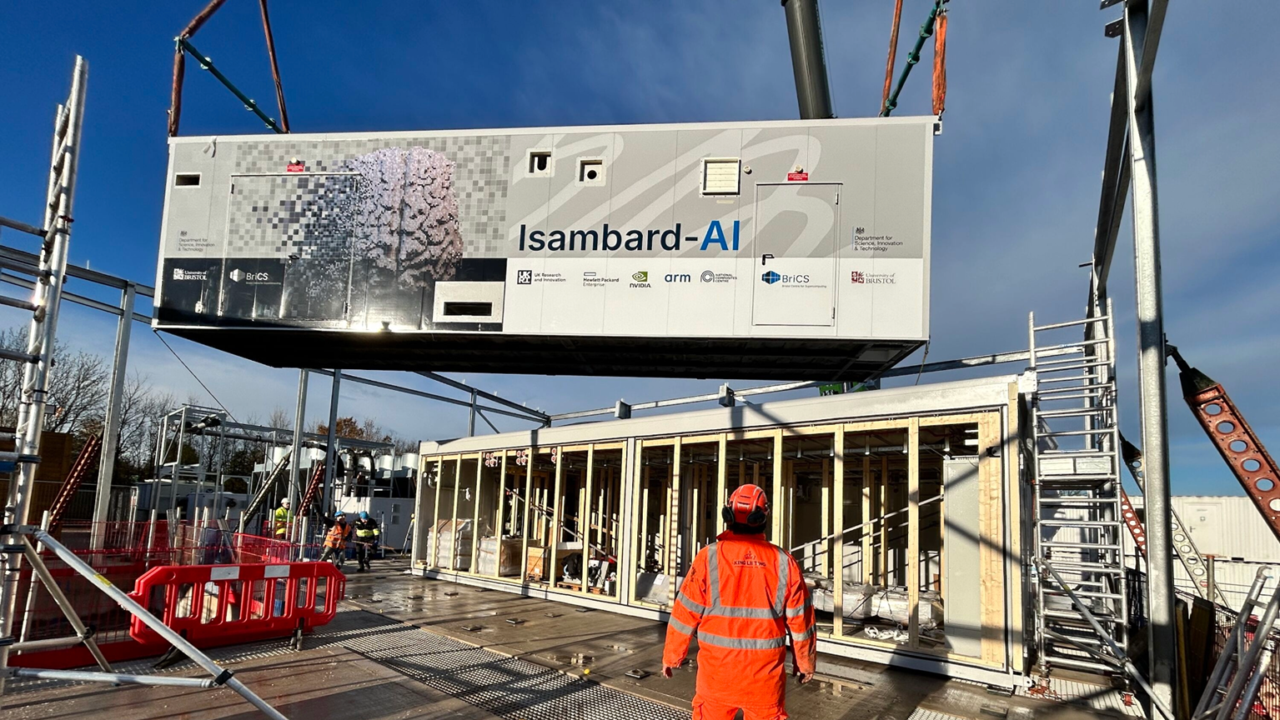
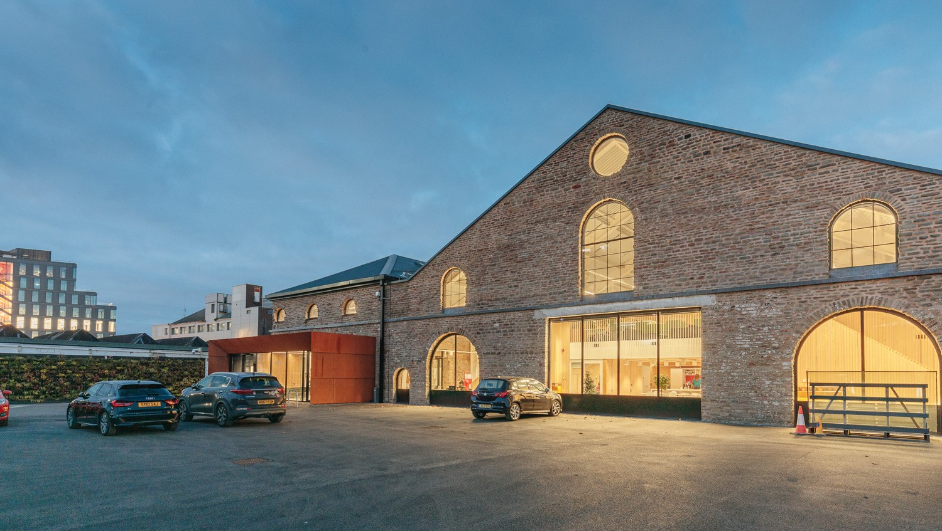
City Hall
Clifton campus
North Somerset Campus
Isambard AI

Slide 4
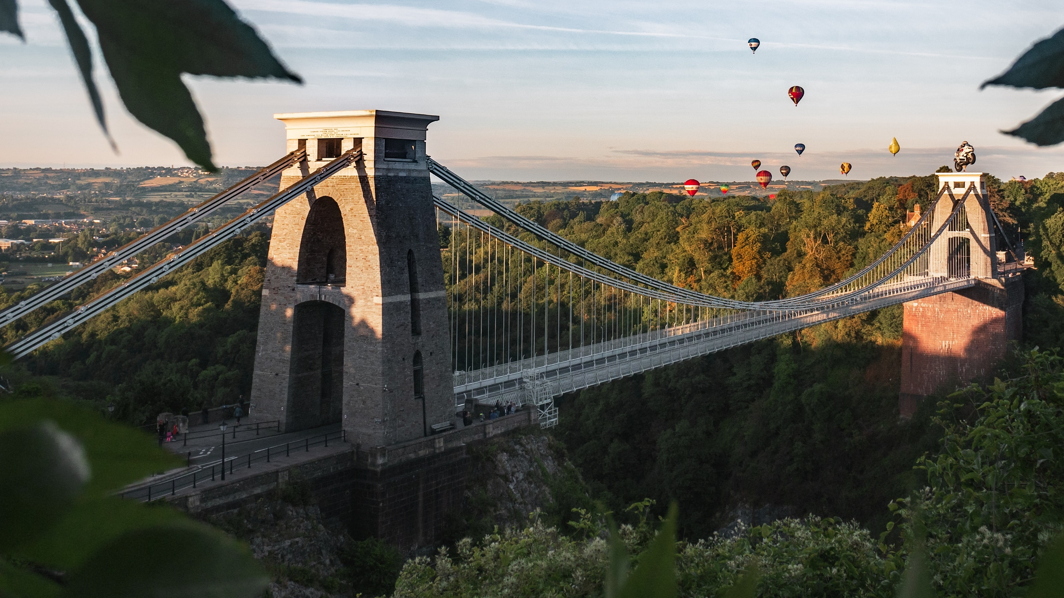
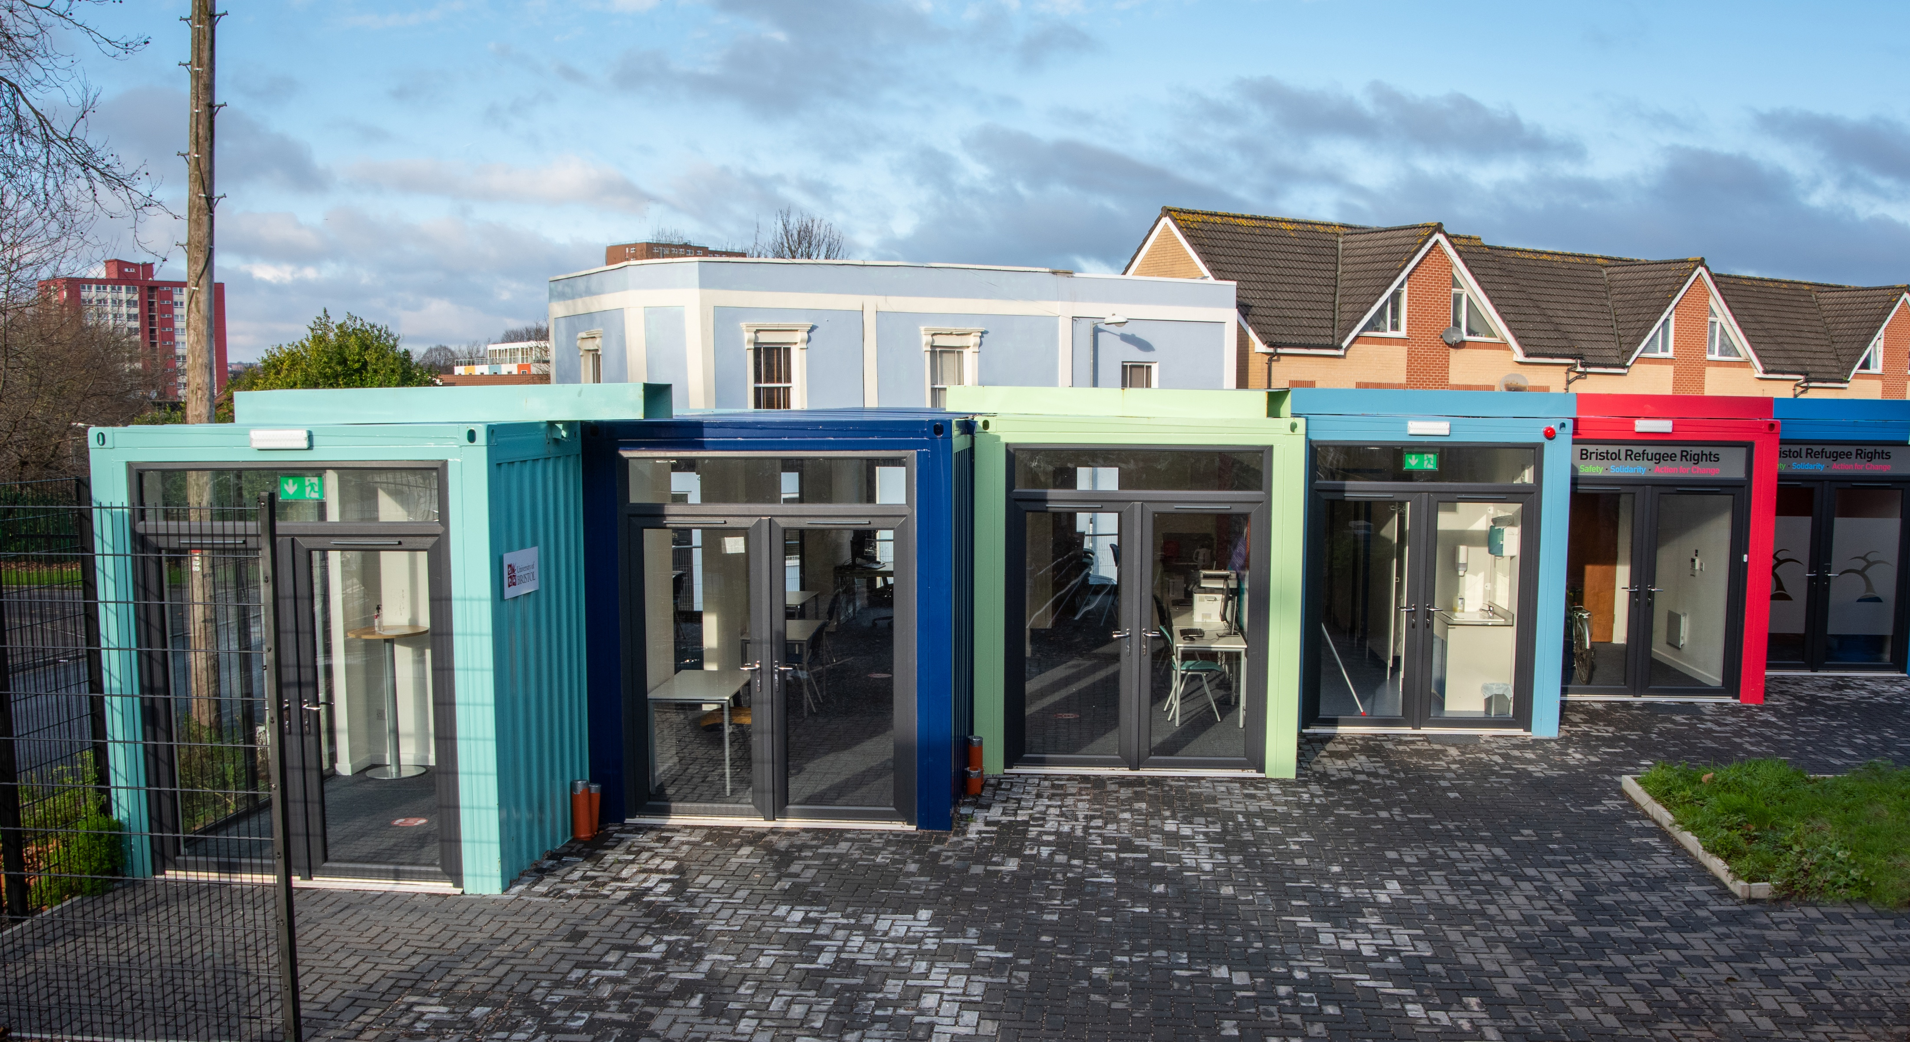
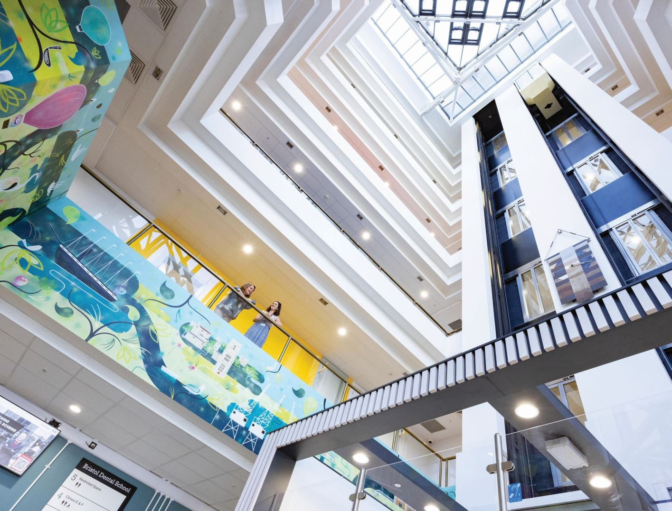
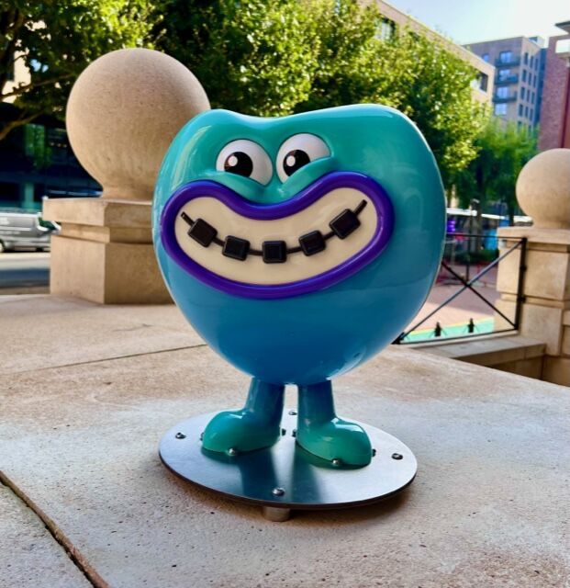
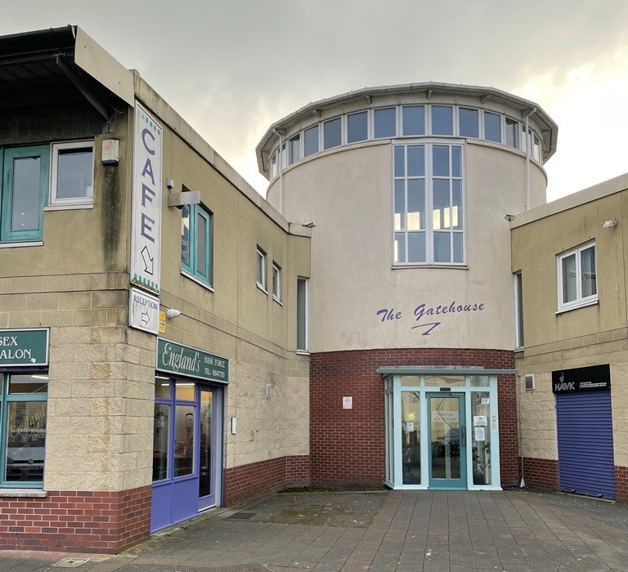
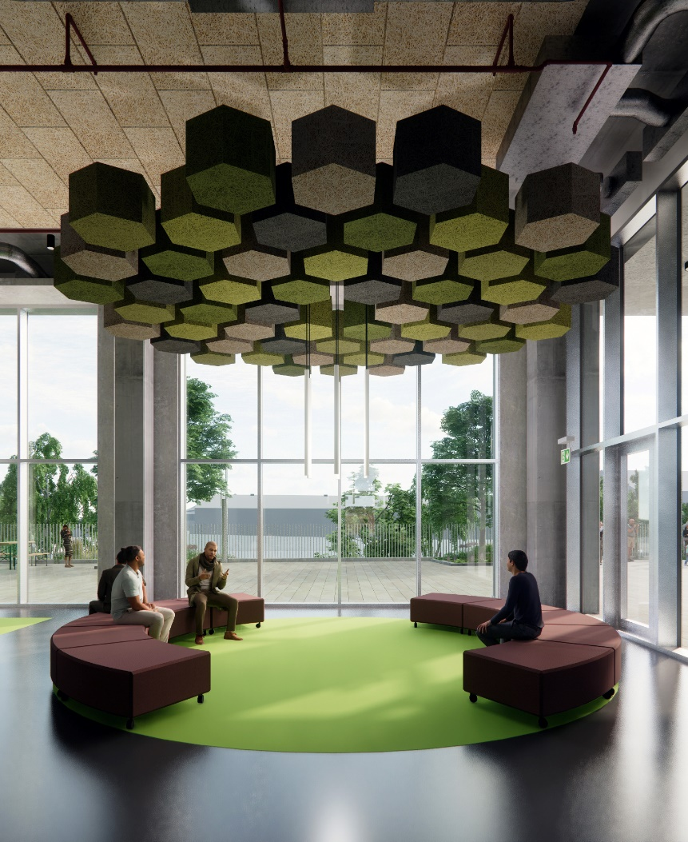
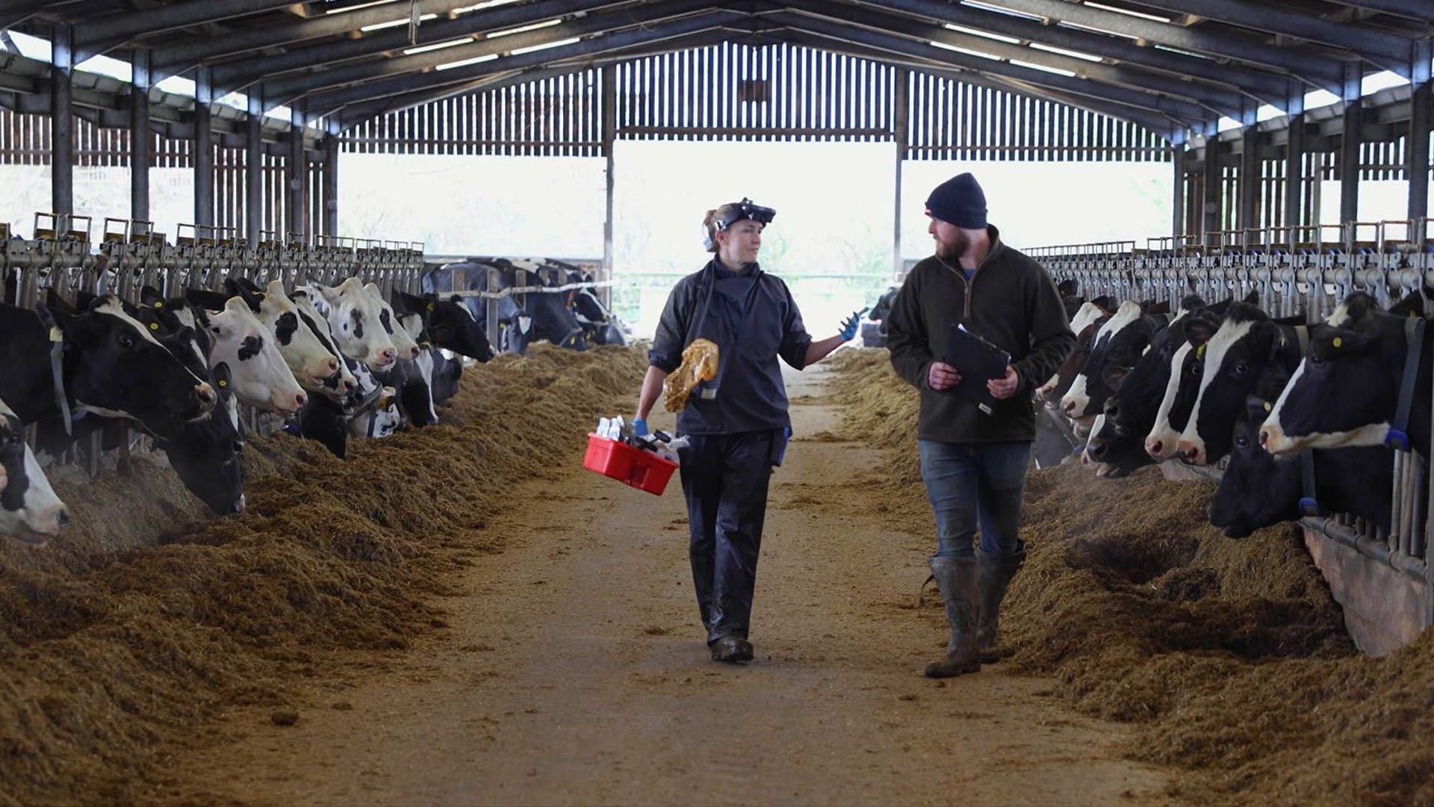

Bristol
Civic Spaces
Bristol Public Engagement Spaces

Slide 5
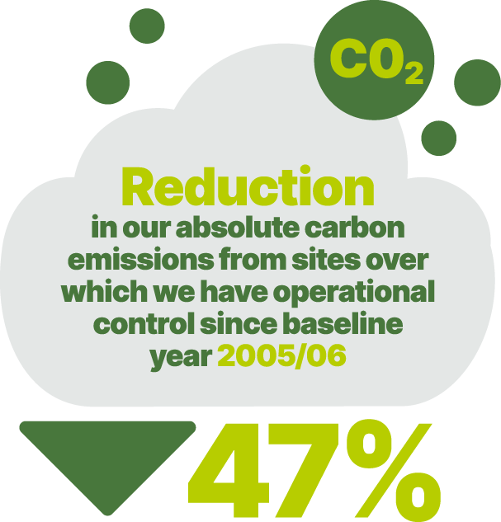


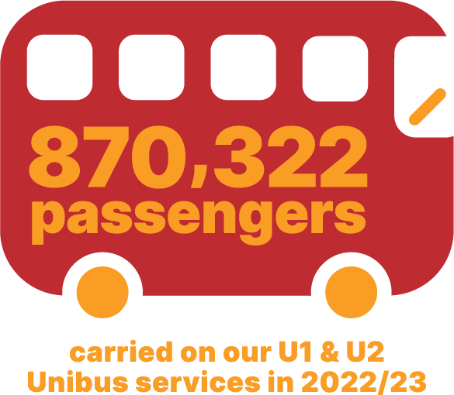

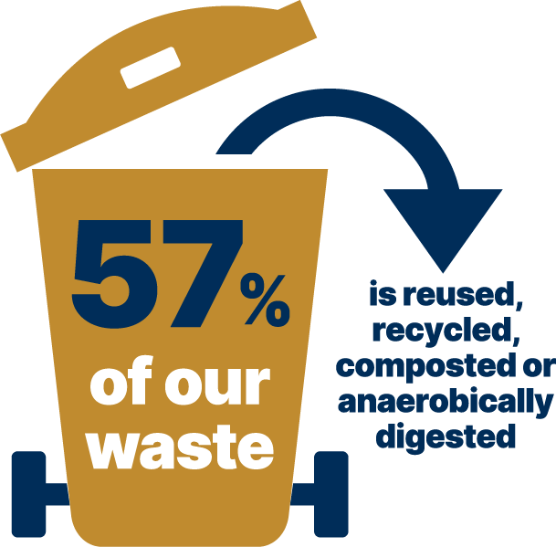
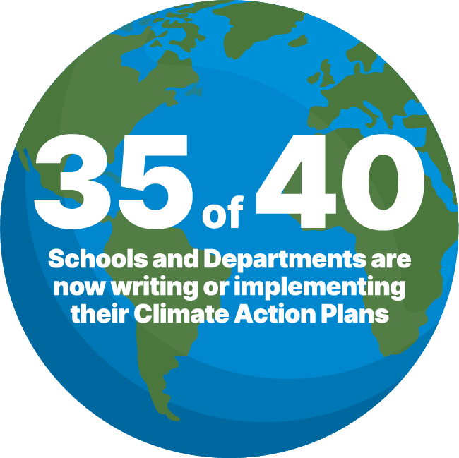
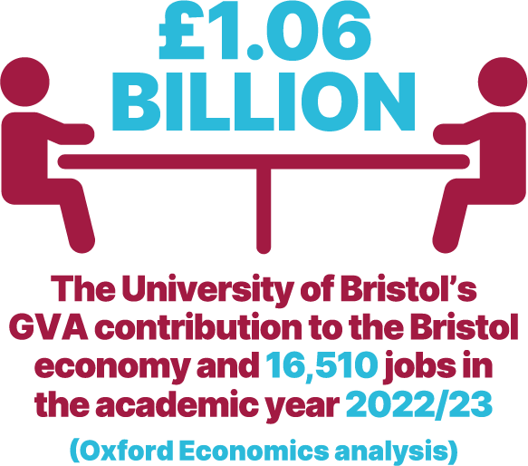

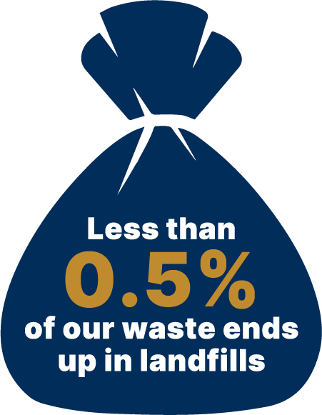


Slide 6


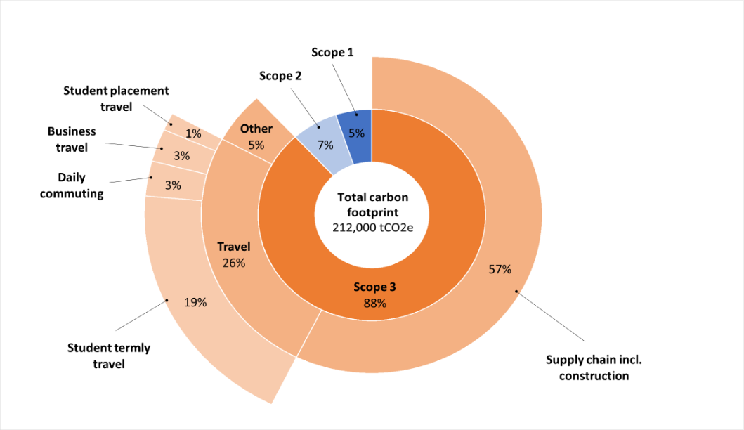
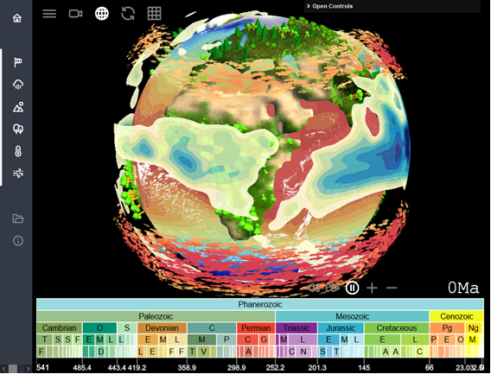

Slide 7
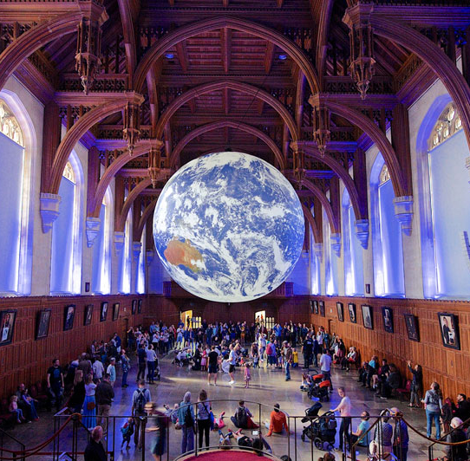




Slide 8
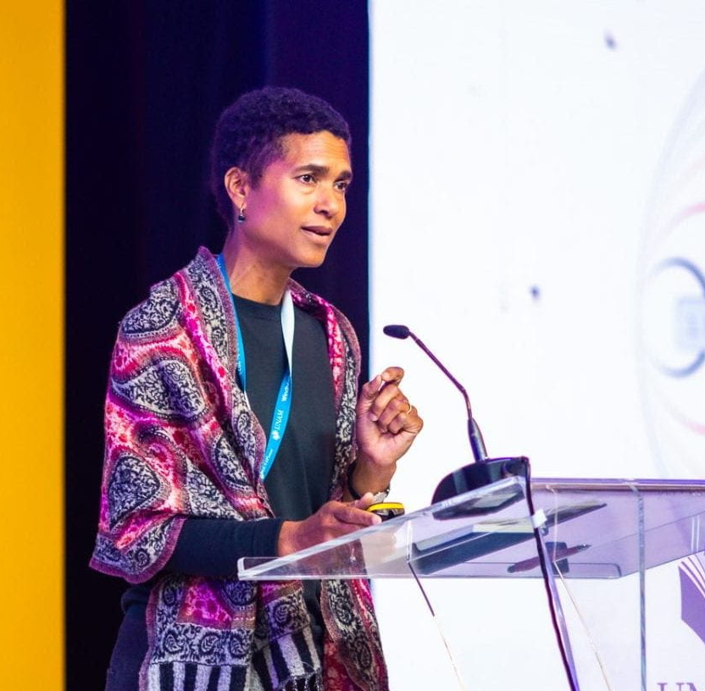
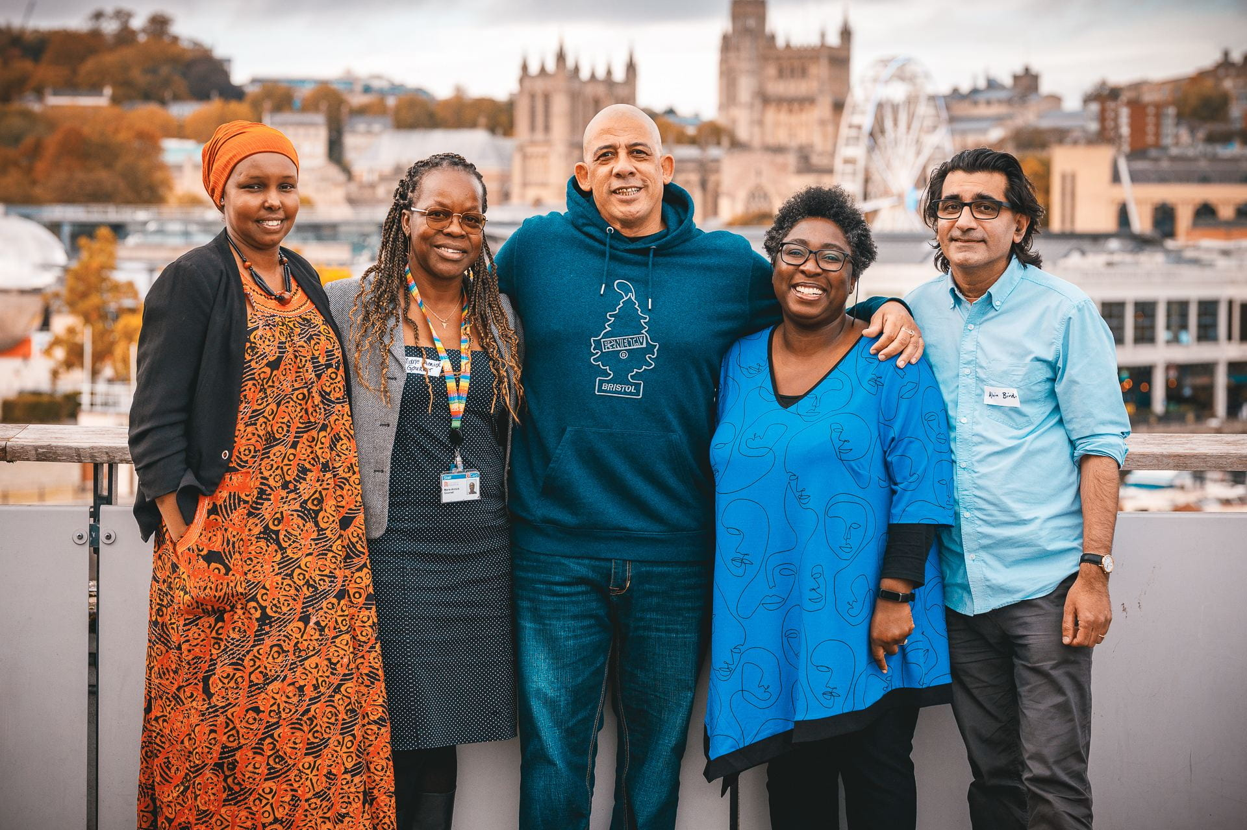
our REPARATIVE FUTURES and the AFRICA CHARTER commitment

Slide 9
Bristol’s climate partnership approach:
a CIVIC ART, and a GLOBAL RESPONSIBILITY
leveraging “the transformative power of global civic university”
EMBRACING CHANGE, at a complex and challenging time for HEIs
AI and DIGITAL FUTURES: driving CLIMATE INNOVATION
CIVIC PARTNERSHIPS: delivering in partnership
SUSTAINABLE DEVELOPMENT: setting climate action into context
..within our REPARATIVE FUTURES and AFRICA CHARTER commitments

Slide 10
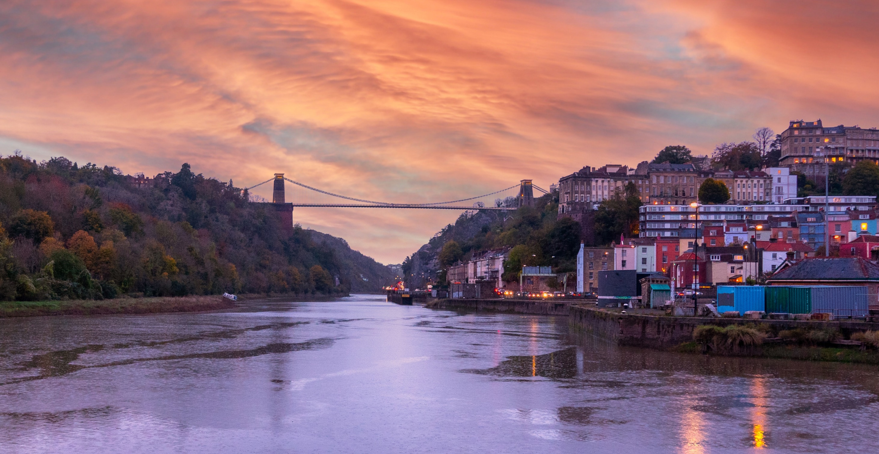

LET'S CONTINUE
THE CONVERSATION.

