Slide 1
The Organization of Shared Infrastructure at the University of Vilnius
The Case Study of Life Sciences Centre &
National Centre for Physical Sciences and Technology
Prof. Artūras Žukauskas
Rector, Vilnius University

Slide 2
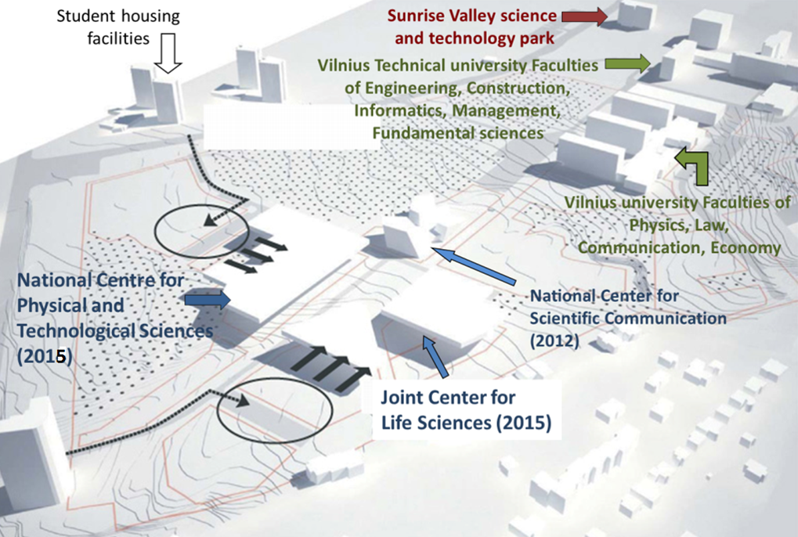
Campus of Saulėtekis (Sunrise Valley)

Slide 3
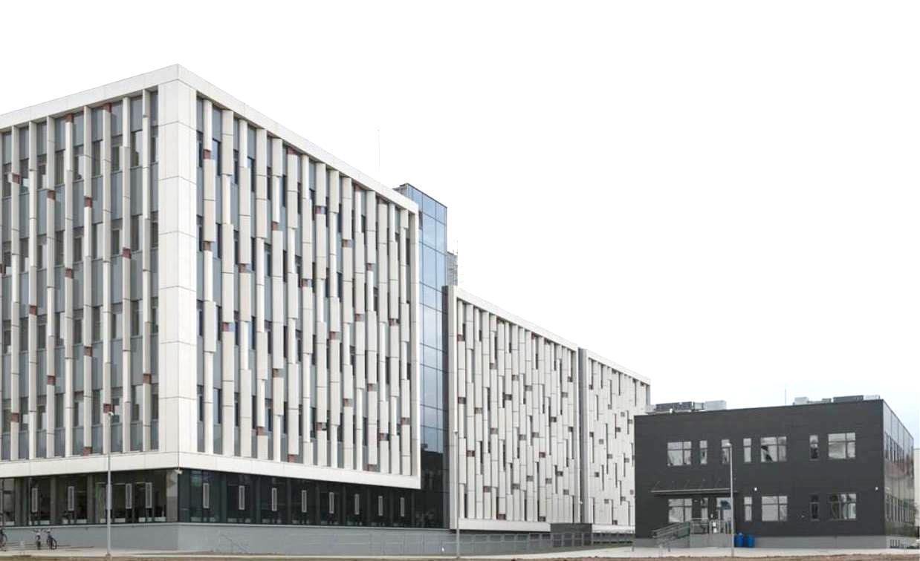
1. Life Sciences Centre (LSC)

Slide 4
LSC’s Key Facts & Figures
Total investments – 42 MEUR
24 000 m² total premises
1360 m² area of Bio-incubator
High quality infrastructure: modern laboratories and instrumentation:
23 modern research laboratories
10 educational laboratories
24 lecture halls
3 computer classes

Slide 5
Facilities of LSC
New education facilities for more than 800 students in Bachelor and/or Master study programmes of:
Biochemistry
Biophysics
Genetics
Microbiology and Biotechnology
Molecular Biology
Neurobiology
Ecology
Research facilities for:
> 200 researchers (PhDs),
> 160 PhD students,
~ 80 technicians,
~ 300 students graduating with Bachelor and Master thesis

Slide 6
Basic Resources
X-ray crystallography system
Mass spectrometers and liquid chromatography systems for proteomics analysis
High Pressure liquid chromatography system mass detector (HPLC-MS system)
Surface plasmon resonance biosensor combined with potentiostat SPR Twingle, Metrohm Autolab
Atomic force microscope, Dimension Icon, Bruker AXS
Automated system for cell imaging
Universal small molecule and macromolecule diffractometer
Sequencing platforms (IonTorrent, Illumina, Solid, Roche 454)
Continuous wave solid state lasers (266 nm, 405 nm, 457 nm, 532 nm)
Spin coater, WS-650-23NPP, Laurell

Slide 7
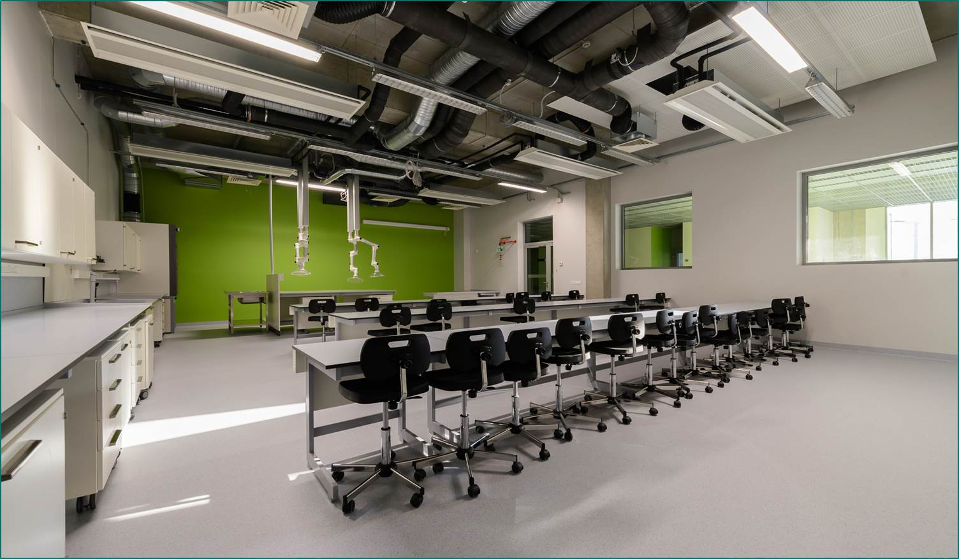
Teaching Facilities

Slide 8
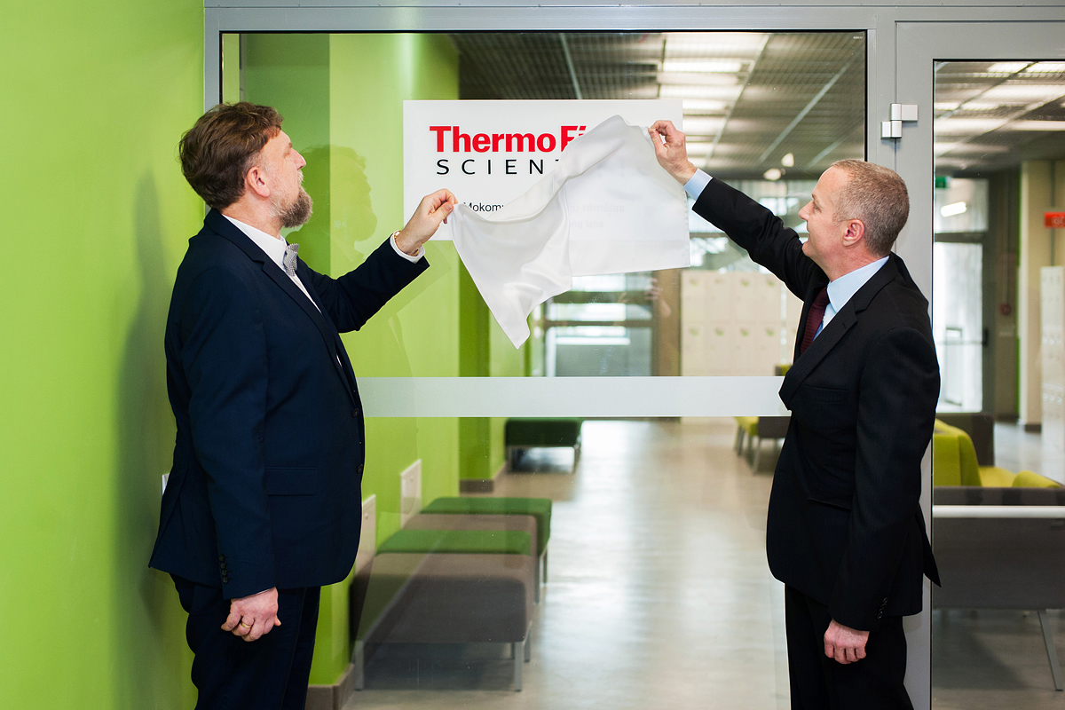
Support from Industry

Slide 9
Research
Smart Specialisation: Health Technologies and Biotechnologies
Main fields of research:
  Structure and functional research of biomolecules
  Human, plant and microbial genome research
  Antigenicity studies of recombinant viral proteins and development of monoclonal antibodies
  Proteomic analysis
  Structural biology and bioinformatics
Average annual expenditures on research (external grants and industrial contracts) ~ 6 MEUR

Slide 10
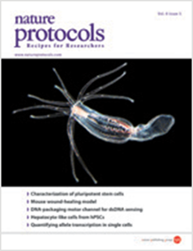
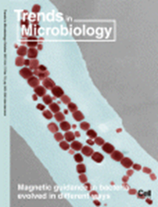
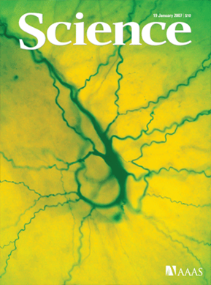

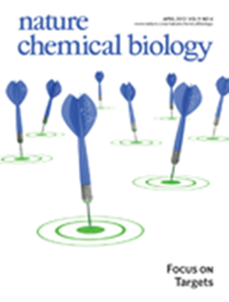
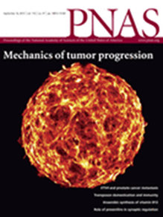

Research Outcomes

Slide 11
IP Outcomes
24 patents and patent applications in USA, UK and Europe in recent years (http://www.ibt.lt/en/patents.html):
Siksnys V., Gasiunas G., Karvelis T., Lubys A., Zaliauskiene L., Glemzaite M. Smith A. RNA-directed DNA cleavage by the Cas9-crRNA complex. WO 2013142578 A1
Weinhold E., Dalhoff C., Klimašauskas S., Lukinavičius G. New S-adenosyl-L-methionine analogues with extended activated groups for transfer by methyltransferases. JP 129120 B2. 2013-01-23
Matulis D., Cikotiene I., Kazlauskas E., Matuliene J. 5-aryl-4-(5-substituted 2,4-dihydroxyphenyl)-1,2,3-thiadiazoles as inhibitors of Hsp90 chaperone and the intermediates for production thereof. US 831413220. 2012-12-20
D. Matulis, Cikotiene I., Kazlauskas E., Matuliene J. 5-aryl-4-(5-substituted 2,4-dihydroxyphenyl)-1,2,3-thiadiazoles as inhibitors of Hsp90 chaperone and the intermediates for production thereof. EP 2268626 B1. 2012-02-01
Matulis D., Dudutienė V., Matulienė J., Mištinaitė L. Benzimidazo[1,2-C][1,2,3]thiadiazol-7-sulfonamides as inhibitors of carbonic anhydrase and the intermediates for production thereof. EP2054420. 2011-06-22
E. Weinhold, C. Dalhoff, S. Klimašauskas, G. Lukinavičius. New S-adenosyl-L-methionine analogues with extended activated groups for transfer by methyltransferases. US 8,008,007. 2011‑08‑30
Žvirblienė A., Gedvilaitė A., Ulrich R., Sasnauskas K. Process for the production of monoclonal antibodies using chimeric VLPs. US 7919314 B2. 2011-04-05
Weinhold E., Dalhoff C., Klimašauskas S., Lukinavičius G. S-adenosyl-L-methionine analogues with extended activated groups for transfer by methyltransferases. EP1874790. 2010-08-18

Slide 12
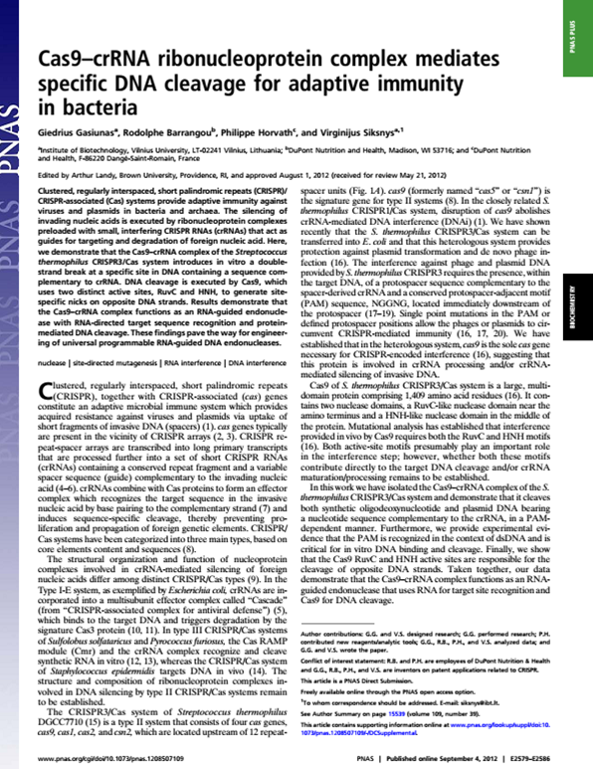
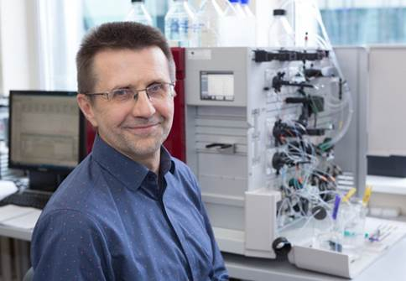
Vilnius University professor
Virginijus Šikšnys
2016 Warren Alpert Foundation Prize

Slide 13
“DuPont Pioneer unveils its first CRISPR product”
April 21, 2016
DuPont Pioneer recently unveiled waxy corn hybrids as its first commercial agricultural product developed through the application of CRISPR-Cas enabled advanced breeding technology.
This next generation of waxy corn hybrids is expected to be available to U.S. growers within five years, pending field trails and regulatory reviews.
“Starting with an identity-preserved product as our initial CRISPR-Cas offering allows us to lay a solid foundation for success of future larger volume products from this plant breeding innovation,” said Neal Gutterson, vice president, research and development for DuPont Pioneer.
Pioneer previously announced strategic agreements for research collaborations and intellectual property (IP) licenses with Vilnius University and with Caribou Biosciences to advance CRISPR-Cas.

Slide 14

















Industrial Collaboration

Slide 15
Bio-Incubator of LSC
1360 m²
22 laboratories
14 offices
General facilities

Slide 16
Main Goals to be Achieved for LSC
To be among top 20 strongest research and learning institutions in the field of life sciences in Europe.
To generate 2-3 new biotech companies annually.
To have 1/5 of international PhD students, postdocs and researchers.
To have at least 5 international MSc programmes in modern life sciences (molecular biology, biochemistry, biotechnology, genetics) that would be attractive for students from EU and other countries.

Slide 17
2. National Centre for Physical Sciences and Technology (NCPST)
Vilnius University:
  Faculty of Physics
  Institute of Applied Research
  Institute of Theoretical Physics and Astronomy
  Institute of Chemistry
State Centre for Physical Sciences and Technology
  Institute of Chemistry
Institute of Physics
Semiconductor Physics Institute
Textile Institute
  Science & Technology Park of Institute of Physics
Vilnius Gediminas Technical University

Slide 18
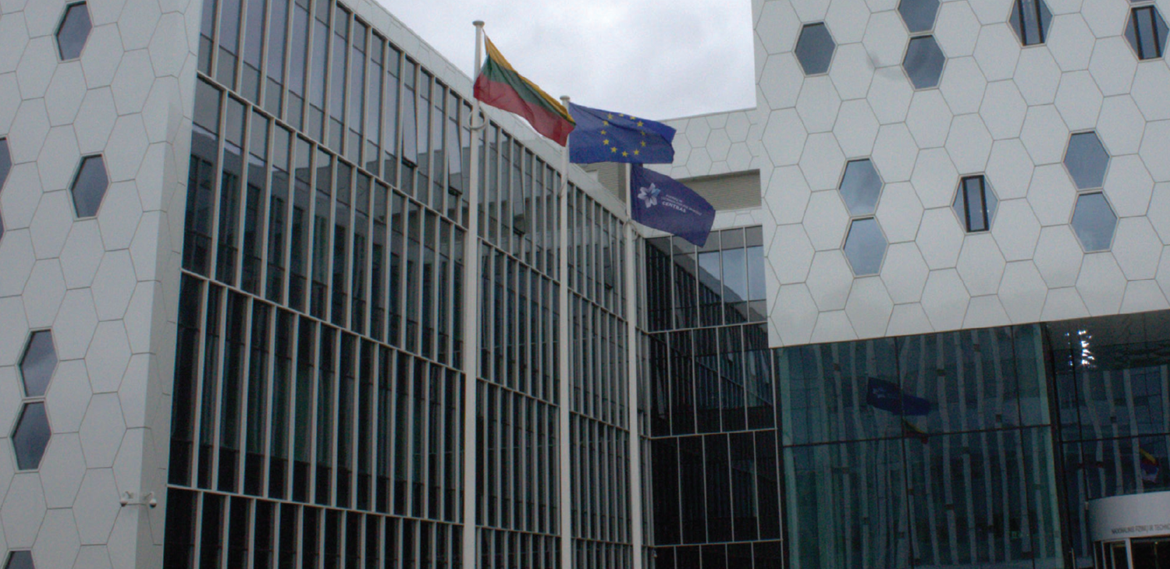
NCPST is a consortium of Vilnius University, Centre for Physical Sciences and Technology, and Vilnius Gediminas Technical University

Slide 19
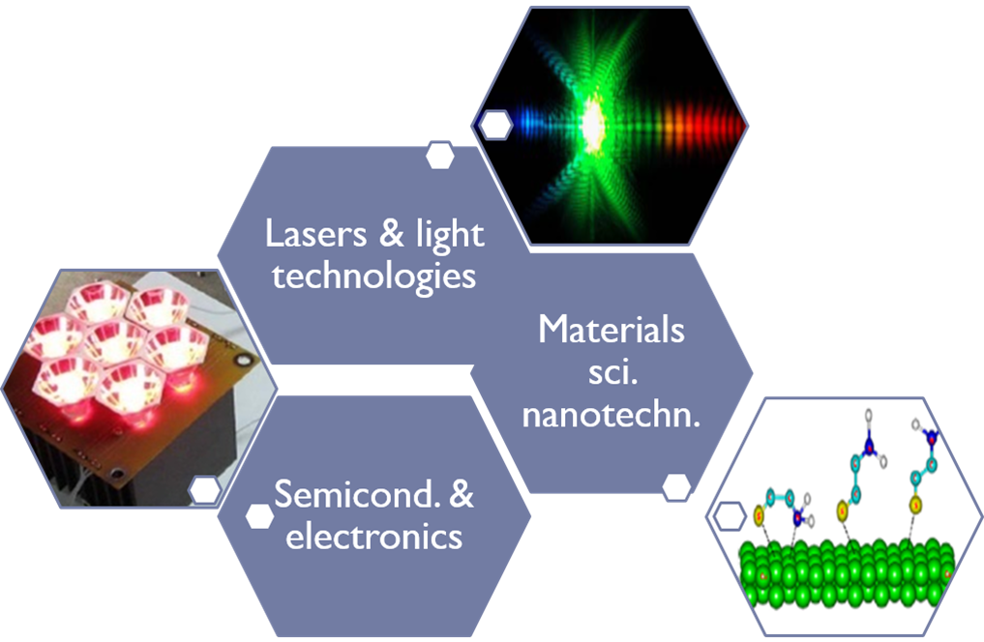
Primary Targets for Technology Development in NCPST

Slide 20
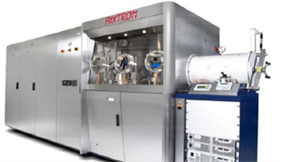
MOCVD Technology for GaN Based Materials
GaN-based epitaxy growth for LEDs and smart illumination

Slide 21
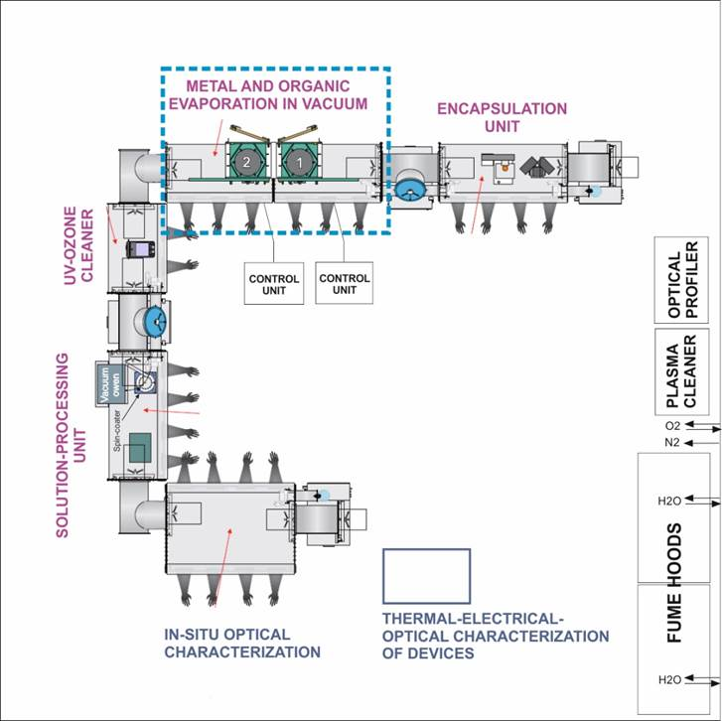
Technology Cluster for Organic Semiconductors:
The Clean Room Facilities & The Line for Formation + Prototyping
The primary targets for R&D:
Highly efficient white LEDs based on nanostructured objects (EC Framework project)
Organic laser based transistor (joint project Lithuania–Japan)

Slide 22
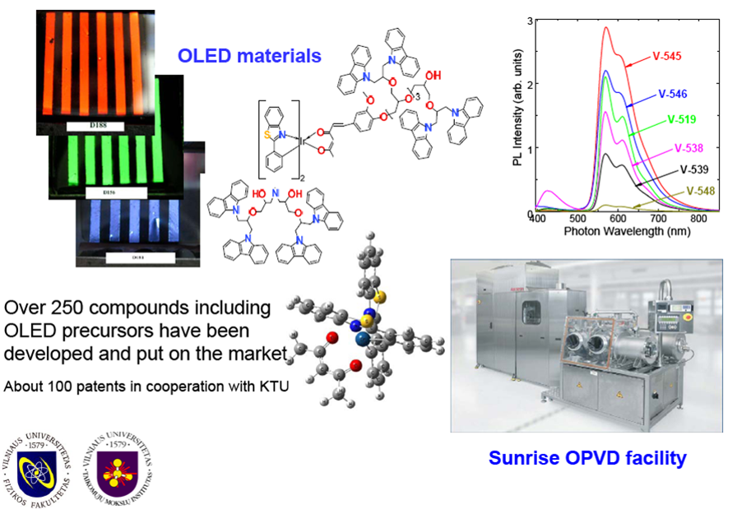
Organic LED Materials

Slide 23
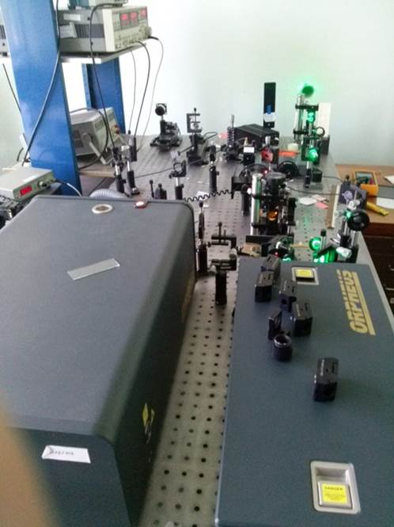
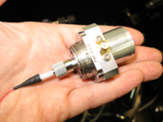
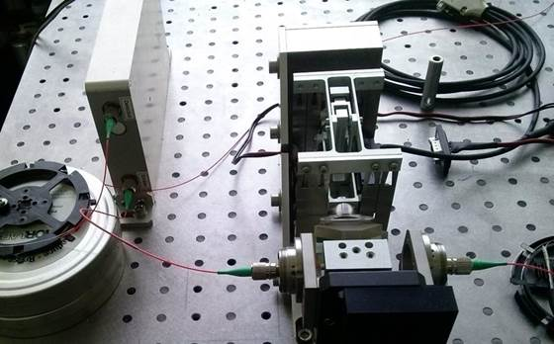

Applied Optoelectronics
Manufacturing of special lasers and systems for research: spin-off company and it’s products
Highly improved system for ultra-fast experiments:
  THz time domain spectroscopy
  Compact
  High accuracy
  Reliability
  Low price

Slide 24
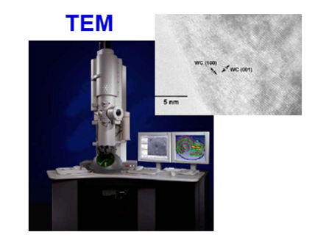
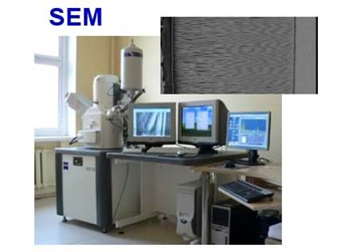
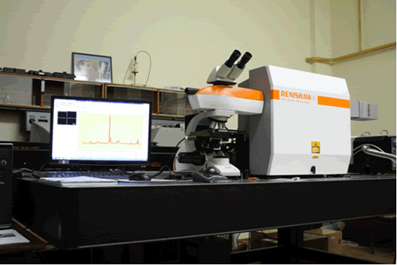
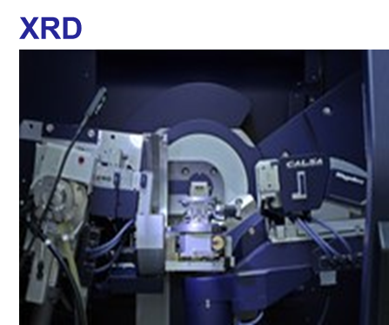
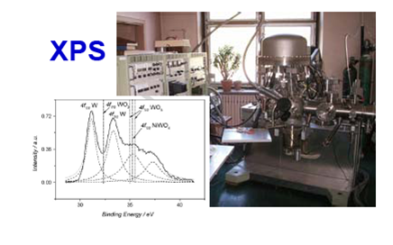
Materials Analysis
Raman spectrometer

Slide 25
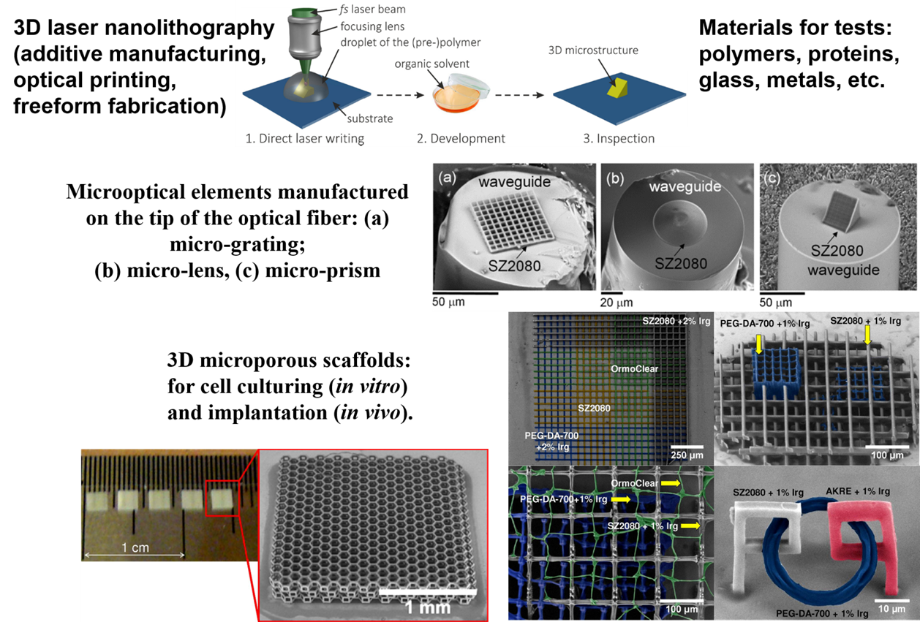
Direct Laser Writing: True 3D Micro-/Nanolithography

Slide 26
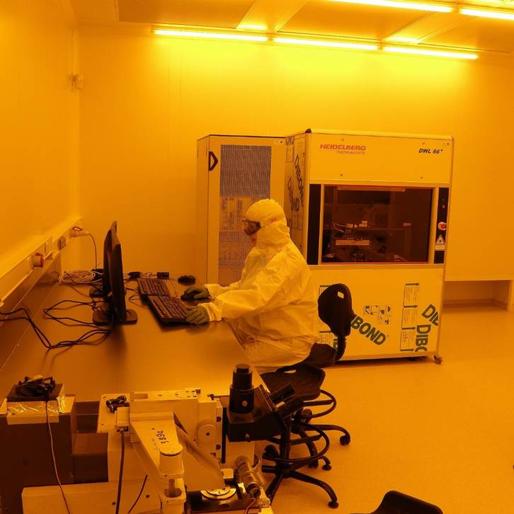
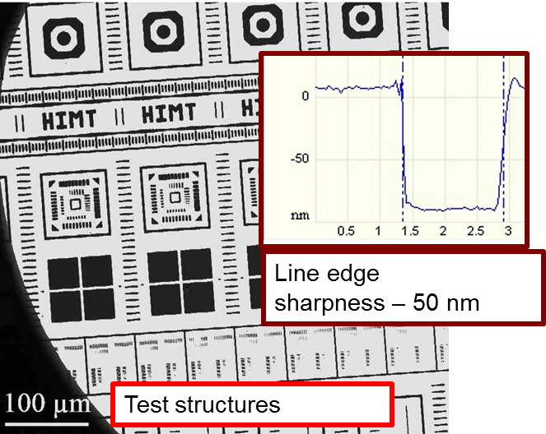
Direct Circuit Printing with Laser Lithography
Multiplication by photolithography
DWL66-FS Heidelberg
# photolithography (resolution ~ 1 µm)
# laser lithography + environment control
resolution ~ 0,5 µm, sharpness ~ 50 nm

Slide 27


Coordinated Activities and Collaboration
Lasers & laser technology
Structural analysis & spectroscopy
Chemical technology & application
Optoelectronics & application
Semiconductor technology & sensors
Joint PhD courses in physics and technology ~ 20–25 new students each year
Materials & devices for optoelectronics
LEDs & smart illumination
Laser research & nanophotonics
Organic semiconductor synthesis & properties
Information technology & particle physics

Slide 28



Technology: Basis & Expectations
NCPST is accepted as a modern infrastructure
that connects science, studies and innovative industry
Training, R&D + concept demonstration
Increase in competitiveness
SCIENCE
BUSINESS
High added value products
Innovations in products and technologies
Science of new quality
Notes:
2016 metų sausio mėnesio 13 diena
28

Slide 29
Technology: Basis & Expectations
NFTMC is accepted as a modern infrastructure
that connects science, studies and innovative industry
Training, R&D + concept demonstration
Increase in competitiveness
SCIENCE
BUSINESS
High added value products
Universities
Applied
Science
Centre
Parks of
Science &
Technology
Innovative
Company
Start-up
Inovations in products and technologies
Science of new quality
Notes:
2016 metų sausio mėnesio 13 diena
29

Slide 30
Supporting strategic projects
The effective employment of the new research infrastructure is supported by strategic projects of Vilnius University:
Strengthen researchers’ skills
Establish international advisory boards
Establish research project preparation office
Introduce postdoc positions
Outreach science and innovation
Establish PhD schools
Improve cooperation with partners
Establish Industry professor, Associate industry professor, and Full professor positions
Improve organisational structure of the University
Optimise the process of public procurement

Slide 31
Thank you for your attention and
Welcome to Vilnius!

