Slide 1
Open Access und der Open Data Pilot in Horizon 2020
Daniel Spichtinger
DG Research & Innovation, European Commission
Open Access und Open Data in Horizon 2020
29. Oktober 2014
Niedersächsische Staats- und Universitätsbibliothek (SUB) Göttingen, via web

Slide 2
Content
What is open access
Open Access Policy: The ERA and the Communication/Recommendation on scientific information
Open Access in Horizon 2020
The international landscape
Upcoming challenges and conclusions

Slide 3
What do we understand by OA?
OA = online access at no charge to the user
  to peer-reviewed scientific publications
  to research data
Two main OA publishing business models
  Self-archiving: 'traditional' publication plus deposit of manuscripts in a repository ('Green OA')
    Both versions contain the same peer-reviewed content, but may be differently formatted
  OA publishing: immediate OA provided by publisher ('Gold OA')
    usually, but not always, 'Author-pay' model (APC)
    some journals offer both subscriptions and open access publishing to selected on-line articles (hybrid journals)

Slide 4
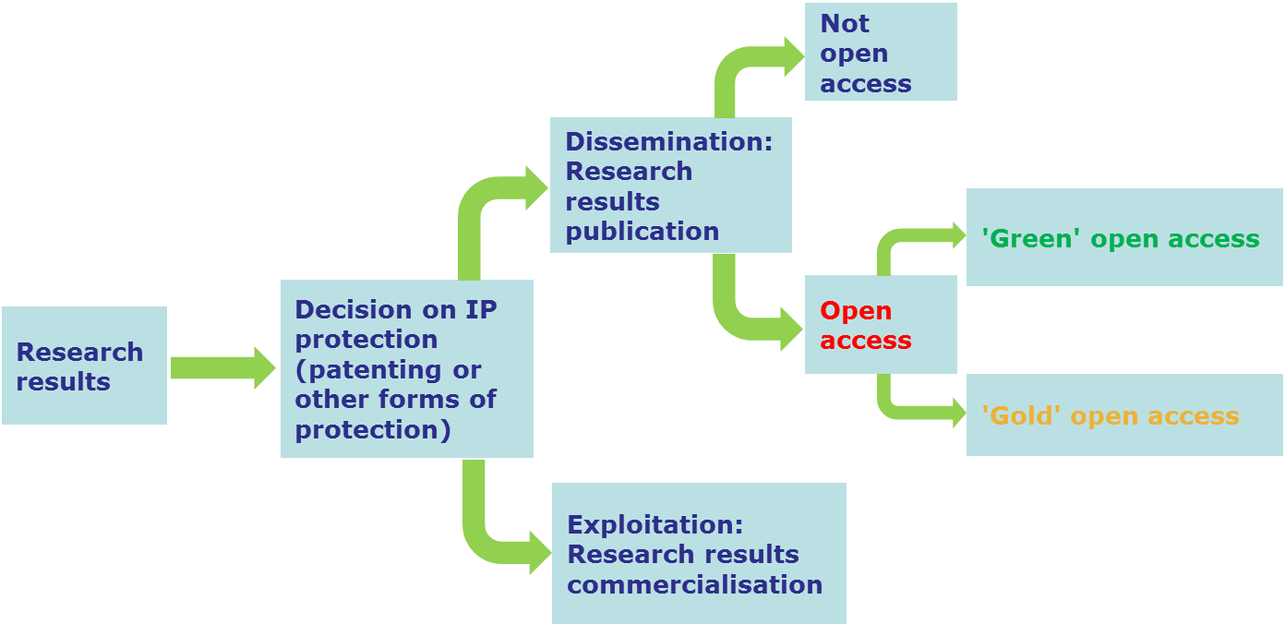
  What OA is NOT
  Not an obligation to publish
  Not at odds with patenting (see graph)
  OA publications go the same peer review process

Slide 5

The European Commission is a...
Policy maker
  It proposes EU legislation & legislates with other EU institutions
  It invites Member States to act
Funding agency
  It sets its own access and dissemination rules for EC-funded research
Capacity builder
  It funds projects that support EC/EU policy

Slide 6
The Commission objective
optimise the impact of publicly-funded scientific research
  At European level (FP7 & Horizon 2020)
  At Member State level
One way to get there: open access
Expected benefits:
  Better and more efficient science → Science 2.0
  Economic growth ➔ Innovation Union
  Broader, faster, more transparent and equal access for the benefit of researchers, industry and citizens ➔ Responsible Research and Innovation
  … in the European Research Area and beyond

Slide 7
Three key documents (16.07.2012)
Communication 'A reinforced European Research Area partnership for excellence and growth'
Communication 'Towards better access to scientific information: boosting the benefits of public investments in research'
Recommendation on access to and preservation of scientific information

Slide 8
Communication 'ERA'
MS are invited to coordinate their policies on access to and preservation of scientific information
→ Recommendation on access to and preservation of scientific information (C(2012)4890).
SHO are invited to adopt and implement open access measures for publications and data resulting from publicly funded research
→ Signed Memorandum of Understanding with LERU, EARTO, EUA, NORDFORSK and Unilateral Statement by Science Europe
The Commission "will adopt establish open access to scientific publications as a general principle for all EU funded research projects in Horizon 2020. For research data the EC will develop a flexible approach that takes into account different scientific areas and business related interests". "The Commission will continue to fund projects related to open access."
→ Communication 'Towards better access to scientific information', COM(2012)401

Slide 9
Open access in the ERA (2014)
Member States (MS)
  ERA Progress Report (2013): progress among MS "gradual yet visible" (legal and administrative) but efforts need to continue.
  For interaction with the EC and among each other MS have nominated a national Point of Reference (NPR)
    First meeting of NPRs held in 2013, second in September 2014
  Commissioner Geoghegan-Quinn participated in a Competitiveness Council debate on open access
  Interest from ERAC – taskforce on "open access and innovation"
Stakeholder Organisations (SHO)
  Significant interest in the subject, have organised a variety of events, many of them with Commission
  Open access also a point for discussion in the ERA High Level Stakeholder Platform and the associated doers network.
  ERA Progress Report (2013): Significant number of Research Funders and Research Performing Organisations support OA on the national level

Slide 10
From FP7 to H2020: OA to publications from pilot to underlying principle
FP7
  Green open access pilot in 7 areas of FP7 with 'best effort' stipulation
  Allowed embargoes: 6/12 months
  Gold open access costs eligible for reimbursement as part of the project budget while the project runs
Horizon 2020
  Obligation to provide OA, either through the Green or Gold way in all areas
  Allowed embargoes: 6/12 months
  Gold open access costs eligible for reimbursement as part of the project budget while the project runs & post-grant support being piloted
  Authors encouraged to retain copyright and grant licences instead

Slide 11
OA to publications mandate in H2020
Each beneficiary must ensure OA to all peer-reviewed scientific publications relating to its results:
  Deposit a machine-readable copy of the published version or final peer-reviewed manuscript accepted for publication in a repository of the researchers choice (possibly OpenAIRE compliant)
  Ensure OA on publication or at the latest within 6/12 months
  Ensure OA to the bibliographic metadata that identify the deposited publication, via the repository
  Aim to deposit at the same time the research data needed to validate the results ("underlying data")

Slide 12
Pilot on Open Research Data in H2020
Three key questions:
Which thematic areas should be covered?
What kind of data should be covered?
What about data management?

Slide 13
Pilot on Open Research Data in H2020
Areas of the 2014-2015 Work Programme participating in the Open Research Data Pilot are:
  Future and Emerging Technologies
  Research infrastructures – part e-Infrastructures
  Leadership in enabling and industrial technologies – Information and Communication Technologies
  Societal Challenge: Secure, Clean and Efficient Energy – part Smart cities and communities
  Societal Challenge: Climate Action, Environment, Resource Efficiency and Raw materials – except raw materials
  Societal Challenge: Europe in a changing world – inclusive, innovative and reflective Societies
  Science with and for Society
  Projects in other areas can participate on a voluntary basis.

Slide 14
Pilot on Open Research Data in H2020
Projects may opt out of the Pilot on Open Research Data in Horizon 2020 in a series of cases:
  If the project will not generate / collect any data
  Conflict with obligation to protect results
  Conflict with confidentiality obligations
  Conflict with security obligations
  Conflict with rules on protection of personal data
  If the achievement of the action’s main objective would be jeopardised by making specific parts of the research data openly accessible (to be explained in data management plan)

Slide 15
Pilot on Open Research Data in H2020
  Types of data concerned:
  Data needed to validate the results presented in scientific publications ("underlying data")
  Other data as specified in data management plan (=up to projects)
Beneficiaries participating in the Pilot will:
  Deposit this data in a research data repository of their choice
  Take measures to make it possible to access, mine, exploit, reproduce and disseminate free of charge
  Provide information about tools and instruments at the disposal of the beneficiaries and necessary for validating the results (where possible, provide the tools and instruments themselves)
  EC: Support & monitoring (Annotated MGA, Specific guidance etc…)

Slide 16
Data management in Horizon 2020
  Data Management Plans (DMPs) mandatory for all projects participating in the Pilot, optional for others
    DMPs are NOT part of the proposal evaluation, they need to be generated within the first six months of the project and updated as needed
  DMP questions:
    What data will be collected / generated?
    What standards will be used / how will metadata be generated?
    What data will be exploited? What data will be shared / made open?
    How will data be curated and preserved?

Slide 17
ORD Pilot: a chance to co-shape policy
  Opening up research data: the new frontier
  Ambitious, yet pragmatic design of the pilot: broad scope, opt-out, voluntary participation possible
  Pilot is flexible; numerous safegards in place
  Aim: kick-starting a virtous circle
  Uptake of and experiences with the Pilot need to be monitored during the complete life cycle of a project: from application, to grant preperation, execution and final reporting
  Participating in the Pilot means co-shaping European policy on opening up research data
Notes:
The main objective is to optimise the impact of publicly-funded scientific research, both on the specific research issues and on the development of research methodologies and disciplines themselves

Slide 18
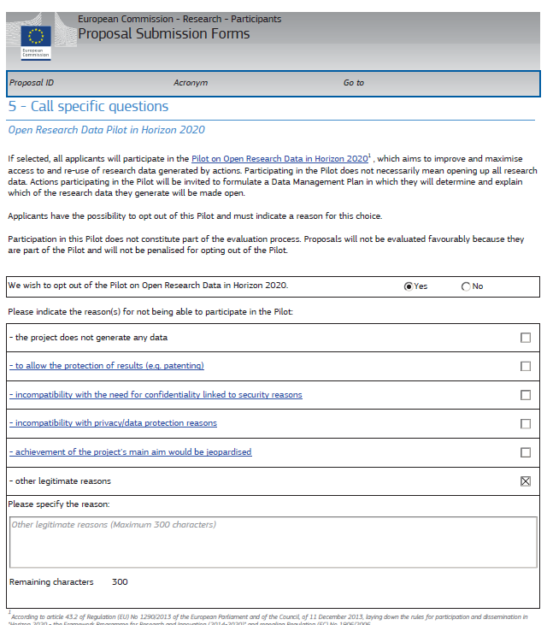
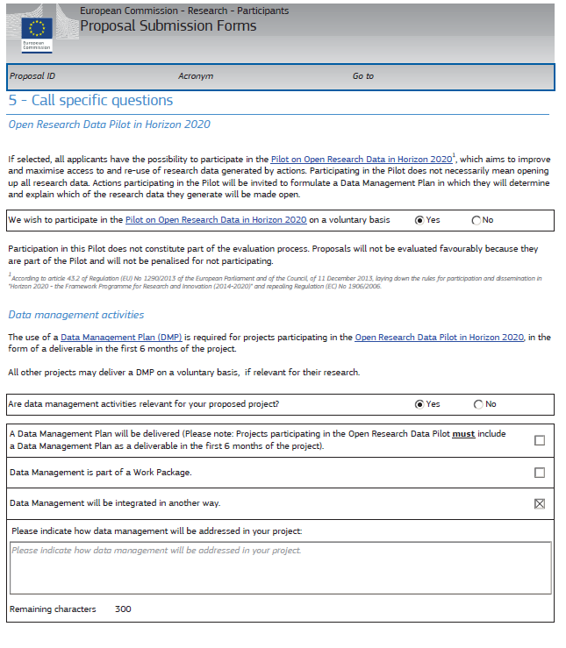
Forms on the participant portal

Slide 19
ORD Pilot: initial take-up in first calls of H2020
  Preliminary!
  Basis: 3054 Horizon 2020 proposals
    Calls in core-areas: opt out 24.2% (442 of 1824 proposals) – range from 9,1-29,1%
    Other areas: voluntary opt in 27.2% (334 of 1230 proposals) – range from 9 to 50%
  Conclusion: 'early days' for the open access to research data pilot, but initial data on uptake in the proposals for the first calls of Horizon 2020 are encouraging. Initial areas well chosen (drop outs below 30%, similar range), comprehensive follow up needed
Notes:
See table with more detailed info

Slide 20
ORD Pilot: initial take-up in first calls of H2020 (II)
'early days' for the open access to research data pilot, but initial data on uptake in the proposals for the first calls of Horizon 2020 are encouraging.
The initial number of areas for the pilot seems well chosen, since opt-out rates tend to below 30% and are in many cases quite similar in percentage range.
Follow up need in the full life cycle of EU funded projects (ex-ante, during and ex-post)

Slide 21
Ongoing coordination and support actions (FP7 funded)
  PASTEUR4OA (Open Access Policy Alignment Strategies for European Union Research) Started 2014
  FOSTER (Foster Open Science Training for European Research) Started 2014
RECODE - (Policy Recommendations for Open Access to Research Data in Europe) – 2013, finishing
OpenAIRE/OpenAIRE+: supporting the implementation of Open Access in Europe (publications and data)
Infrastructure projects(with OA components), e.g. GEO/GEOSS, ELIXIR…

Slide 22
The international landscape (1)
Study to measure the growth of OA
  Wide sample of 1 million records for in-depth study of between 2008 and 2013
  Focus on ERA, Brazil, Canada, Japan and USA
  Global proportion higher than previously assumed:
    55% of those published in 2012 are now free (adjusted for precision and recall)
    Quantity of Gold OA papers increasing by 18% per year
    Quantity of Green OA papers increasing by 8.8% per year
    Quantity of Other OA papers increasing by 8.8% per year
  OA papers were between 26% and 64% more cited on average
  Backfilling of papers is really important: about 700,000 papers from 1996-2011 became freely available between April 2013 and April 2014, the same quantity as those published 2013

Slide 23
The international landscape (2)
Study to measure the growth of OA
  OA availability varies among disciplines: 'tipping point' passed in Biology, Biomedical Research, Mathematics & Statistics and in General Science & Technology. Least open access in SSH, applied sciences, engineering and technology
  The majority of 48 major science funders considers both Gold and Green OA acceptable. More than 75% accepted embargo periods of 6-12 months
  Policies for OA to data not as well developed but increasing
  Working with international organisations (OECD, RDA, 'Berlin conferences and others)

Slide 24
New developments
Open access in the context of a systemic change in the modus operandi of science and research ("Science 2.0/Open Science")
Affecting the whole research cycle and its stakeholders
  Data intensive science
  Alternative metrics – researcher career evaluation
  Citizen science – new actors
  Publishing activities: new comers, new business models, new peer review models, new services...

Slide 25
Data-intensive
Citizens science
Open code
Open workflows
Pre-print
Analysis
Publication
Review
Conceptualisation
Data gathering
Open data
Open access
Open annotation
Alternative Reputation systems
Scientific blogs
Collaborative bibliographies

Slide 26
In summary…
  Open access as part of a changing scientific system (Science 2.0/Open Science)
  Open access as a means to improve knowledge circulation and provide value for the taxpayers' money
  Horizon 2020 ambitious yet pragmatic on aspects of open access
    Open access to publications mandatory (green or gold)
    Limited pilot for open access to research data (opt-in/opt out principle)
  Support from/for H2020: work programmes e-Infrastructure & Science with and for Society
  Open access must be effective, affordable, competitive and sustainable for researchers and innovative businesses

Slide 27

We welcome your input
Contacts DG RTD
Functional mailbox:
RTD-OPEN-ACCESS@ec.europa.eu
Daniel SPICHTINGER (Unit A6, DG RTD)
daniel.spichtinger@ec.europa.eu
Monica TARAZONA RUA(Unit A6, DG RTD)
maria-monica.tarazona-rua@ec.europa.eu
  Links
  EC OA website
  http://ec.europa.eu/research/science-society/open_access
  Open Access Resources: Links (Netvibes – EC Central Library)
  http://www.netvibes.com/open-access
  Study to measure growth of OA
  http://europa.eu/rapid/press-release_IP-13-786_en.htm
  H2020 guidance
  http://ec.europa.eu/research/participants/data/ref/h2020/grants_manual/hi/oa_pilot/h2020-hi-oa-pilot-guide_en.pdf
  http://ec.europa.eu/research/participants/data/ref/h2020/grants_manual/hi/oa_pilot/h2020-hi-oa-data-mgt_en.pdf
Twitter:
@OpenAccessEC

