Slide 1
Universities as Innovators: Learning Experiences from Heidelberg University
Dr. Max Jungmann
Managing Director of the Heidelberg University Center for the Environment

Slide 2
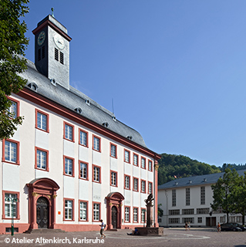
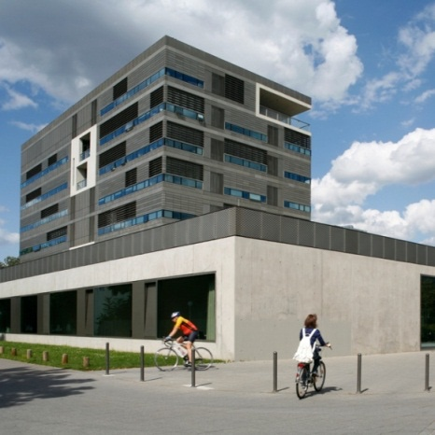
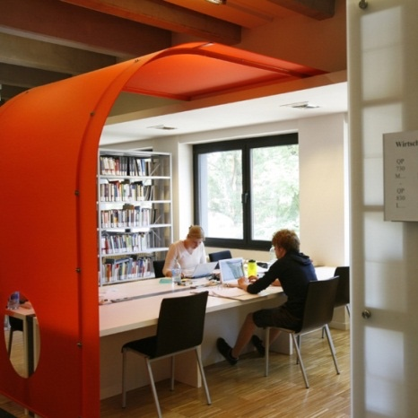
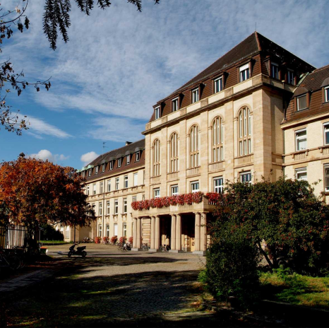
HOW THE PUBLIC SEES US
Campus Altstadt
Campus
Neuenheimer Feld
Campus Bergheim
Campus Mannheim
Academic Ranking of World Universities (Shanghai Ranking 2024)
Rank 3 in Germany
Rank 14 in Europe
Rank 50 worldwide
QS World University Ranking (2024/2025)
Rank 3 in Germany
Rank 28 in Europe
Rank 84 worldwide
Times Higher Education Ranking (2024/2025)
Rank 3 in Germany
Rank 13 in Europe
Rank 47 worldwide

Slide 3
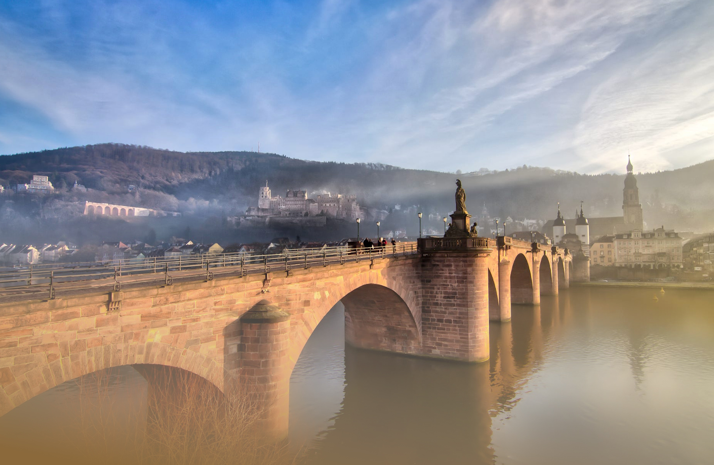
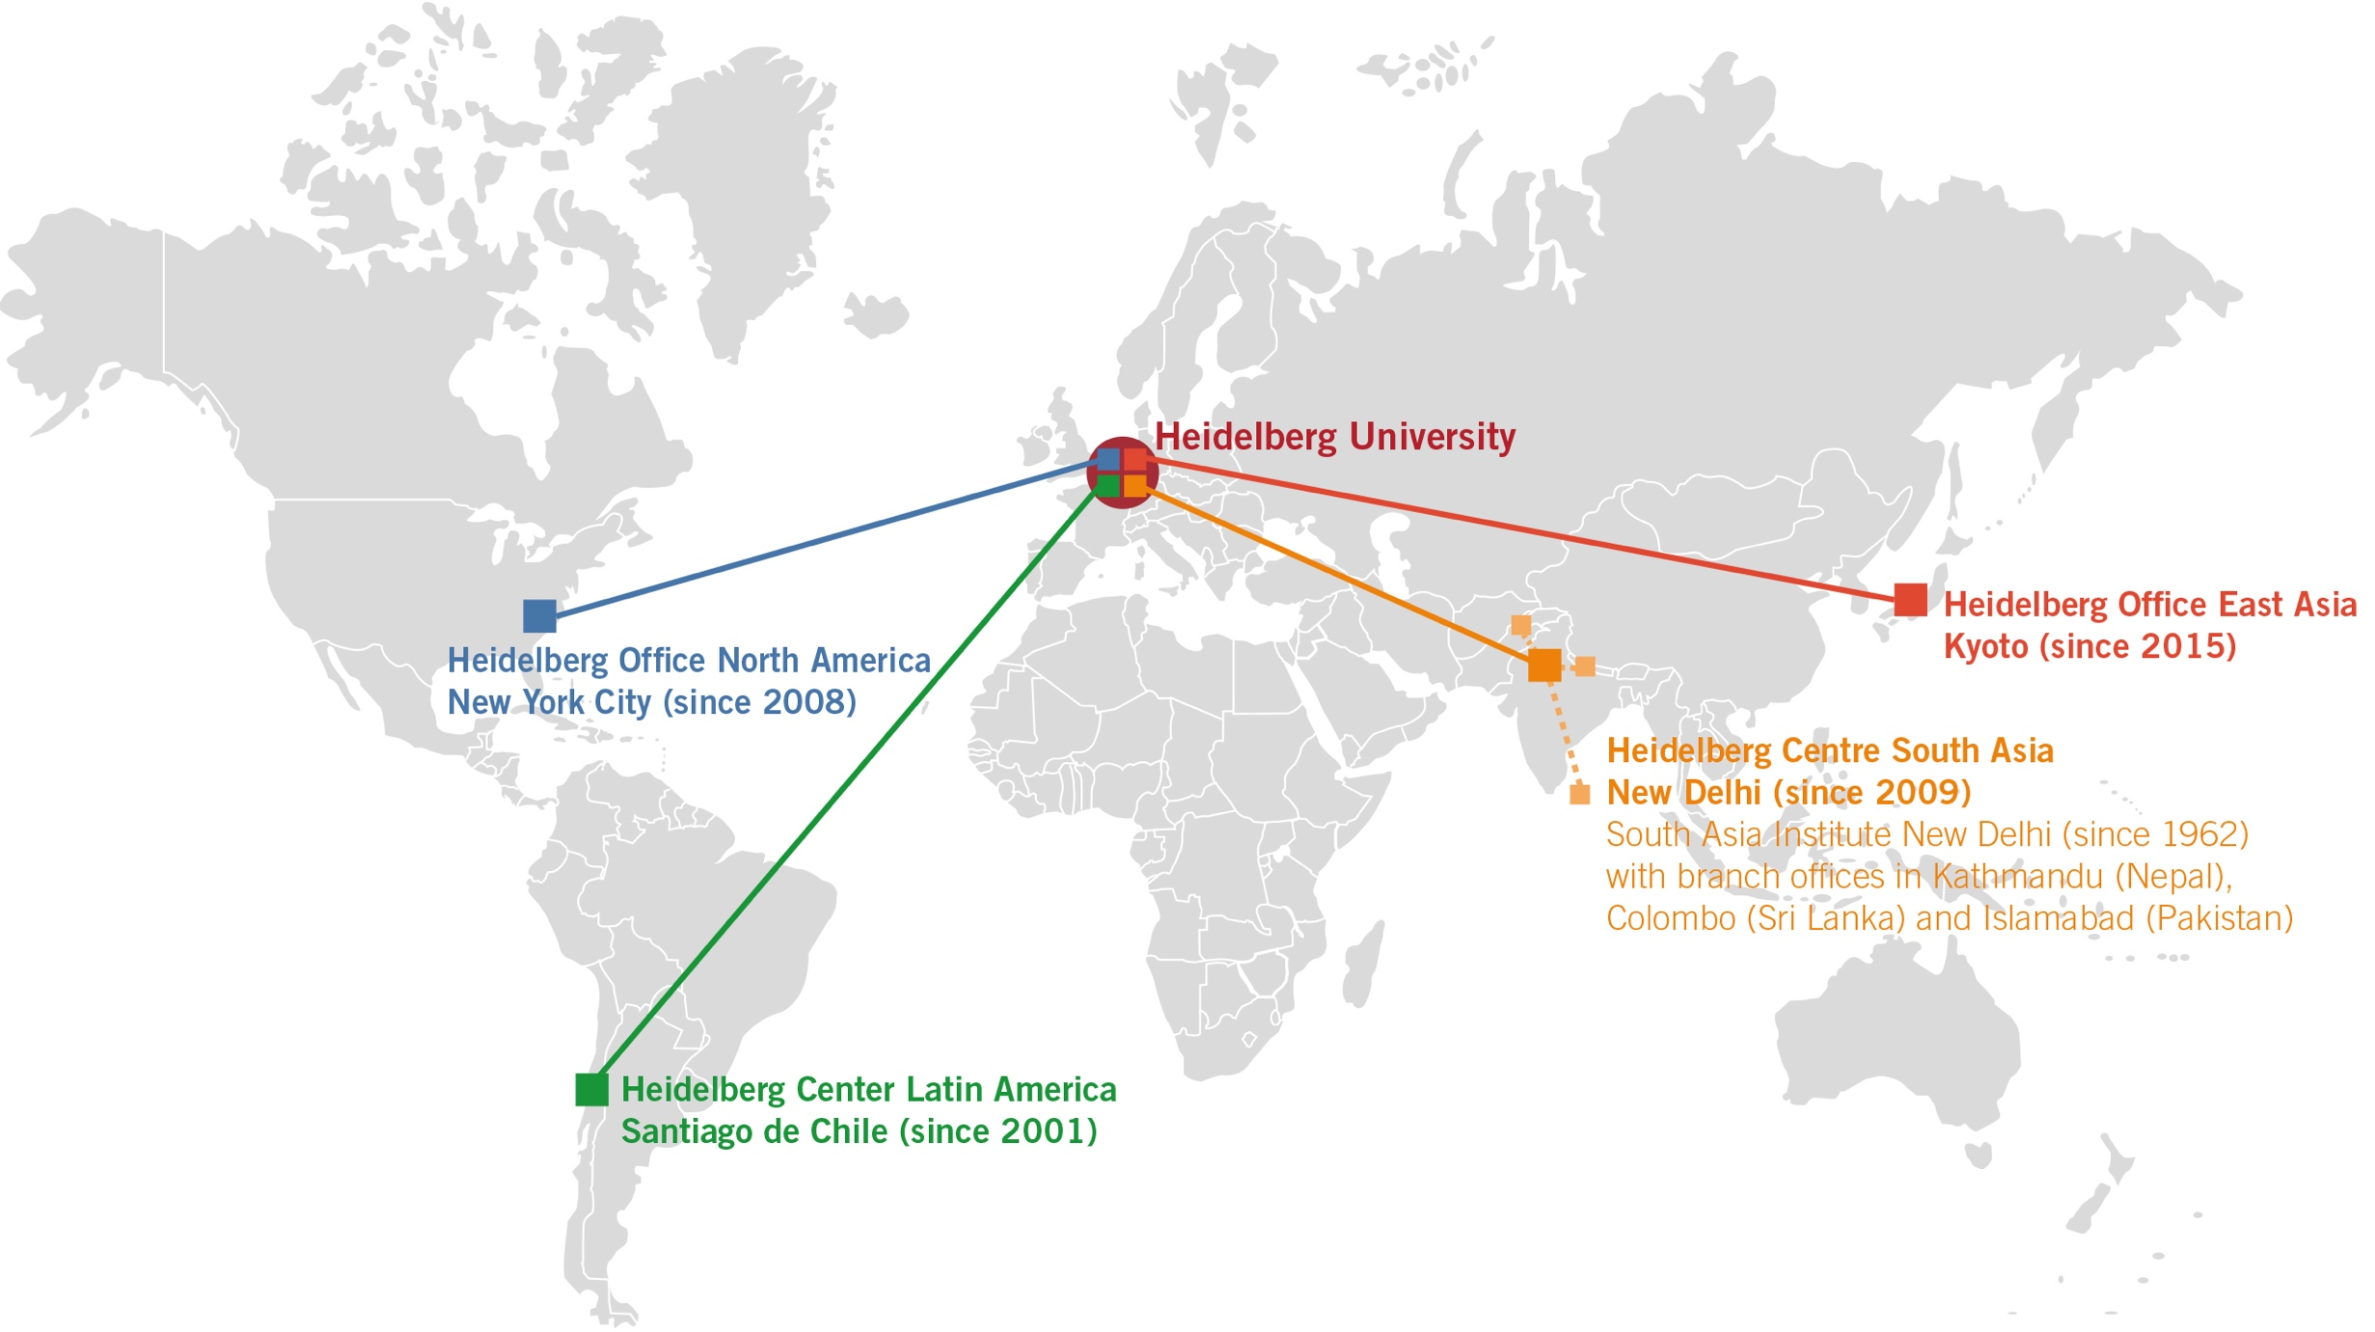
BUILDING BRIDGES
Faculty of Theology
Faculty of Law
Medical Faculty Heidelberg
Medical Faculty Mannheim
Faculty of Philosophy
Faculty of Modern Languages
Faculty of Economics and Social Sciences
Faculty of Behavioral and Empirical Cultural Sciences
Faculty of Mathematics and Computer Science
Faculty of Chemistry and Earth Sciences
Faculty of Physics and Astronomy
Faculty of Biosciences
Faculty of Engineering Sciences

Slide 4
WHY DO WE FOSTER INNOVATION
FOR CLIMATE ACTION?
Notes:
In his famous book, the Black Swan, Nassim Nicholas Taleb states: understanding how to act under conditions of incomplete information is the highest and most urgent human pursuit.
Ask yourselves, what did you do exactly one year ago? I checked my calendar and I couldn’t believe that I was actually in my final preparations for a business trip to Japan where I would give keynote speeches on energy transition two days later. Looking back at February 2020, I must admit that even then, I did not fully understand the scale and intensity of the virus that would dominate the world only a few weeks later. And neither did any of my colleagues there.
As such, COVID-19 constitutes what Taleb describes as a black swan event. An event that is highly unlikely, but when it happens, it changes the entire world and impacts every single part of our lives.

Slide 5
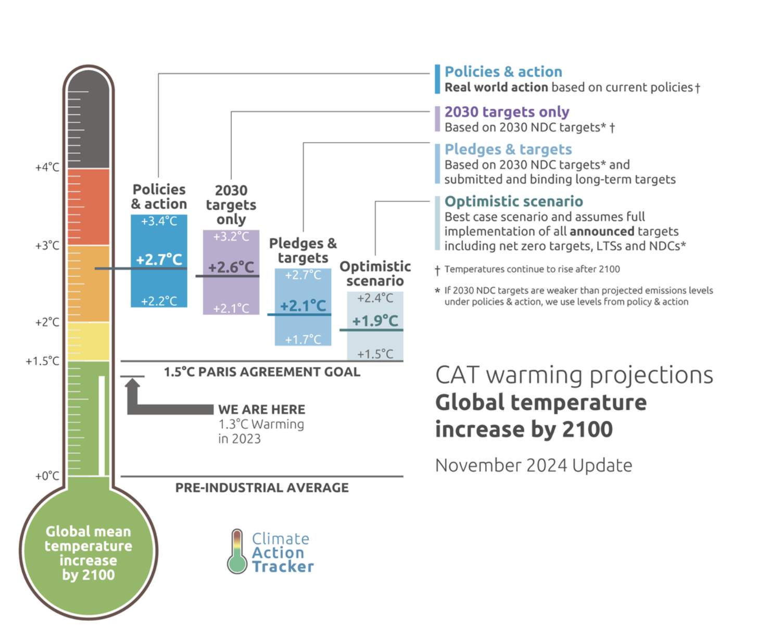
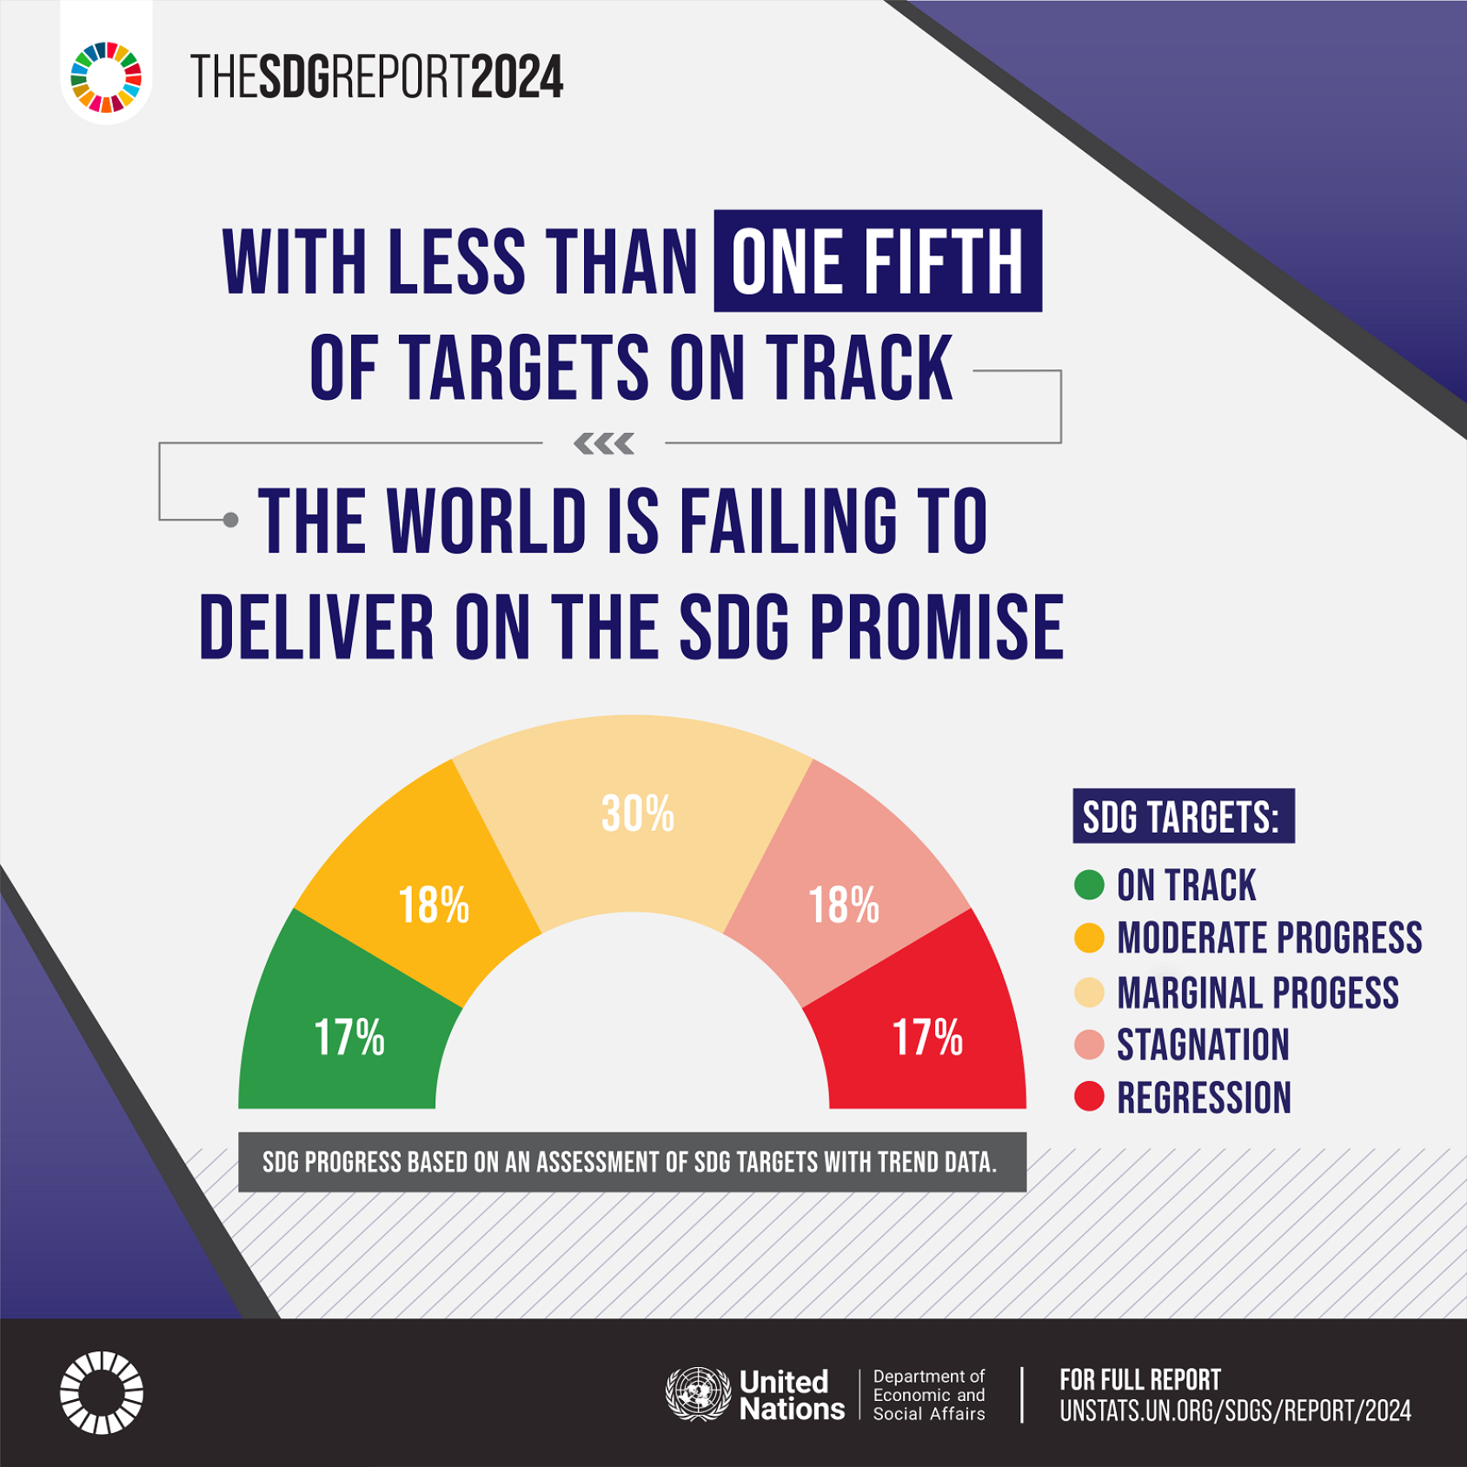
WHY WE TAKE ACTION

Slide 6
FROM RESPONSIBILITY TO IMPACT
Prof. Dr. Karin Schumacher
Vice-Rector for Quality Development and Sustainability
SUSTAINABILITY THINK TANK

Slide 7
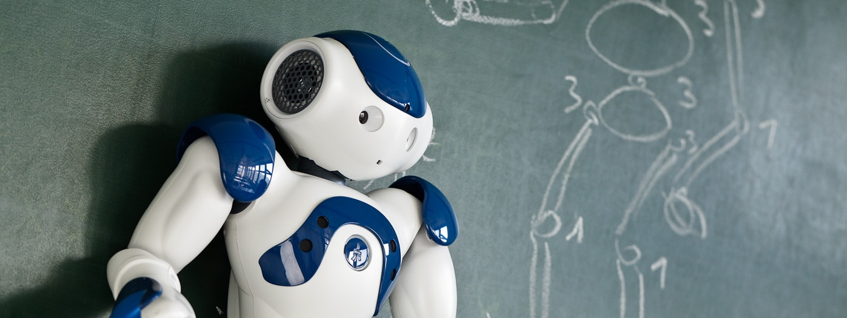
HOW DO WE INNOVATE FOR CLIMATE ACTION?
Notes:
In his famous book, the Black Swan, Nassim Nicholas Taleb states: understanding how to act under conditions of incomplete information is the highest and most urgent human pursuit.
Ask yourselves, what did you do exactly one year ago? I checked my calendar and I couldn’t believe that I was actually in my final preparations for a business trip to Japan where I would give keynote speeches on energy transition two days later. Looking back at February 2020, I must admit that even then, I did not fully understand the scale and intensity of the virus that would dominate the world only a few weeks later. And neither did any of my colleagues there.
As such, COVID-19 constitutes what Taleb describes as a black swan event. An event that is highly unlikely, but when it happens, it changes the entire world and impacts every single part of our lives.

Slide 8
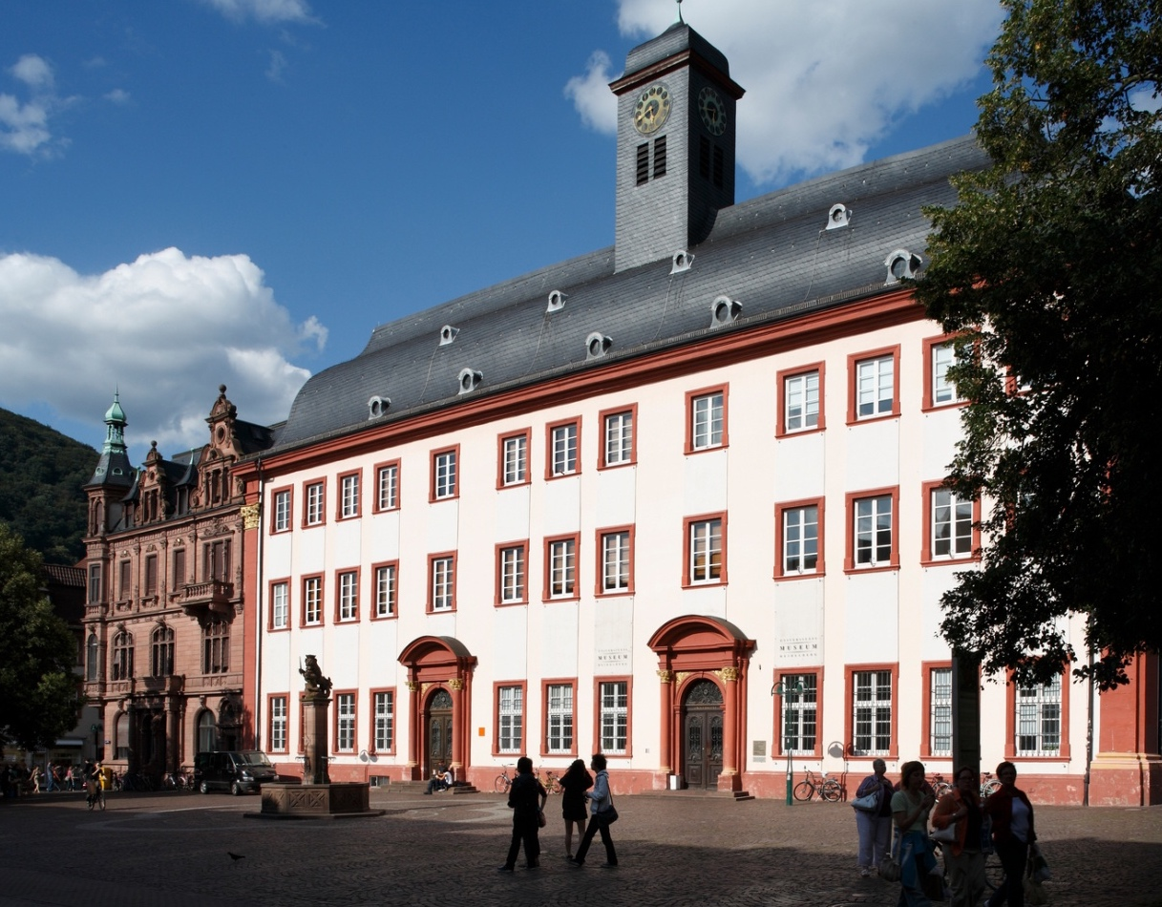
Comprehensive Research University
Oldest university in present-day Germany (founded in 1386)
Research university of international standing
Successful in all funding lines of the Excellence Initiative and Excellence Strategy
Comprehensive university with a broad range of disciplines
Focus on research-based teaching and structured doctoral training

Slide 9
GOVERNANCE
RESEARCH
TEACHING
OPERATIONS
TRANSFER
SUSTAINABILITY THINK TANK

Slide 10
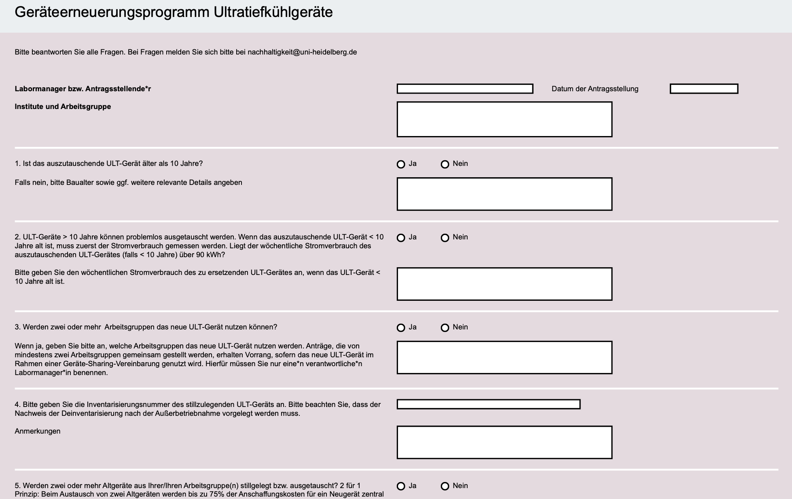
HIGHLIGHTS

Slide 11
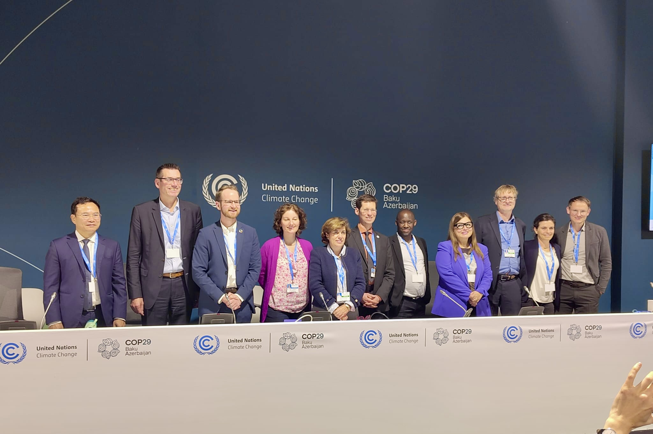
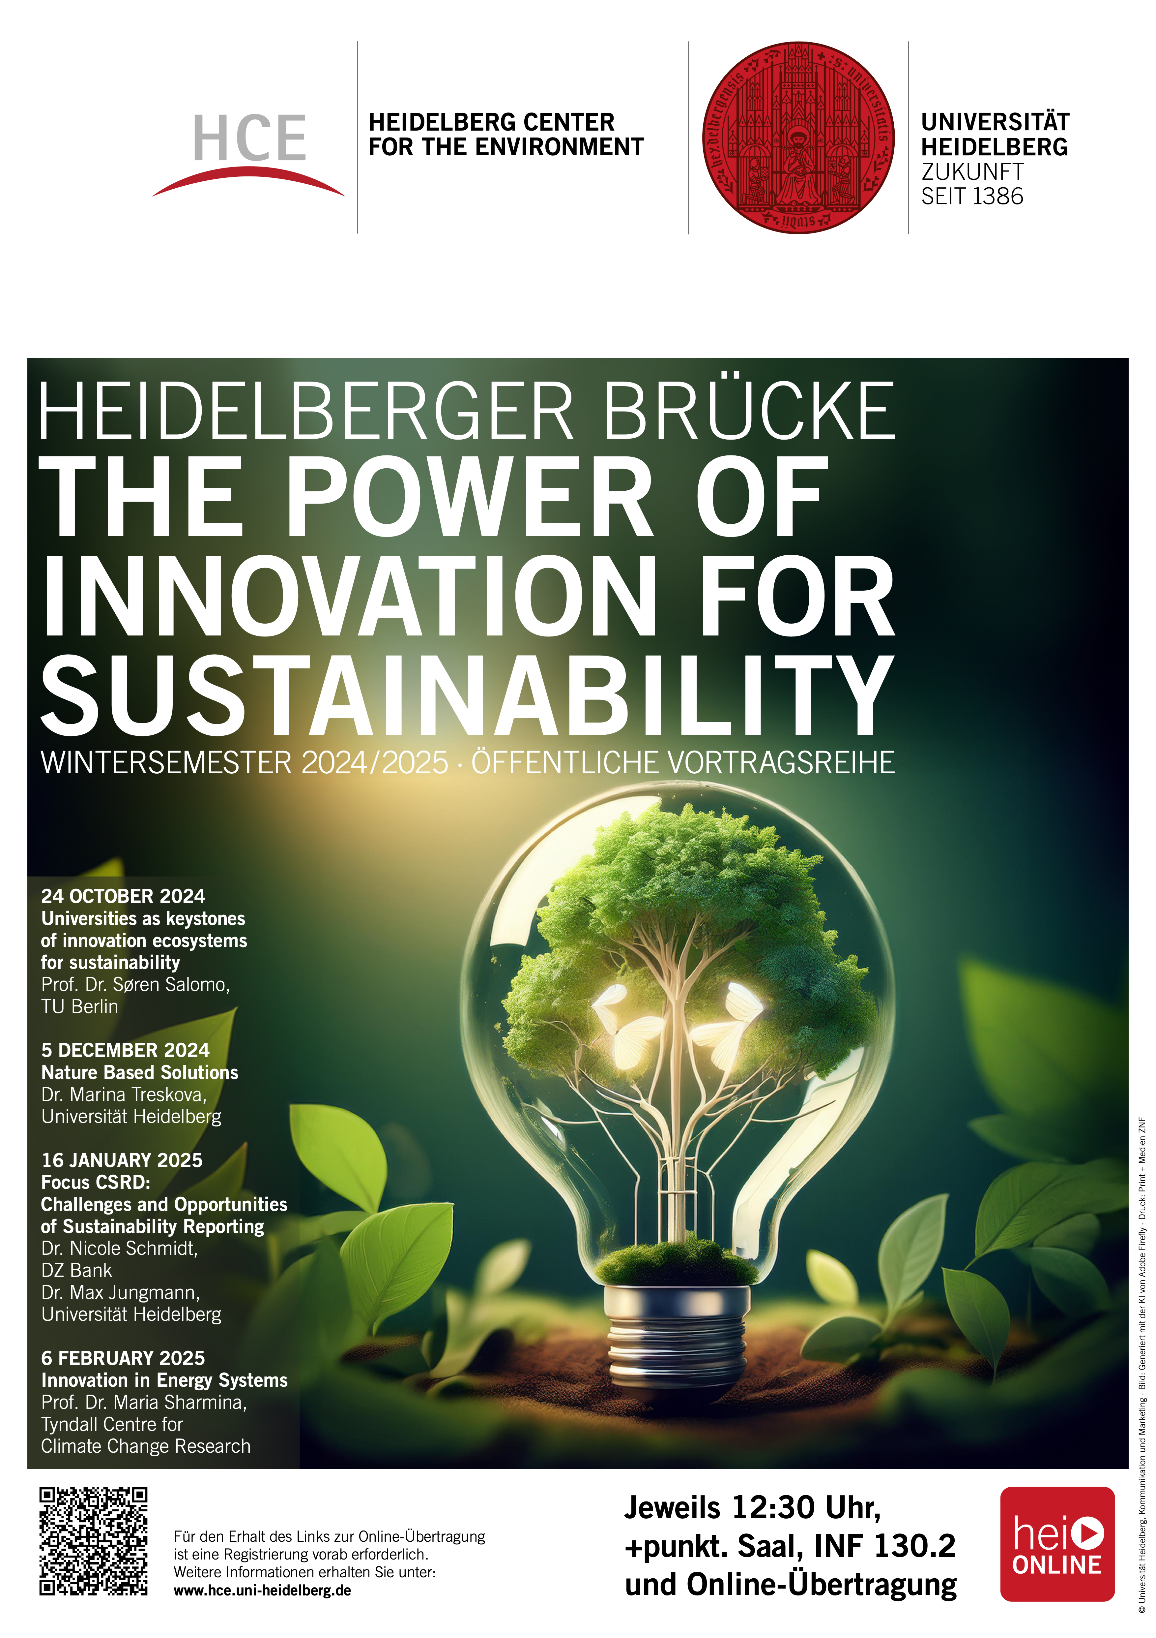
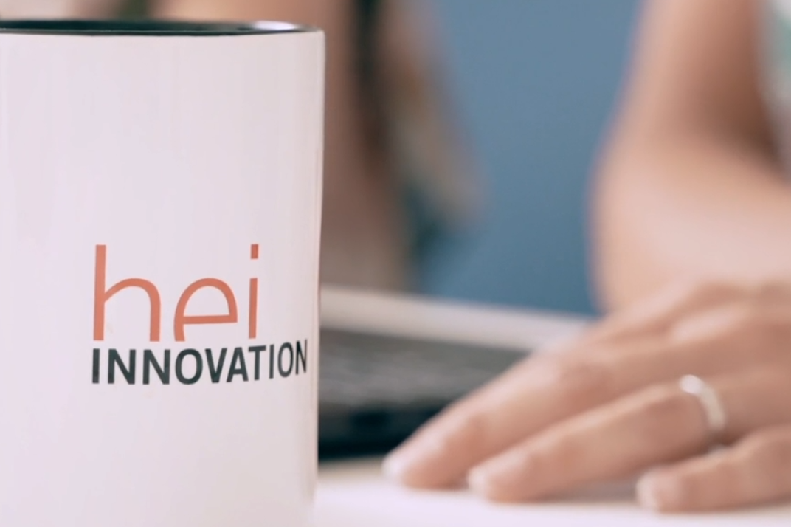
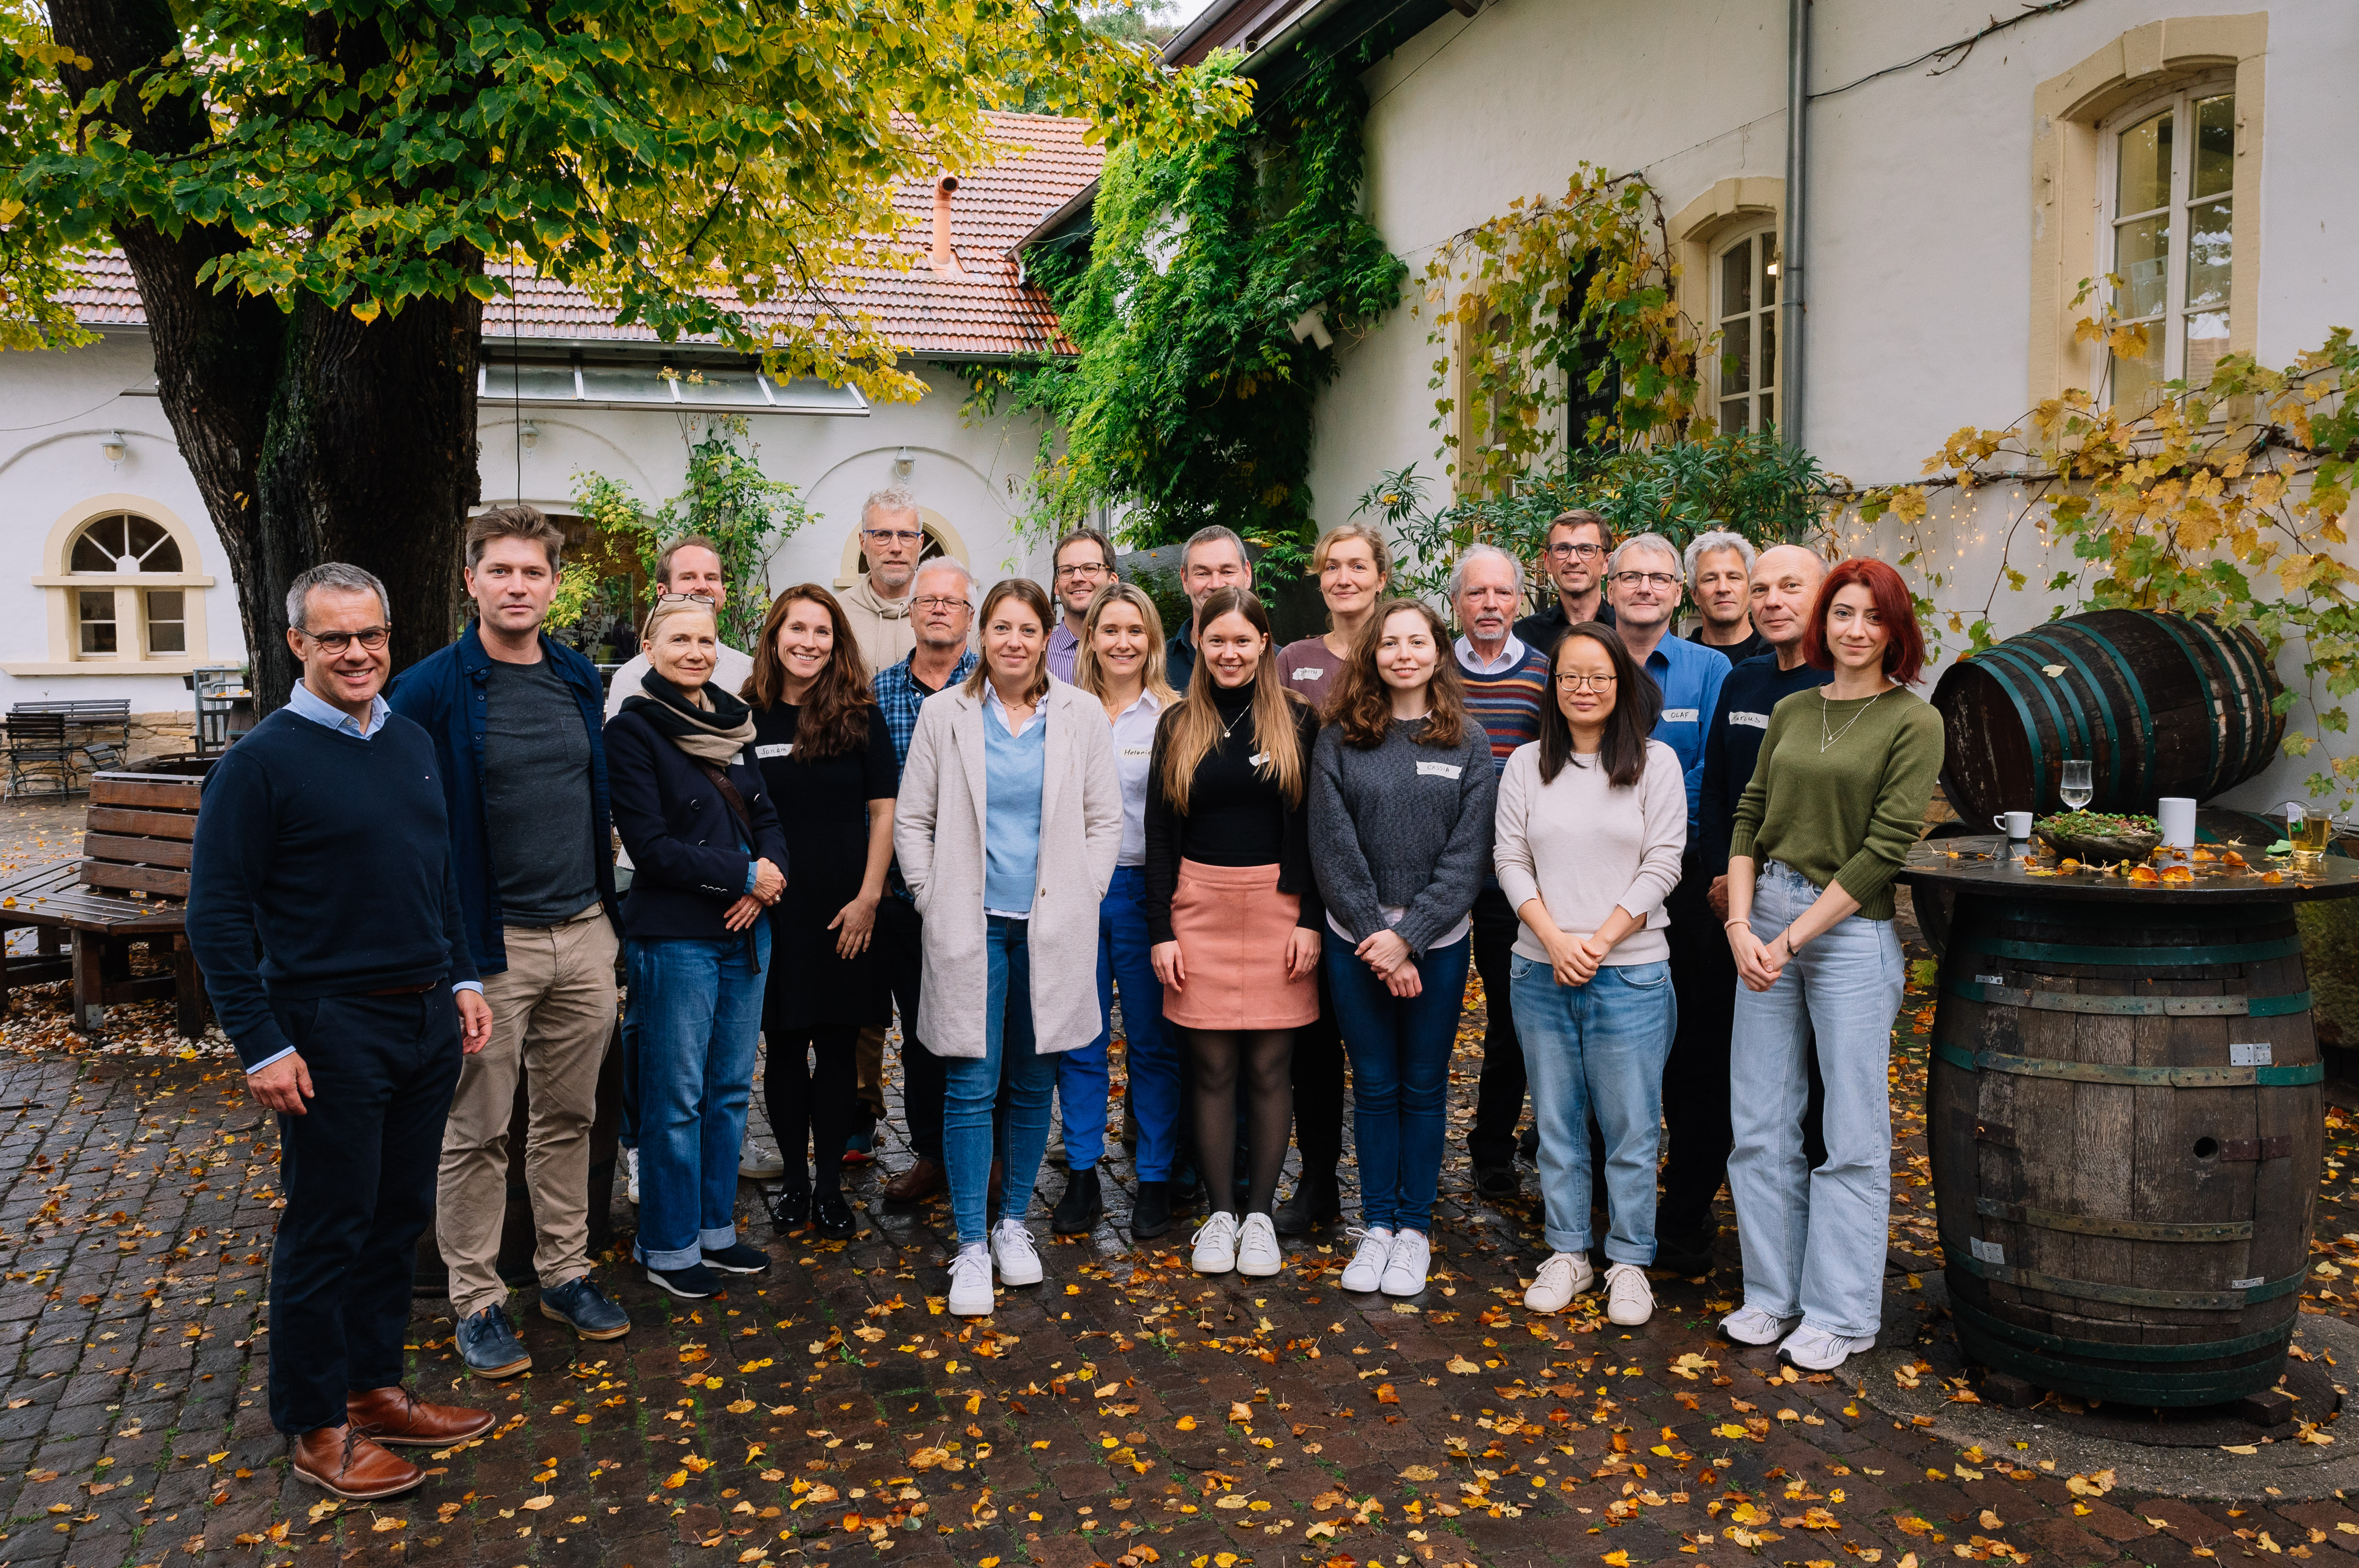
HIGHLIGHTS

