Slide 1
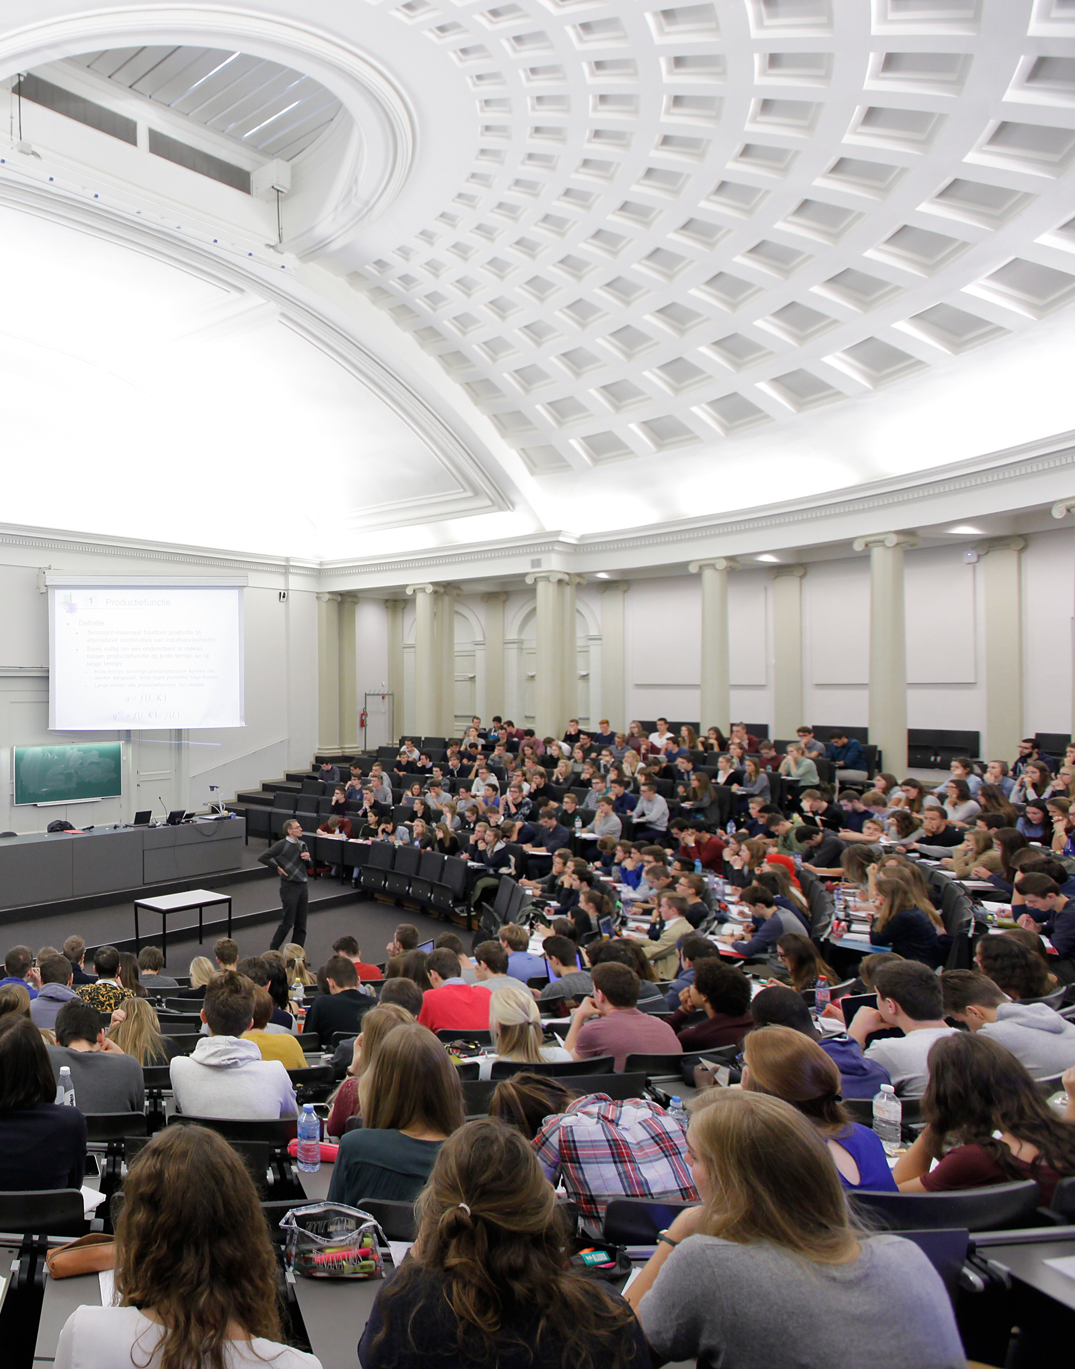
Coimbra Group 40th Anniversary Climate Symposium
24th-26th March 2025, Durham University

Slide 2
Universities as Partners
Professor Marjo Kaartinen
Coimbra Group Honorary President and Rector of the University of Turku

Slide 3
Strategic Partnership with the City of Turku
Multidisciplinary co-operation in research and education
Aims to increase
the intellectual capital and competitiveness of both parties as well as the region.
discussions between the University and the city leadership on the future of the organisations and the region.
Special emphasis on increasing co-operation supporting green transition and sustainable development.
Photo: Heikki Räisänen / City of Turku

Slide 4
Turku Urban Research Programme
A joint research programme of the City of Turku, University of Turku and Åbo Akademi University
Established 2010; an institutionalised form of co-operation aiming to
promote knowledge-based development of the vitality of Turku and the increased well-being of local people;
support knowledge-based, strategic decision-making of the city;
and increase the impact of academic urban research.
Four two-year research projects with high academic autonomy, funded each year; in addition, smaller projects tailored to cater the immediate needs of the city

Slide 5
Climate commitment with the City of Turku
The City of Turku is one of the EU Mission “100 Climate-Neutral and Smart Cities”
The University of Turku signed a climate commitment with the city committing to:
contribute to realising the Carbon Neutral Turku 2029 goal
reduce emissions
make the University’s climate work visible

Slide 6
Turku Urban Climate Research Group
Weather observations have been systematically collected since 2001 by the urban climate research group in the Turku region.
The observation network is unique worldwide in its regional coverage.
The general objective is to contribute to our understanding of climatological variations in and around the city of Turku.
Weather observations since 2001
83
temperature & relative humidity loggers
3
weather stations

Slide 7
Climate Nudge
A multi-year research project funded by the Strategic Research Council of Finland and led by the University of Turku.
The project creates, develops and tests nudges to create solutions for climate change mitigation, reduce greenhouse gas emissions in traffic and optimise carbon storage in land use.

Slide 8
Climate Nudge
The City of Turku is a partner in planning and implementing nudges that that promote walking and cycling.
The co-operation also creates an important channel for feedback.
How to reduce the use of private cars in commuting
How to promote children’s cycling in winter

Slide 9
Urban Biodiversity Parks
The Urban Biodiversity Parks project funded by the European Urban Initiative – Innovative Actions will create Europe's first biodiversity park in Turku.
The park will serve as both a recreational space and an educational hub to raise awareness about biodiversity. Residents, associations, students, and the private sector will collaborate in its design and implementation to integrate biodiversity into urban planning and daily life.

Slide 10
Urban Biodiversity Parks
University of Turku researchers organised two biological surveys, BioBlitzes, at the biodiversity park area.
These citizen science events welcomed everyone, regardless of their level of knowledge or skills, to map the different species in the park area and learn about biodiversity together with University experts.

