Slide 1
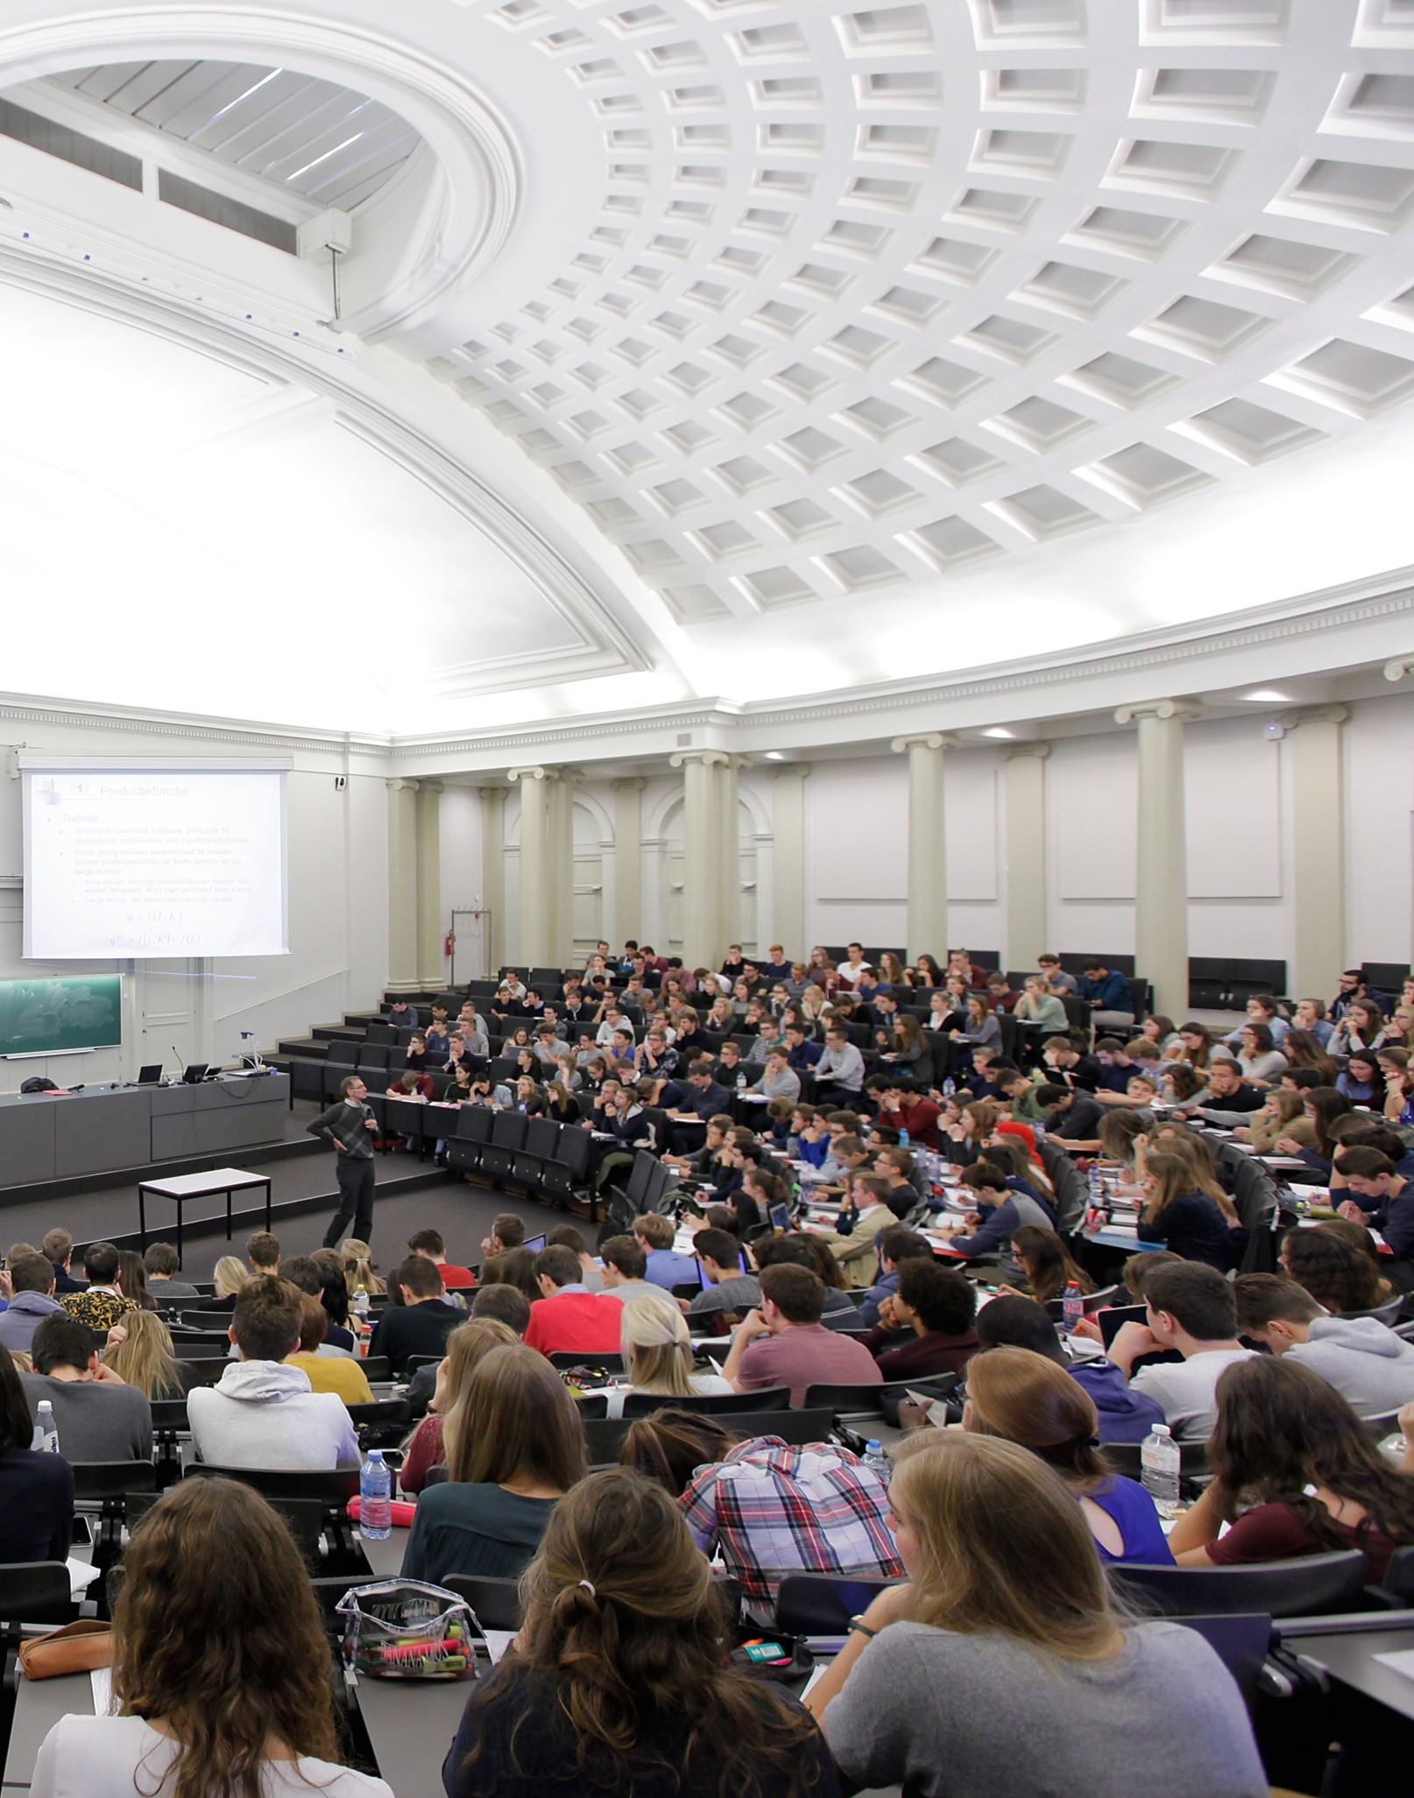


Coimbra Group 40th Anniversary Climate Symposium
24th-26th March 2025, Durham University

Slide 2
Universities as Partners
Professor Ludovic Thilly
Vice-Rector for a European University, Poitiers University

Slide 3

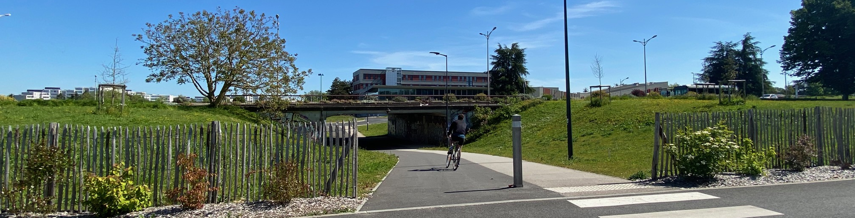

- University of Poitiers -
2025-2030 Strategic Plan for Sustainable Development
& Social and Environmental Responsibility (DD&RSE)

Slide 4
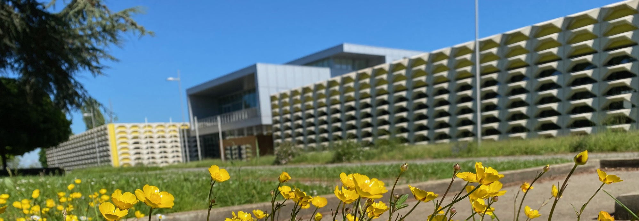


Context of the UP Strategic Plan
  Regulatory framework
  Institutional strategy
  Priority UN SDGs
  DD&RSE Strategic Plan & Label
  EC2U Alliance of European Universities

Slide 5



Regulatory framework
The University of Poitiers is a pioneer in the field of Sustainable Development & Social and Environmental Responsibility:
2010: first DD&RSE roadmap
2016: first French University with DD&RSE label
Recent evolution of French Higher Education regulations
DD&RSE strategic plan is mandatory since 2024
Student education to ecological transition and sustainable development is mandatory since 2025
Decree on the reduction of energy consumption

Slide 6
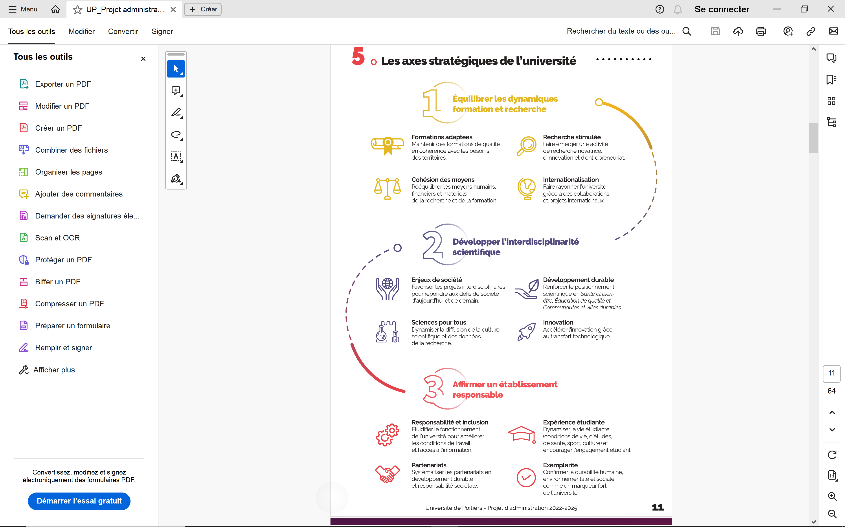



Institutional strategy
Strategic Missions
Transformative programmes
Continual improvement
Partnerships

Slide 7


















Priority & contributive UN SDGs
Priority SDGs
Contributive SDGs

Slide 8
DD&RSE Strategic Plan & Label: six priority axes
Axis 1 : Governance
Promote the leading role of the university in sustainable development and social responsibility at all territorial levels
Axis 2 : Education
Integrate the ecological transition for sustainable development into the training of students and staff
Axis 3 : Research
Support the ecological transition for sustainable development via research and innovation
Axe 4 : Decarbonization
Axe 5 : Environment
Axe 6 : Social policies
Continue the decarbonization of university activities
Control and reduce the university's environmental footprint by taking into account the impacts on health
Strengthen the visibility of social policies and actions for quality of life at work
Notes:
Lionel et Aurélien

Slide 9
Axe 1: Governance
Promote the leading role of the university in DD&RSE at all territorial levels
3 objectives
9 priorities
28 actions
Manage and evaluate the sustainable development and social responsibility approach by involving stakeholders
Raise awareness and train all the members of governing bodies and elected officials
Evaluate the DD&RSE strategy by setting up a participatory assembly including staff and students
Involve partners from different territorial levels
2025
2026
2027
Notes:
Noelle

Slide 10
Axe 2: Education
Integrate the ecological transition for sustainable development into student and staff training
4 objectives
13 priorities
34 actions
Design and implement a 30-hour module on ecological transition common to all curricula (B-M-D)
Identify and design content by setting up working groups
Implement the training module
Assess students through quizzes on sustainable solutions and validate competences
2025
2025
2026
Notes:
Noelle

Slide 11
Axe 3: Research
Support the ecological transition for sustainable development via research and innovation
3 objectives
8 priorities
24 actions
Strengthening DD&RSE in the operational management of R&I activities
Consolidate the integration of DD&RSE principles within the management of research institutes
Train R&I support staff to DD&RSE and its integration in projects
Raising awareness among research teams and doctoral students to sustainable development issues and priority SDGs
Insert a DD&RSE criterion into the internal funding calls
2025
2026
2026
2027
Notes:
Noelle
Ou Aurélien

Slide 12
Axe 4: Decarbonization
Continue the decarbonization of university activities
4 objectives
17 priorities
43 actions
Promoting carpooling with local partners
Organize events to promote carpooling
Create dedicated spaces on campus for carpooling parking lots
Promote territorial carpooling mobile apps on all campus sites
2025
2026
2027
Notes:
Lionel ou Aurélien

Slide 13
Axe 5: Environment
Control and reduce the university's environmental footprint by taking into account the impacts on health
4 objectives
14 priorities
32 actions
Create a recycling centre and support projects promoting recycling and reuse
Organize awareness and repair workshops open to staff and students
Set up a recycling centre on the Poitiers campus with student associations
Establish and promote the recycling report at the university level
2027
2028
2029
Notes:
Lionel ou Aurélien

Slide 14
Axe 6: Social policies
Strengthen the visibility of social policies and actions for quality of life at work
4 objectives
9 priorities
25 actions
Ensure the implementation of the campus life master plan in coherence with territorial partners
Ensure the monitoring of the different categories of students (incl. from other local higher education institutions)
Open the health and prevention service to all local higher education institutions
Guarantee an effective and suitable student life offer (community life, culture and sport) on all campuses
Notes:
Aurélien

Slide 15
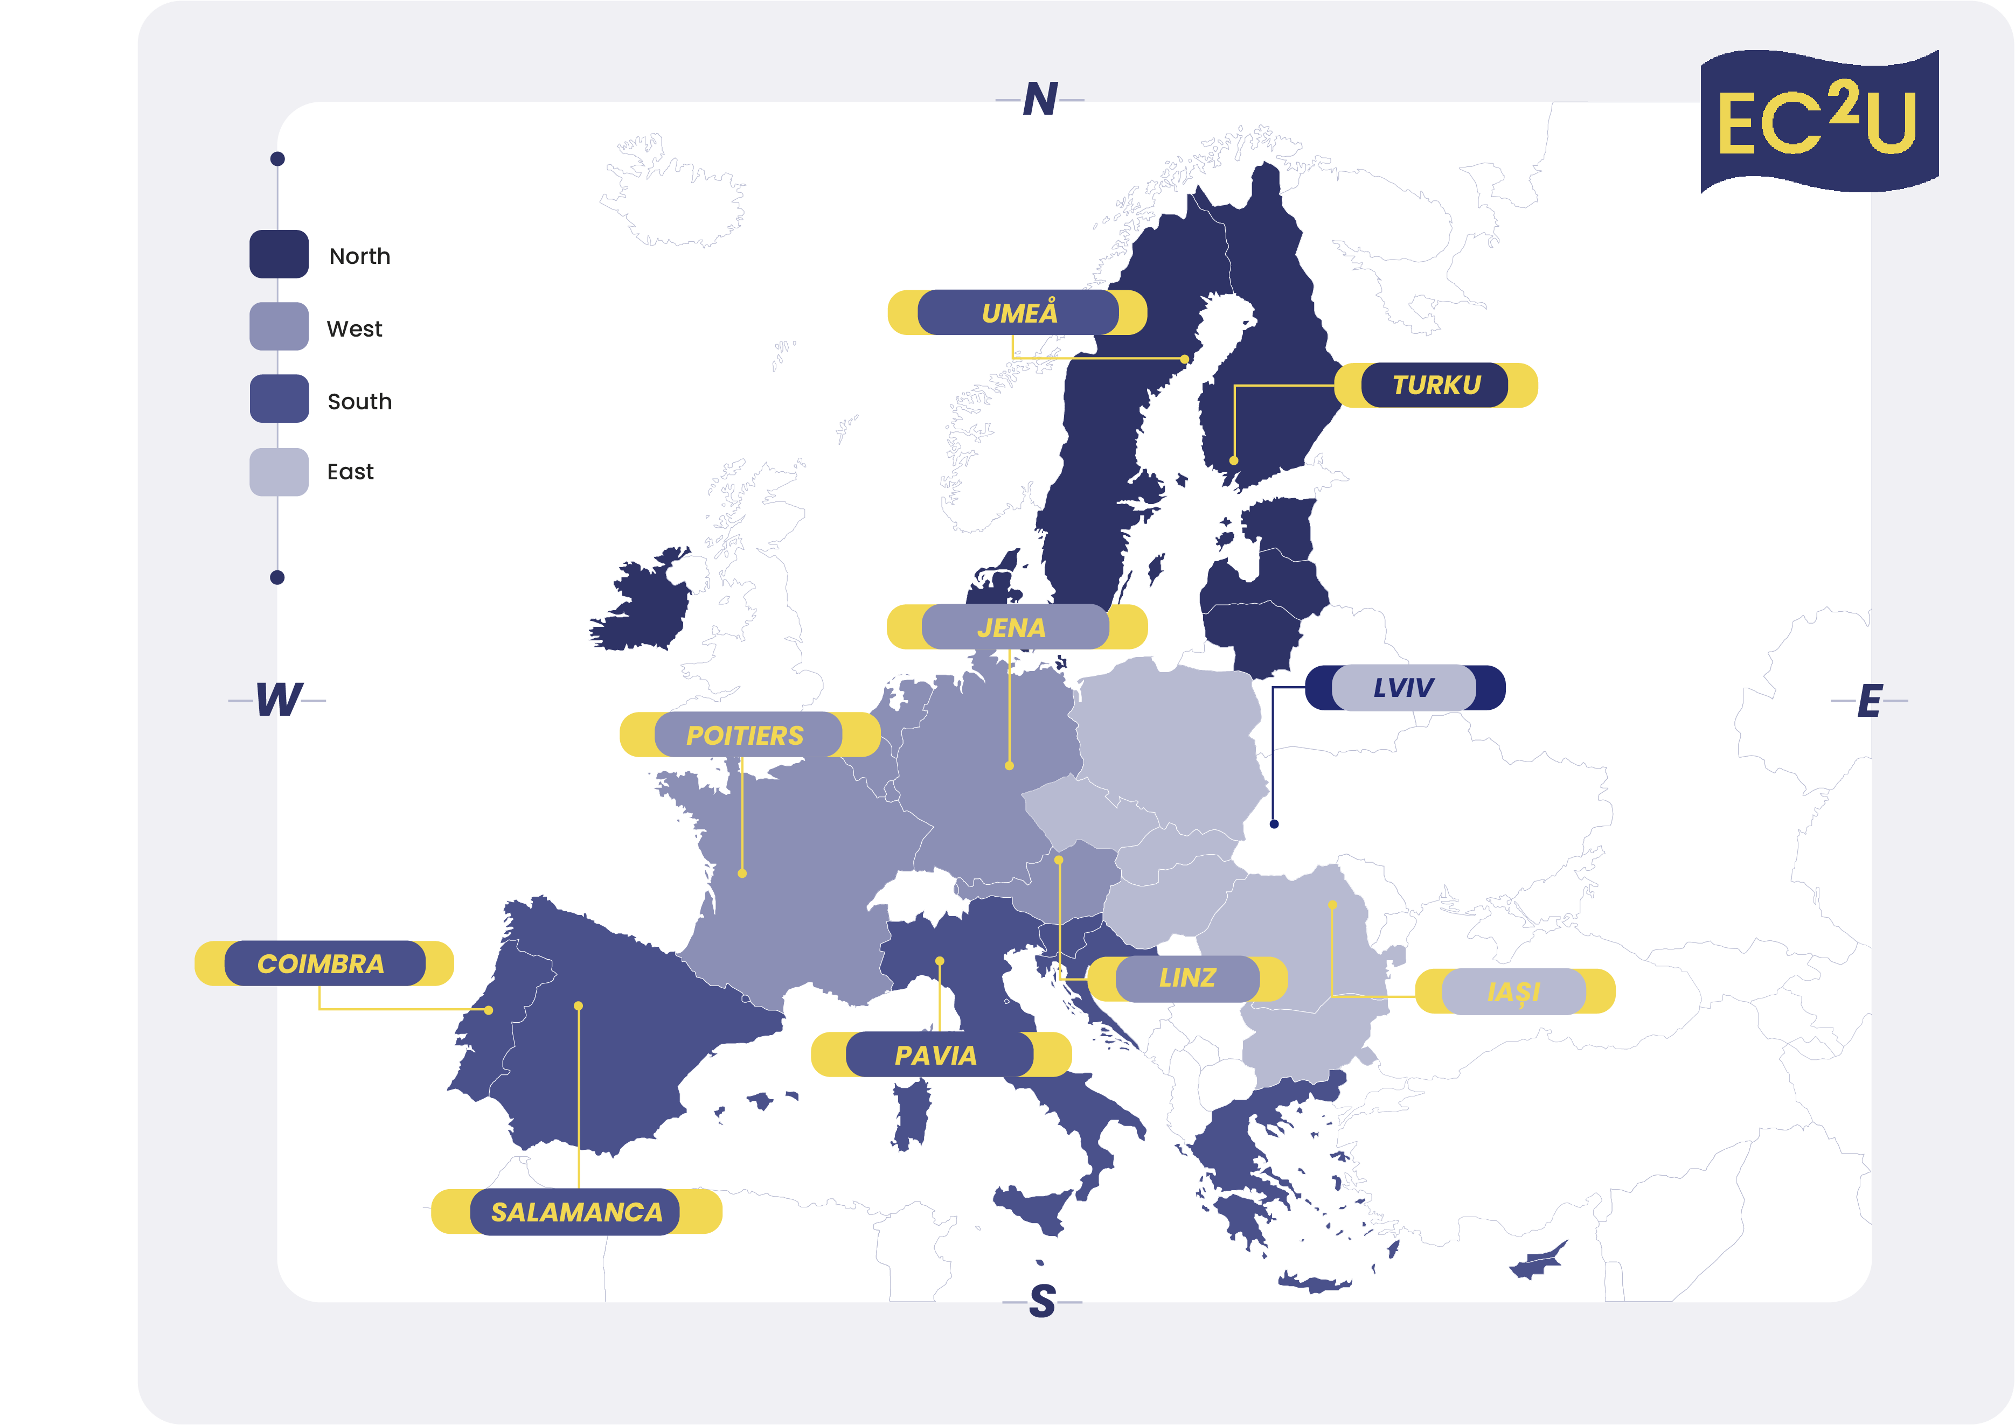
9+1 universities
⭢ Coimbra (PT)
⭢ Alexandru Ioan Cuza, Iasi (RO)
⭢ Friedrich Schiller, Jena (GE)
⭢ Pavia (IT)
⭢ Poitiers (FR, Coordinator)
⭢ Salamanca (SP)
⭢ Turku (FI)
⭢ Linz (AT)
⭢ Umeå (SE)
+ Lviv (UA) - Associated
65 Associated Partners
⭢ Cities & Regional Govs & Agencies
⭢ Students Associations
⭢ Science parks & SMEs & Industry
⭢ University Hospitals & SMEs & Industry

Slide 16
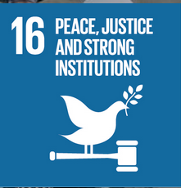
EC2U Virtual Institutes
Sustainable Cities and Communities
Good Health and Well-Being
Peace, Justice and Strong Institutions
Quality Education – Modern Languages
Life on Land
Quality Education – Education Sciences
Materials and Methods for a Sustainable Future

Slide 17
Universities as Partners
Léonore Moncond’huy
Mayor of Poitiers

