Slide 1
Universities as Innovators
Professor Jane Stout
Vice President for Biodiversity and Climate Action, Trinity College Dublin

Slide 2

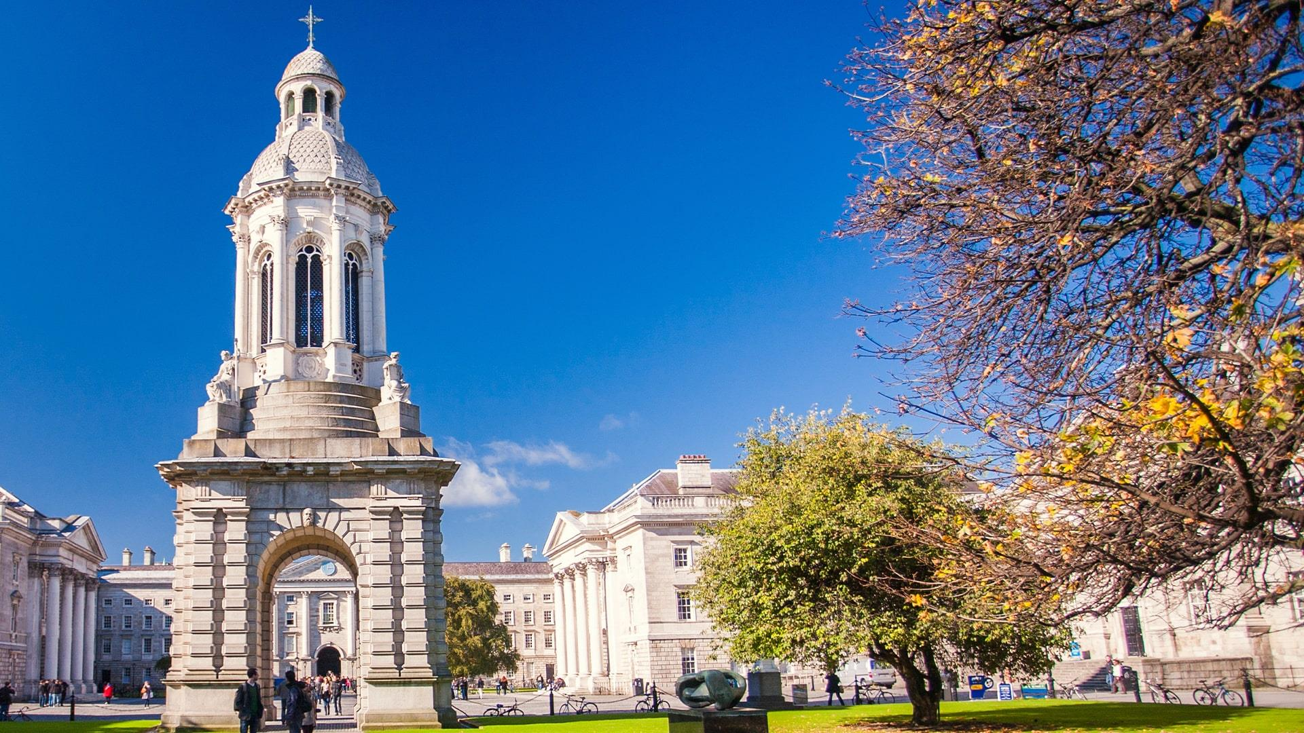



Individually
Collectively
Systematically

Slide 3
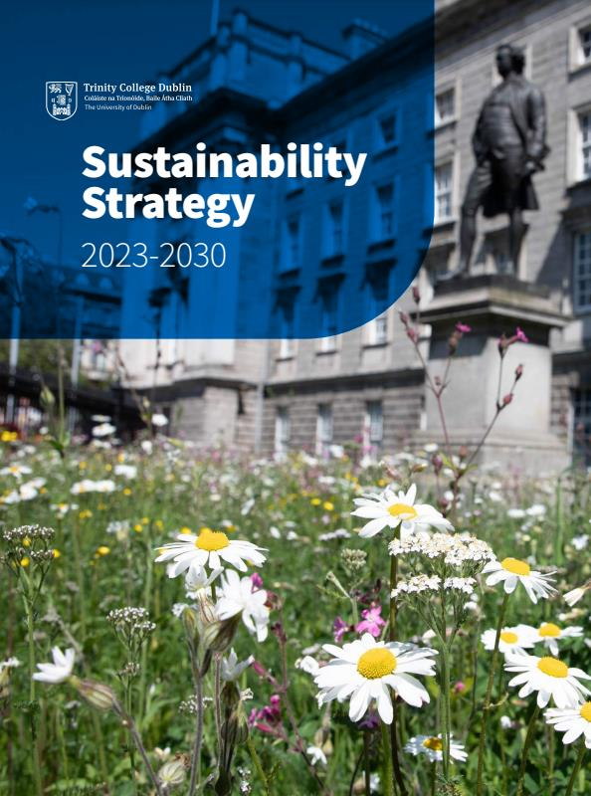
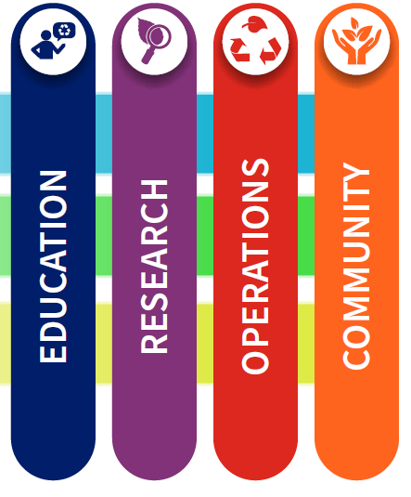

Overall Systematic Approach: Climate-Nature-Health
Targets
Net zero
Nature positive
Improve health
www.tcd.ie/sustainability

Slide 4
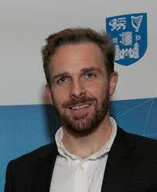
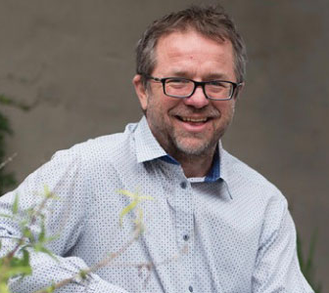
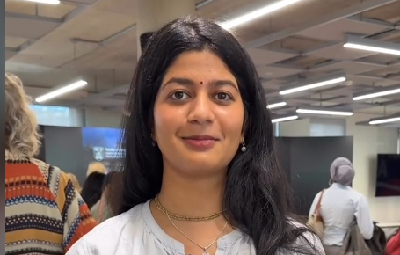
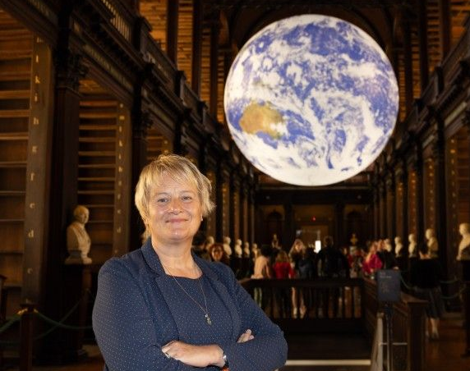
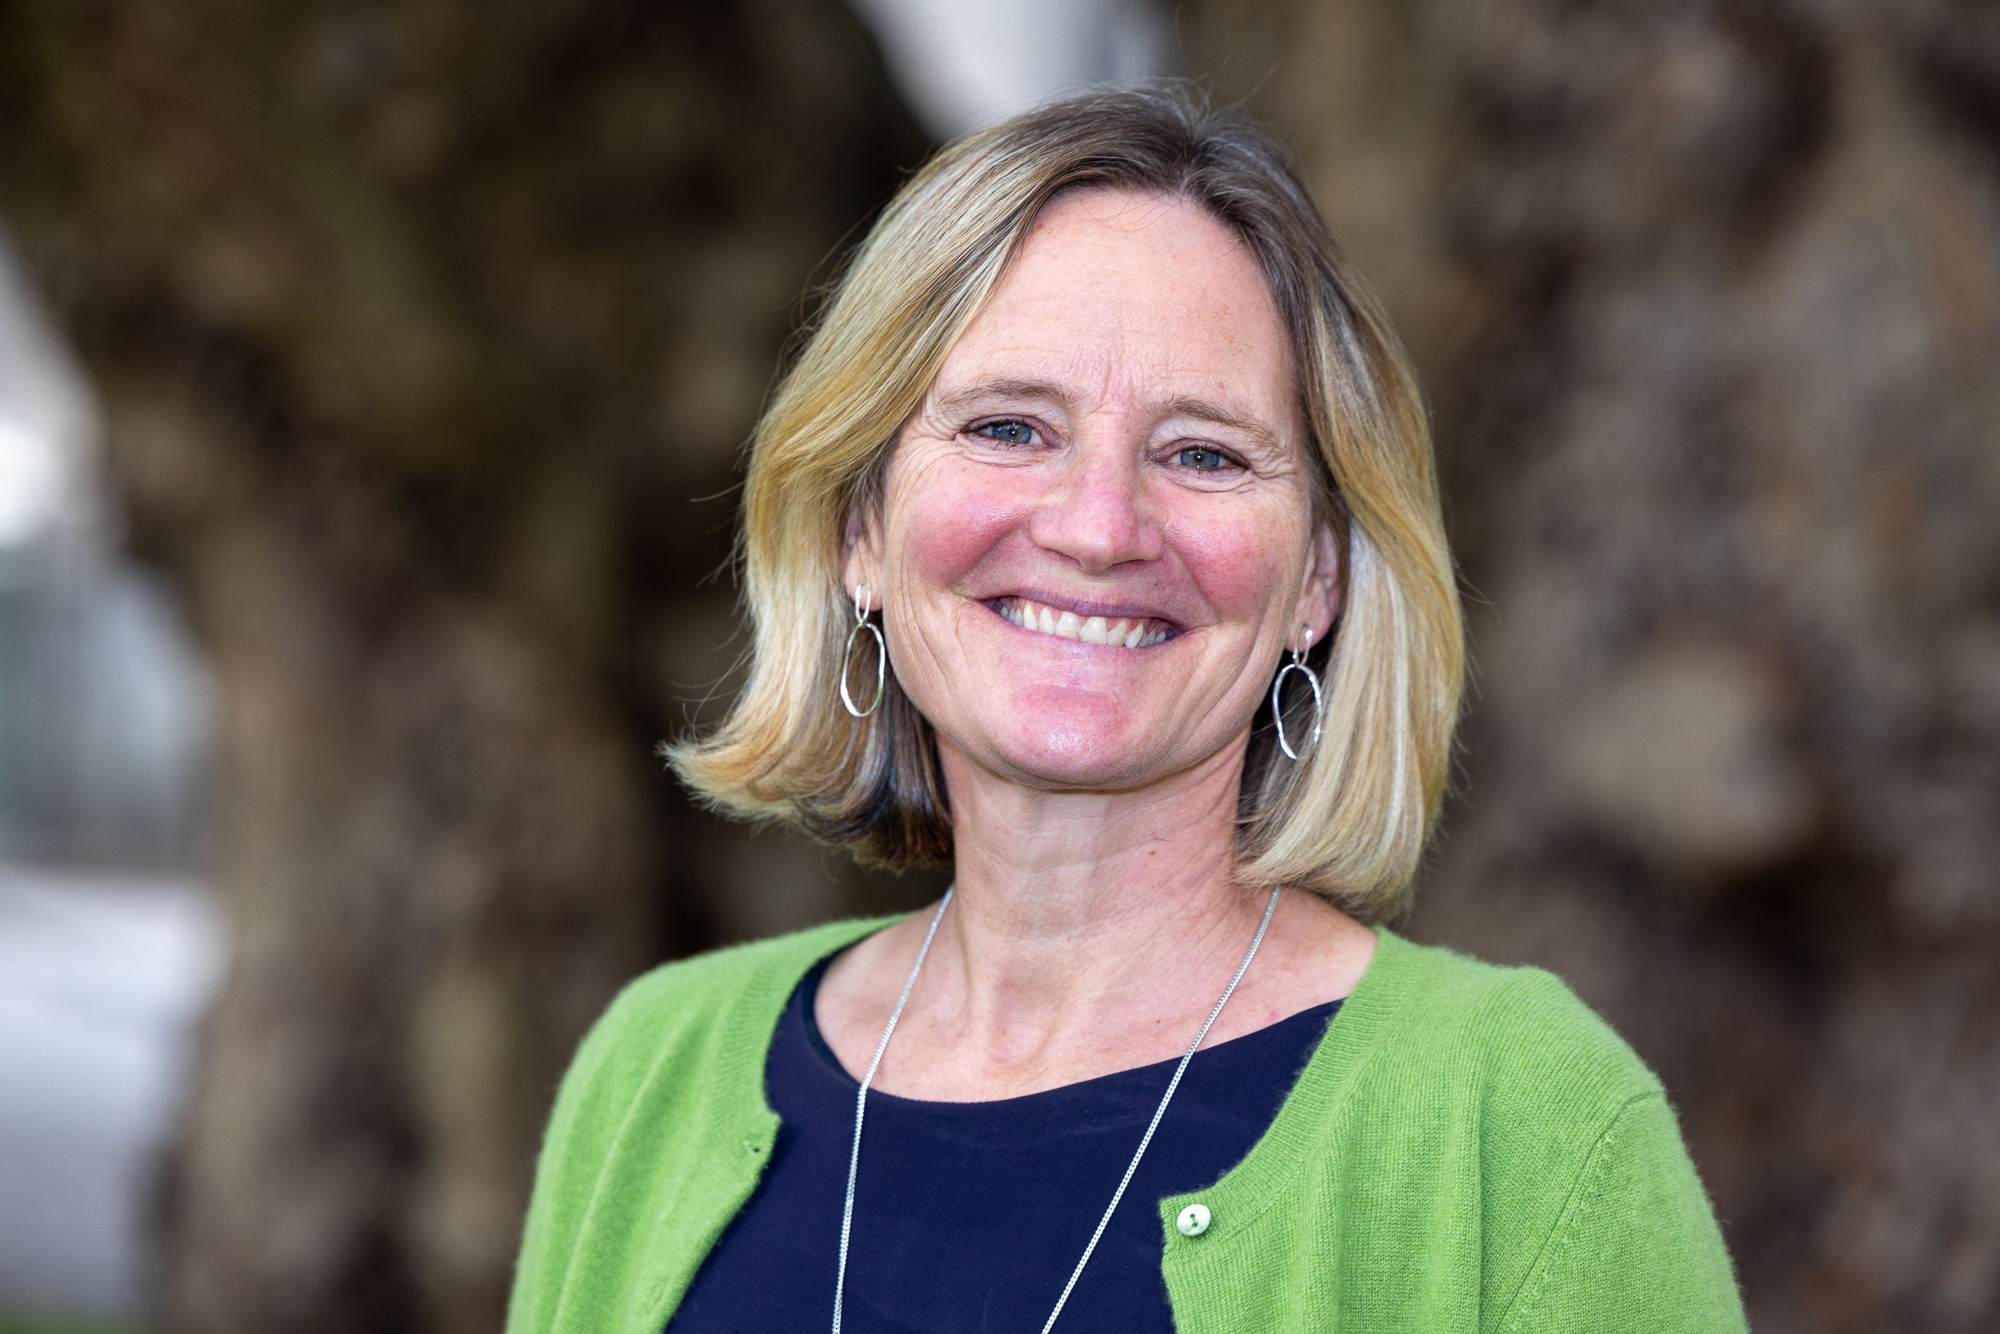



Research & Innovation
Sustainable Aviation
Climate and Health
Individually
Climate Science
Prof Stephen Dooley
Prof Matthew Chersich
Sustainable Finance
Amulya Ganti Sanagavaram Final year UG (BESS) Researching Post Consumer Textile Waste in Ireland
Prof Karen Wiltshire
Prof Martha O’Hagan Luff
Fungal endophytes to enhance crop growth & reduce the need for fertilisers & pesticides
Developing systems that integrate with excessive-heat-producing electronics, to cool, capture and reuse thermal energy, thus increasing efficiency and reducing costs.
Sensor technology that reduces global food waste by non-invasively monitoring MAP in real time

Slide 5





Research & Innovation
Collectively
Other research centres:

Slide 6
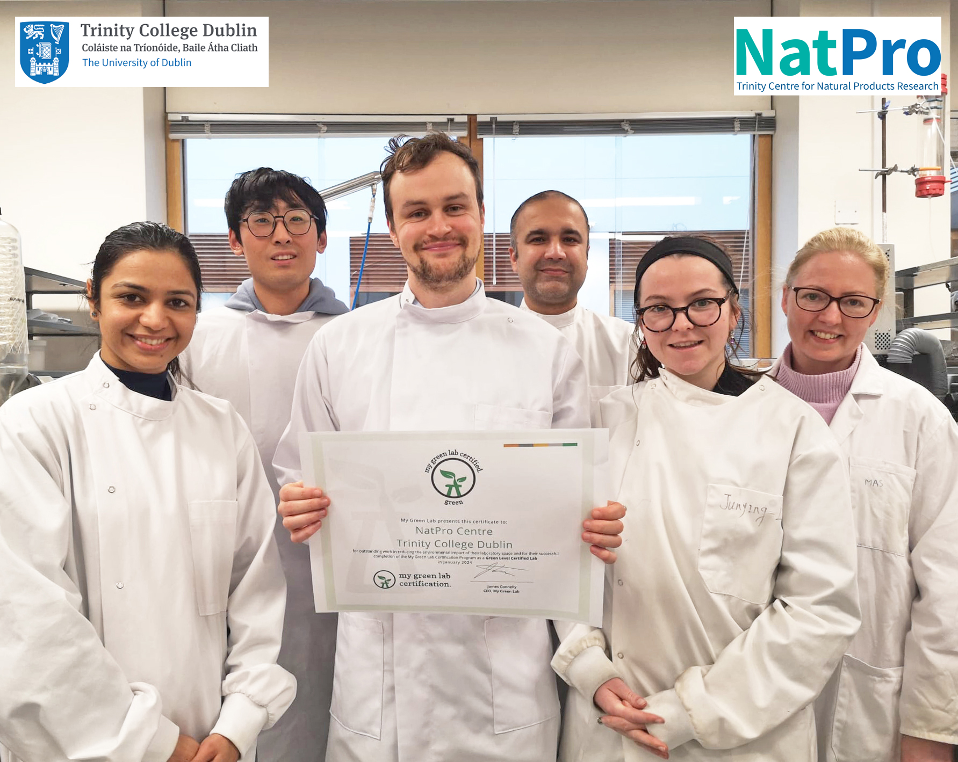

Research & Innovation
2024
84 (18%)
labs in Trinity in the My Green Lab programme
Systematically

Slide 7
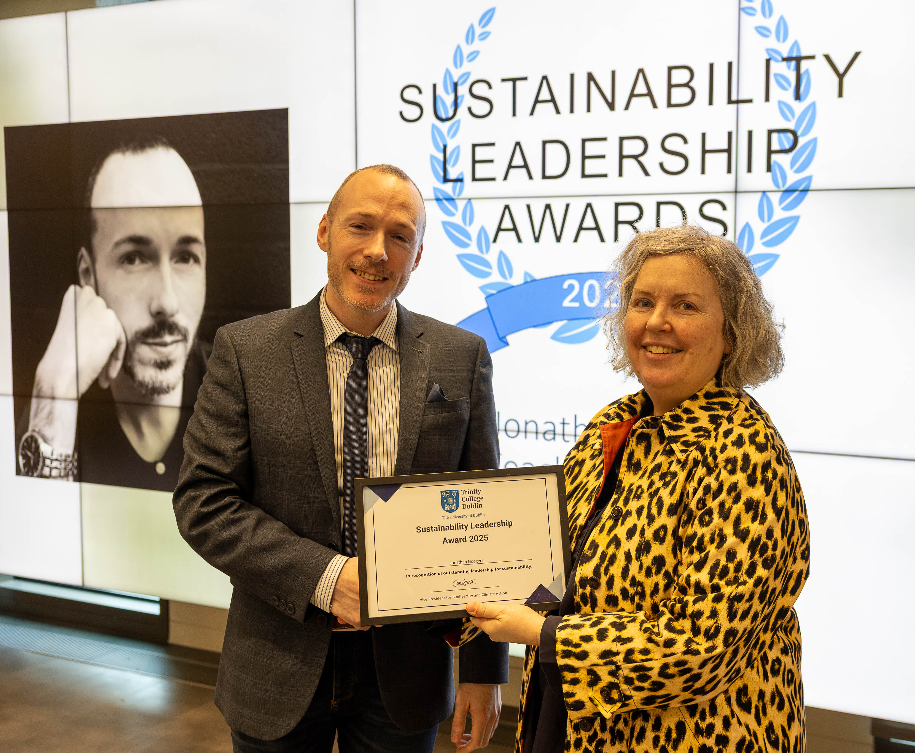
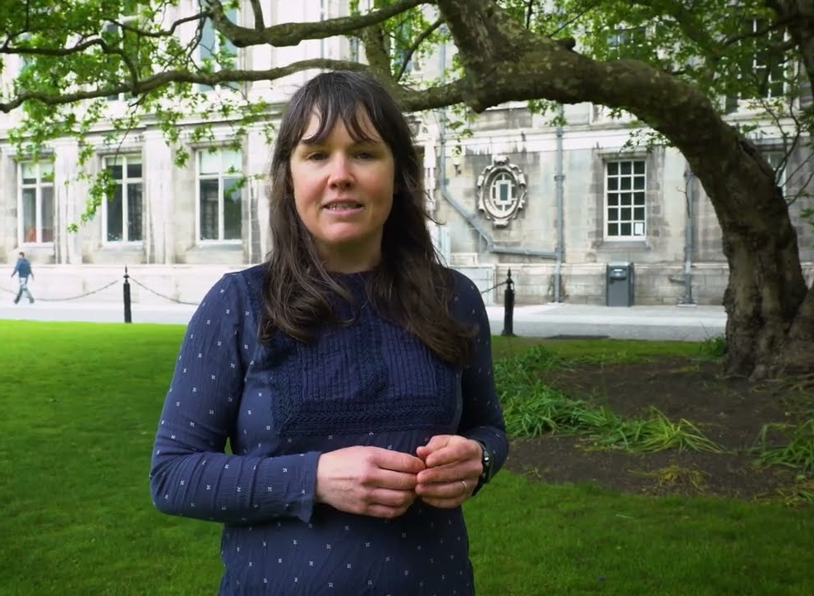
Education & Innovation
Individually
Dr Jonathan Hodgers (Teaching Fellow in Music, School of Creative Arts)
UG module in Music and Climate Change
Dr Clare Kelly (Associate Professor in the School of Psychology)
UG module in Psychology of the Climate Crisis

Slide 8
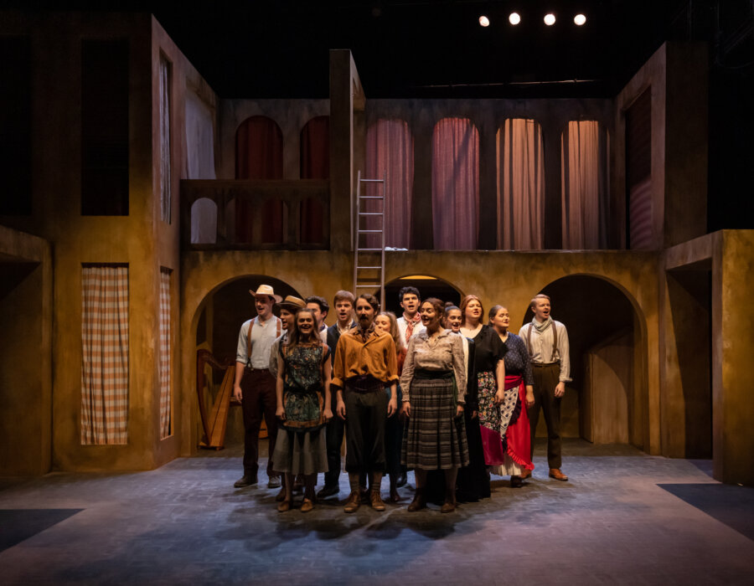

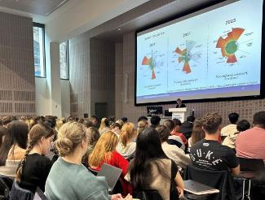
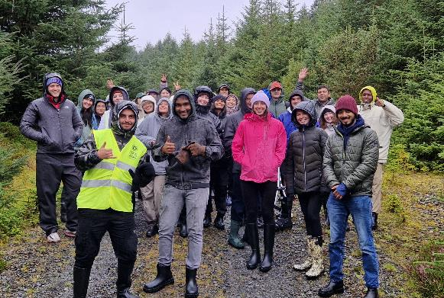
Education & Innovation
Collectively
Trinity Business School
1st year Enacting Sustainable Development
2nd year Organisational Change for Sustainable Futures
4th year Business of Nature Positive
MSc Responsible Business and Sustainability
Lir Academy production, Peribáñez
Cast & crews - undergraduate students
Sets, Scenery, Props, Furniture & Costumes - 93% from repurposed sources; 80% recycled / reused after

Slide 9
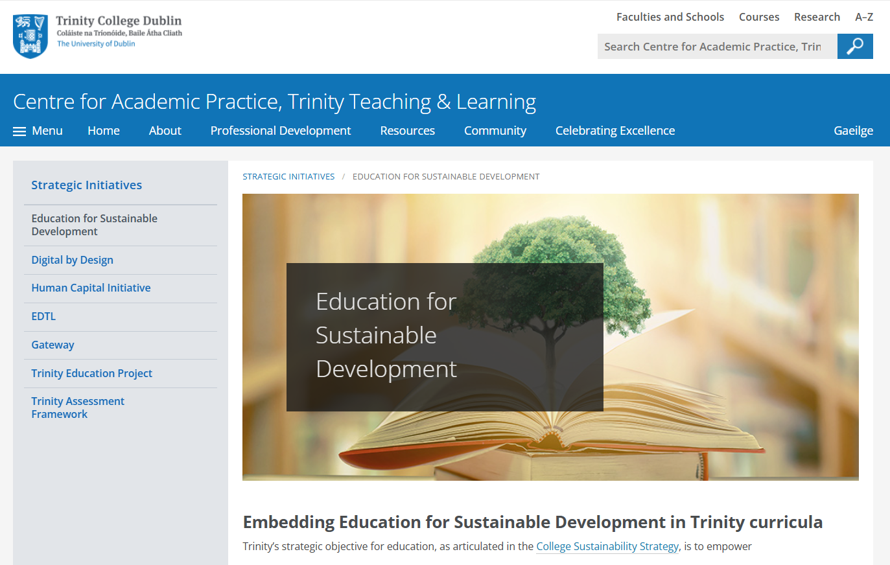

Education & Innovation
Systematically

Slide 10
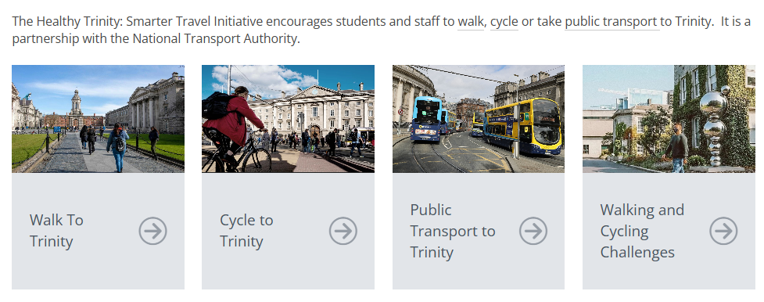
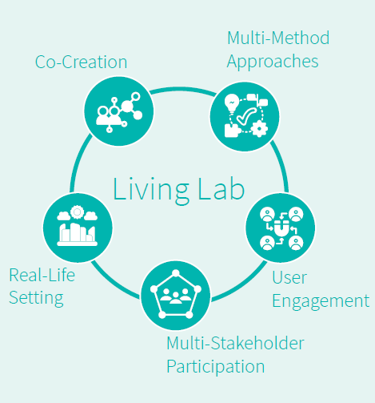
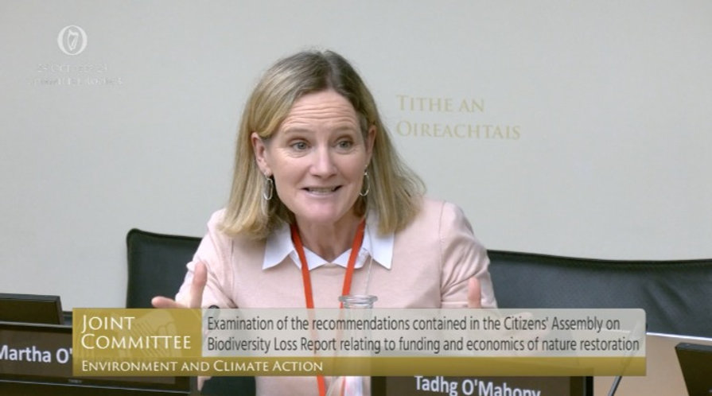
Making the connections…
Smarter Travel Living Labs -> Dublin City Transport Plan
Natural Capital Ireland -> Oireachtas Joint Committee

Slide 11
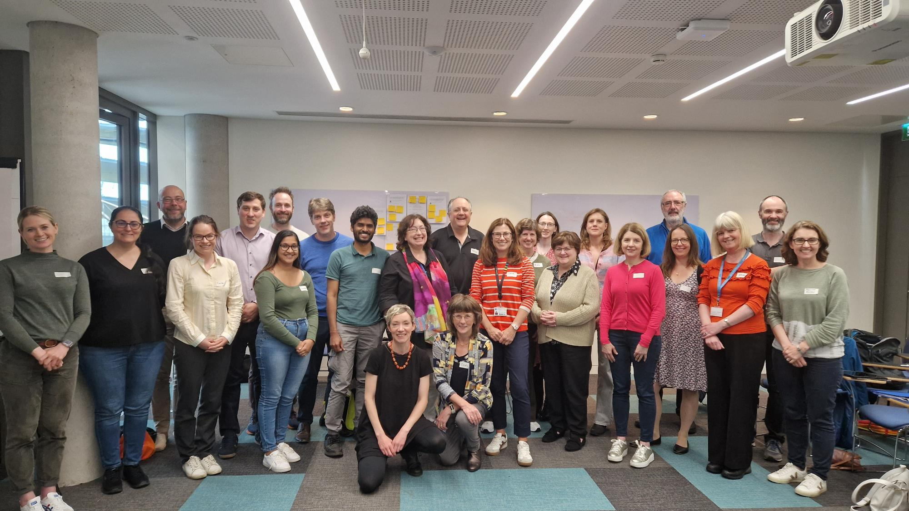

Individually
Collectively
Systematically
www.tcd.ie/sustainability

