Slide 1
Universities as Partners
Professor Giovanni Molari
Rector, Alma Mater Studiorum – Università di Bologna

Slide 2
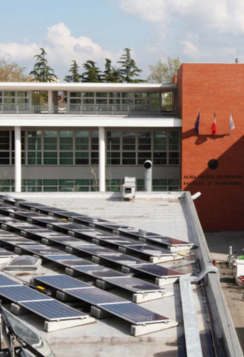
Sustainability: Commitment and Responsibility
In times of crises, universities are called to act responsibly, and to play a leading role.
As centers of learning and innovation, universities have a crucial role to play in addressing the energy and climate crisis, to promote awareness and research, and to contribute to the governance of climate change and of its effects.
Universities contribute by conducting groundbreaking research, educating the next generation of sustainability leaders, and implementing consistently sustainable practices in their campuses.

Slide 3
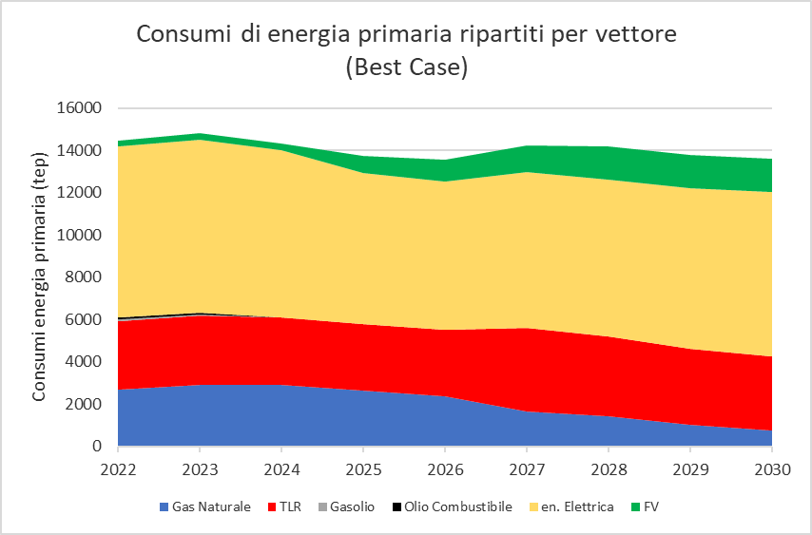
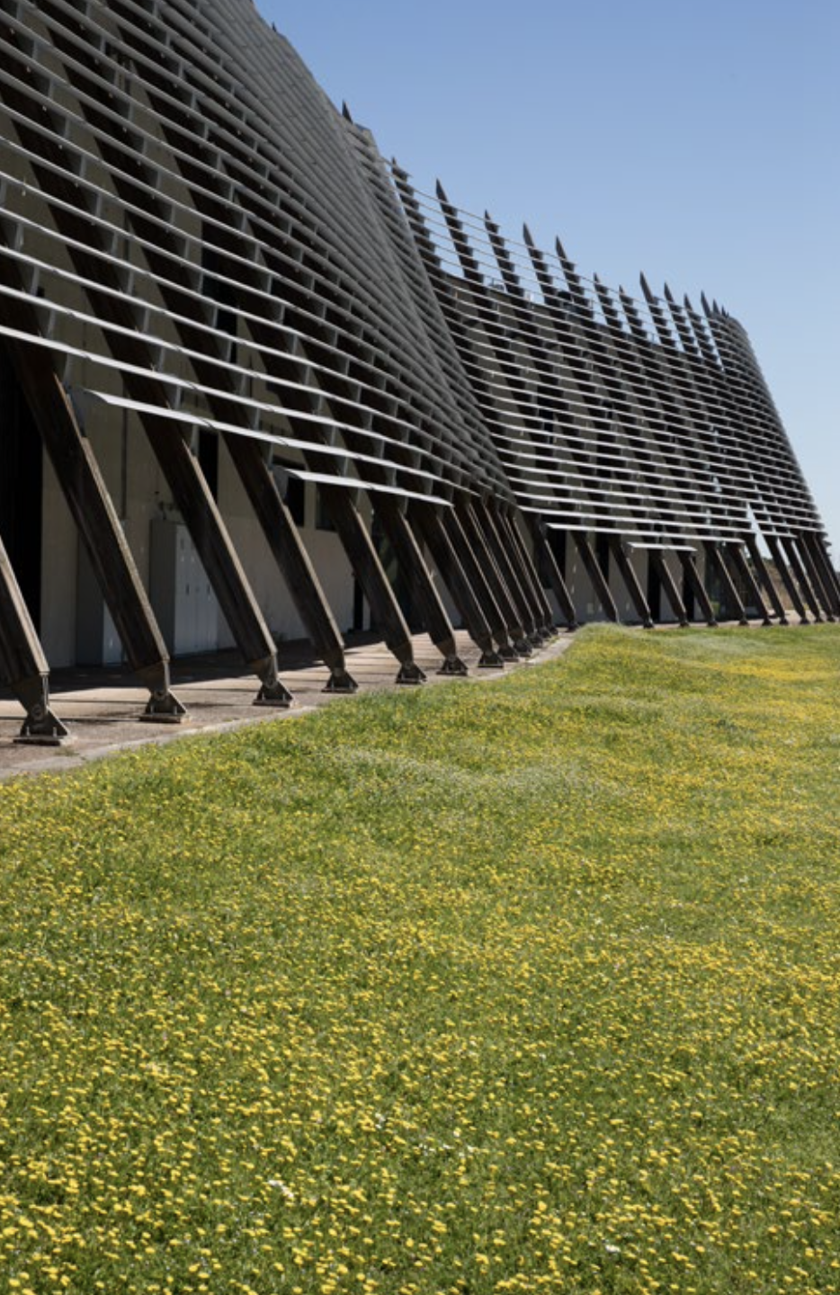

The University of Bologna Energetic Plan
The goal
Breakdown of primary energy consumption
by energy carrier

Slide 4
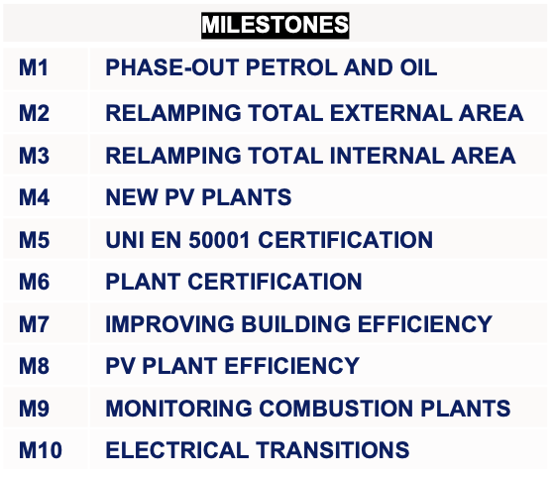
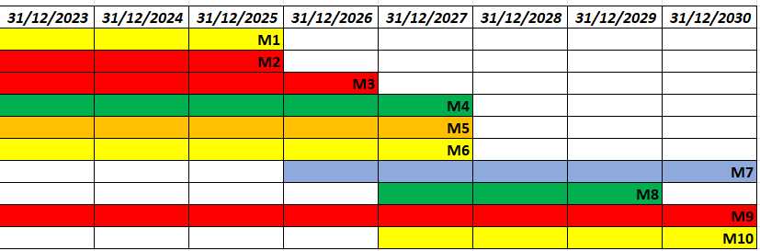
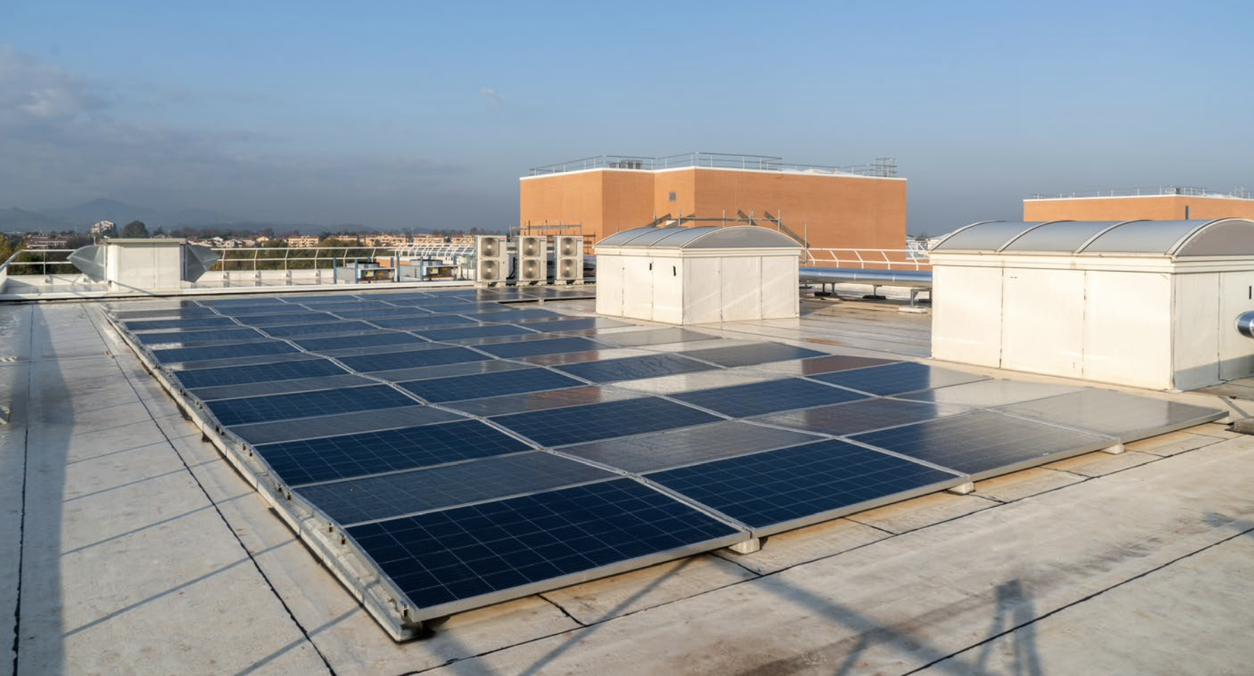
The University of Bologna Energetic Plan

Slide 5
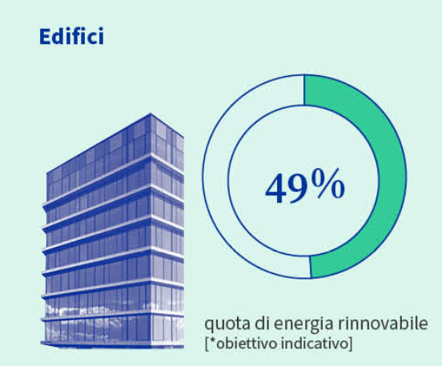
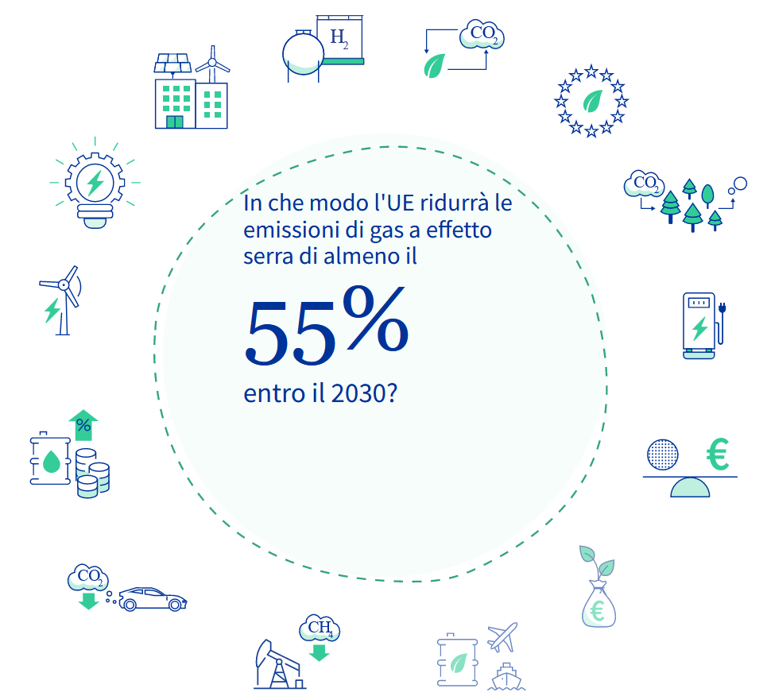

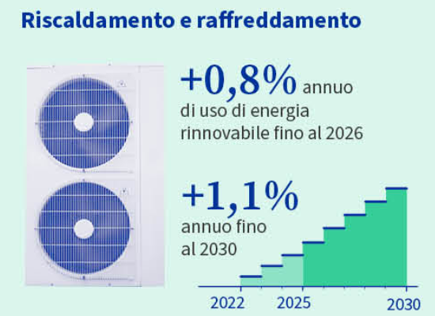
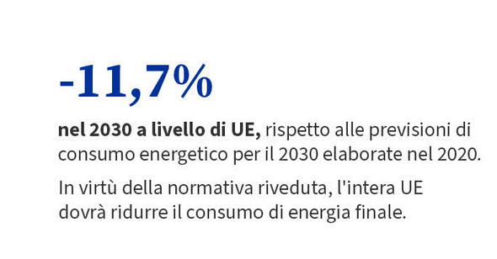
The University of Bologna Energetic Plan
Fit for 55% vs Energetic plan (PEA) UNIBO
Goal | FIT FOR 55% | PEA UNIBO
Reduction of CO2 emissions at 2030 respect to 1990 | 55% | >70%
Renewable on primary energy consumption | 49% | 24%
Annual increase on renewable on primary energy consumption for heating and conditioning | 2020-2026 +0,8% | 2020-2026 +2,1%
 | 2026-2030 +1,1% | 2026-2030 +7%
Reduction on final energy consumption (2020-2030) | -11,70% | -16,40%
Reduction on average annual consumption | -1,90% | -2,30%
Renewable Surface per year | 3% | 3,80%

Slide 6


University and its partners
On the basis of a sharing of the same set of values and goals, universities develop partnerships with institutional partners & private stakeholders. A few examples:
PARTNERSHIP with local and national political institutions for after-floads interventions & prevention strategies
PARTNERSHIP a regional heat pump manufacturer: testing of an innovative model of electric heat pump using propane as refrigerant fluid, which reduces in a significant way the Global Warming Potential (GWP)
PARTNERSHIP with energy distributors: implementation of the revamping the external lighting systems of University buildings in Bologna, with automatic control systems able to switch on and off the fixtures on the basis of the light level.
PARTNERSHIP with the automotive sector: E-Cells a Joint research Lab for the next generation of batteries for automotive & mobility.

Slide 7
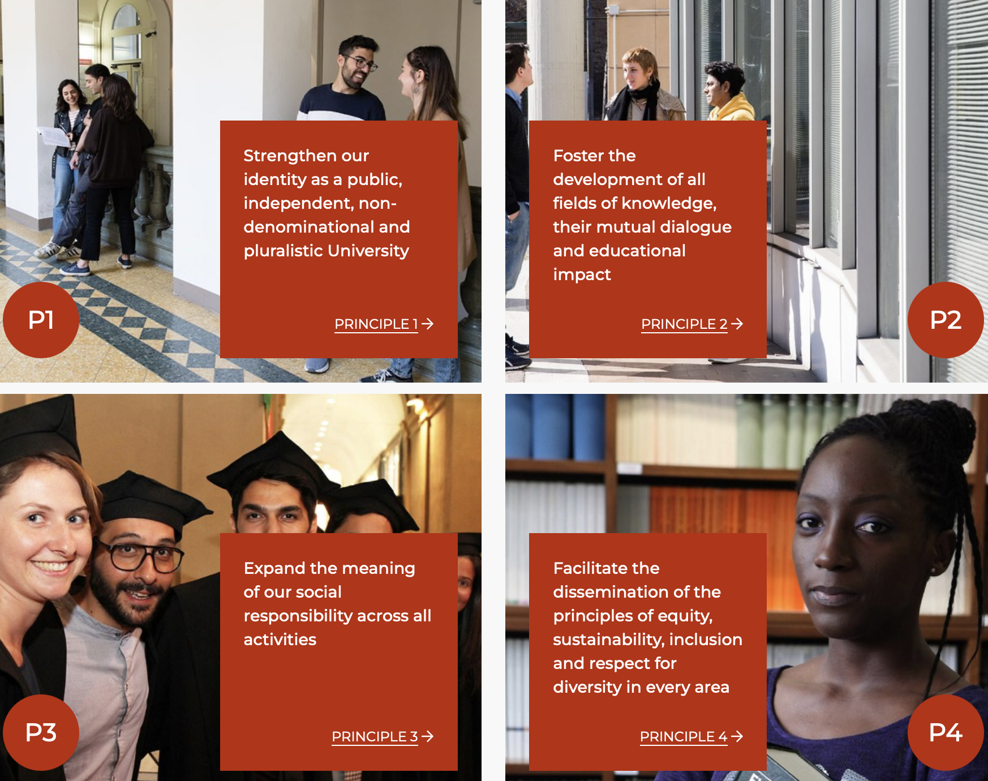
Our Strategic Plan (2022-2027) for a sustainable future

Slide 8
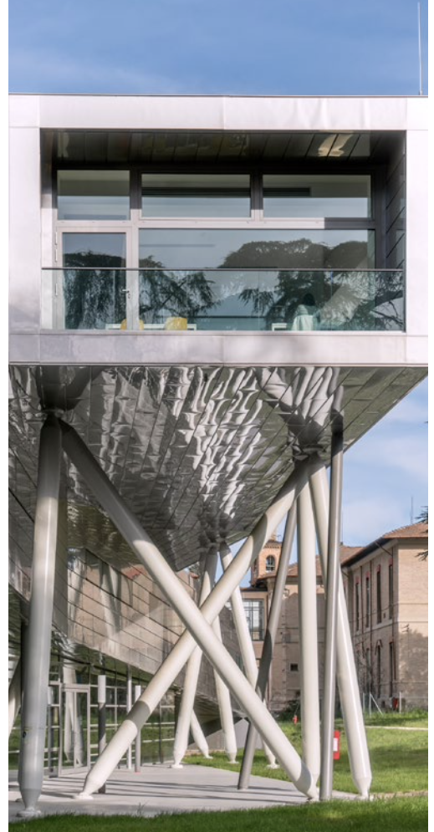
Universities & sustainability: lead by example
Universities are not only called to react to sustainability-related problems, but to act constructively to address challenges ahead, and to do so in a consistent, realistic and responsible way.
With respect to climate change, Universities can be the driver of societal transformations and promote a cultural shift from quick reaction to emergency, to the implementation of expert knowledge, monitoring, and educational formats.
As prominent actors in the global scenario and catalysts of innovation, universities can develop a long-term shared vision for the future, across borders, countries, and generations.

Slide 9
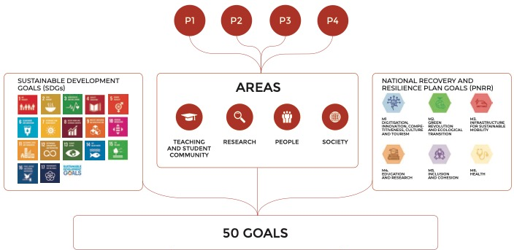

A long-term vision in the global context

