Slide 1


European Strategy forum on Research infrastructures (ESFRI)
David Bohmert
Member ESFRI Executive Board
Swiss ESFRI Delegate
COIMBRA Seminar on Research Policy
Isola di San Servolo (ITALY)
Friday, 28th October 2016

Slide 2
OVERVIEW
Rationale for INCO RI
scope ESFRI
strategic role & robust methodology
landscape analysis
evaluation of scientific case & assessment of implementation
RI lifecycle
Roadmap 2016
Roadmap 2018
evaluation & assessment of new proposals
monitoring of Projects & periodic review of Landmarks
current issues
impact assessment
questions to universities

Slide 3
RATIONALE FOR INCO RI
deliver frontier science, innovation, education and training (e.g. relevance, validity, standardisation, interoperability)
fight fragmentation
effectively contribute to tackling societal challenges
science for diplomacy
ensure competitive position of (limited) science system at global level
efficiently spend scarce public resources
safeguard Long Term Sustainability (LTS) RI

Slide 4

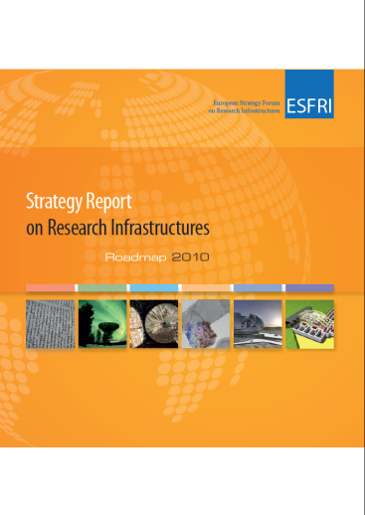
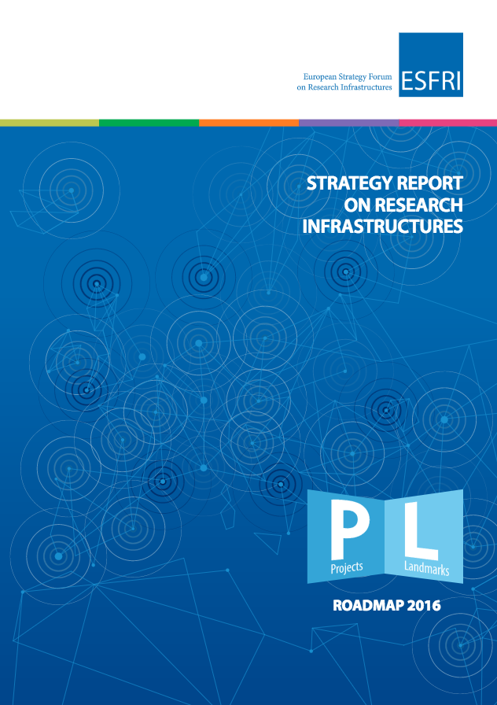

SCOPE ESFRI
support coherent and strategy-led approach to policy making on RI in Europe
facilitate multilateral initiatives leading to better use and development of RI acting as incubator for pan-European RI and Global Research Infrastructures
establish European roadmap for RI for the coming 10 to 20 years, stimulate implementation of these facilities and update roadmap as need arises
ensure follow-up of implementation of on-going Projects after comprehensive assessment as prioritisation of Projects listed in Roadmap

Slide 5
STATE OF THE ART RI ROADMAPPING
strategic role
robust methodology
operate at forefront of European and global science policy
carry out analysis of RI landscapes in five scientific domains
ensure national commitments to implementation of RI on Roadmap
provide advice & guidance on overcoming obstacles
offer support to RI in portfolio and facilitate their implementation
link regional, national, European & international levels
apply & improve common definitions, models, methods and procedures
addresses entire life cycle safeguarding long term sustainability of RI portfolio
organise open calls, check eligibility & review against clear & transparent criteria
apply independent & international peer review
adhere to strict principles, avoid conflict of interest and safeguard confidentiality
apply `parallel` evaluation of scientific case & assessment of implementation

Slide 6

Landscape
analysis
goals
provide analysis & overview of RI ecosystem in scientific domains of operational RI open internationally to scientists and technology developers through peer-review of competitive science proposals
identify gaps and potential evolution of domain in foreseeable future
enable reviewers to position RI in RI ecosystem
Criteria
scientific & technological knowledge delivered or contribution to their advancement
potential for structuring ERA and addressing fragmentation
timeliness (urgency; opportunities lost if delayed)
range of scientific communities covered & potential for integration
potential for knowledge & technology transfer, training & increasing capacity
extent to which RI responds to needs & improves access for (new) scientific communities
extent to which RI meet gap in & connect to landscape

Slide 7
TWO SIDES OF SAME RI
STRATEGY WORKING GROUPS (SWG) IN FIVE SCIENTIFIC DOMAINS EVALUATE SCIENTIFIC CASE
IMPLEMENTATION GROUP (IG) ASSESSES IMPLMENTATION
scientific excellence
pan-European relevance
socio-economic impact
e-needs
stakeholder commitment
user strategy & access policy
preparatory work
planning
governance & management
human resources policy
finances
risks

Slide 8
research infrastructure lifecycle
PROJECTS
LANDMARKS
PREPARATION
preparatory phase, business & construction plan, political and financial support secured, data policy & data management plan, cost book, legal entity
IMPLEMENTATION
site construction and deployment of organisation, recruitment, IPR & innovation policies, perennial operations and upgrade plan, secure funding for operation
DESIGN
design study, business case, political and financial support obtained, common access policy, top-level breakdown of costs, governance and HR policy
OPERATION
frontier research results, services to scientific community, outreach, continuous upgrade of instrumentation and methods, plan and obtain political and financial support for follow up
excellent & mature
proposals
CONCEPT DEVELOPMENT
concept screening, consortium formation, access policy and funding concept, scientific and project leadership
TERMINATION
e.g. dissolution, dismantling of facilities and resurrection of site, reuse, merger of operations and organisation and (major) upgrade

Slide 9
Projects on Roadmap 2016
ENE
ENV
H&F
PSE
SCI
e-RI
ECCSEL
EISCAT_3D
EMBRC
CTA
2008
EPOS
ERINHA
SIOS
EU-OPENSCREEN
Euro-BioImaging
EU-SOLARIS
ANAEE
2010
MYRRHA
ISBE
WindScanner
MIRRI
2016
ACTRIS
EST
DANUBIUS-RI
EMPHASIS
KM3NeT 2.0
E-RIHS

Slide 10
LANDMARKS on Roadmap 2016
ENE
ENV
H&F
PSE
SCI
e-RI
JHR
EMSO
BBMRI ERIC
E-ELT
CESSDA
PRACE
EURO-ARGO ERIC
EATRIS ERIC
ELI
CLARIN ERIC
IAGOS
ECRIN ERIC
EUROPEAN SPALLATION SOURCE ERIC
DARIAH ERIC
ICOS ERIC
ELIXIR
Eu-XFEL
ESS ERIC
LifeWatch
INFRAFRONTIER
FAIR
SHARE ERIC
INSTRUCT
ILL
SKA
SPIRAL2
2006
EMFL
2008
ESRF-EBS
HL-LHC
2016

Slide 11
Roadmap 2018
CAPE TOWN
MALAGA
BRUSSELS
BRUSSELS
VIENNA

Slide 12
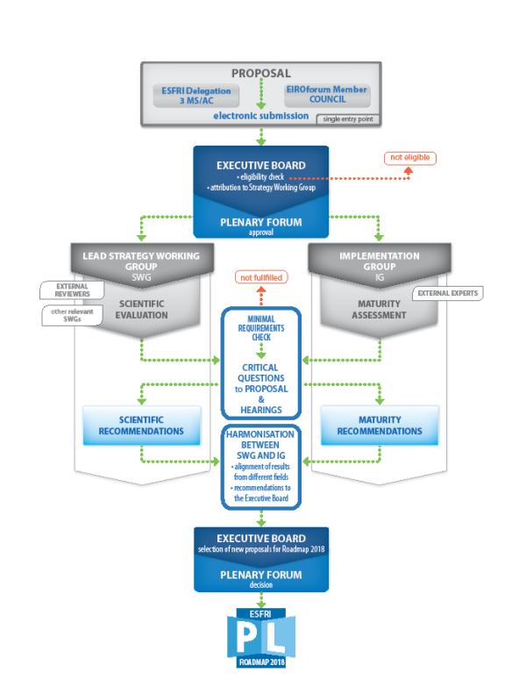
NEW PROPOSALS
Guide for Proposers & submission questionnaire online in January 2017 & other forms
Infoday for Proposers in Malaga on 17th January 2017
only EU MS, AC & EIFOforum members can apply until 31st August 2017

Slide 13
NEW Projects must demonstrate maturity
have successfully completed a design/feasibility study
have planned its business case/delivery strategy
provide proof of political support, i.e. EoS by lead country AND at least two additional MS & AC signed by national ministries responsible for RI (or Council resolution)
provide proof of financial commitment, i.e. EoC to financially contribute to preparation and implementation phases by an authority from lead country (or financial commitment in Council resolution)
provide proof of an inter-institutional and multi-lateral agreement, e.g. MoU signed by core partners - being research institutions - formally involved in the consortium

Slide 14
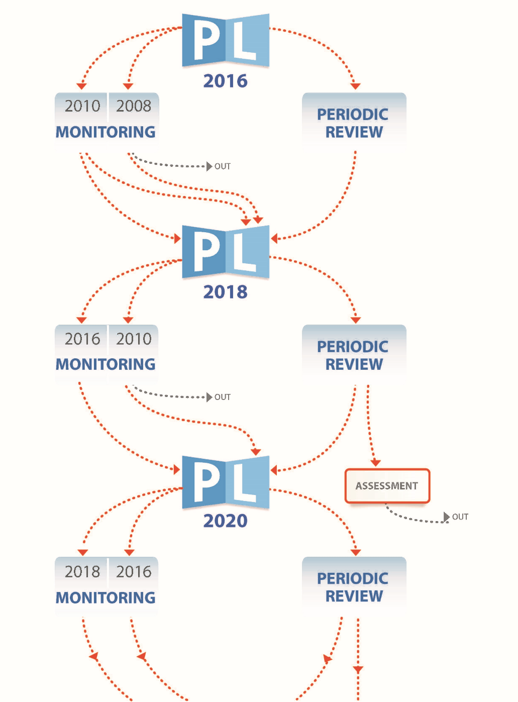
MONITORING & PERIODIC REVIEW
Guide for Projects & Landmarks in January 2017
Exchange of Experience Workshop for Projects & Landmarks in Malaga on 17th January 2017
various publication dates & deadlines for specific questionnaires & forms

Slide 15
CURRENT ISSUES: LTS RI
ensure (continuous) scientific excellence
align institutional, regional, national, European, international and global road mapping (e.g. long list versus short list; new ones versus portfolio approach; proactivity) & roles
unlock innovation potential
improve link between access policies & business case
create transparency in RI funding instruments & cost calculation
resistance: incorporate stakeholder engagement strategies in mission
professionalise leadership & sustain funding
better exploit data generated by RI
structure INCO RI at global level

Slide 16
standardise & normalise impact assessment
scientific (bibliometrics, peer review, altmetrics)
economic (econometrics)
social (statistics, e.g. longitudinal studies)
impact on innovation (statistics)
societal impact (primarily via qualitative methods)
case study approach resulting in non-reliable, non-replicable, difficult & complex methodologies
shortcomings: quantifying research impact; causality; delineation between short, mid and long-term effects; timeframes & lags; opportunity costs; counterfactual & net benefits
call for common, reliable and normalised reference framework for impact assessment taking diversity of RI & evolution of impact along cycle into account
based on set of common minimal indicators of along lifecycle linking external demand for proof of socio-economic impact assessment internal mission, strategy & monitoring of RI

Slide 17
questions to YOU
What are your roles & corresponding responsibilities in RI?
How do you deal with the number of small and mediate-size RI decreasing constantly in favour of few big ones resulting in concentration of RI in few regions?
Do you have institutional RI policies & roadmaps?
Do you comply with the European Charter for Access to RI?
Do you use concept development, design & termination?
Where do you stand in ensuring basic provider-driven infrastructure versus eligibility of access costs in principal investigator-driven & competitive research grants?
What do you do about pseudo-science propaganda feeding further into post factual politics?
How to make toothpaste out of the Higgs boson?

Slide 18

THANK YOU FOR YOUR ATTENTION
QUESTIONS? DISCUSSION!
david.bohmert@snf.ch

