Slide 1
Why Invest in Humanities Research Infrastructure?
Dr Jennifer Edmond
Trinity College Dublin
Co-Head, DARIAH VCC-2

Slide 2
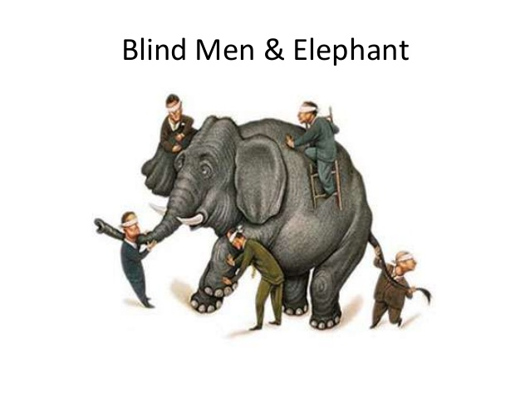
What is a Research Infrastructure?
It seems nobody knows/agrees, definitions tend to have a lot of commas in them
“This definition of Research Infrastructures, including the associated human resources, covers major equipment or sets of instruments, as well as knowledge‑containing resources such as collections, archives and databases. Research Infrastructures may be “single-sited”, “distributed”, or “virtual.” … These include technology-based infrastructures such as grid, computing, software and middleware.” (ESFRI 2006)

Slide 3
What is DARIAH?
Legal entity under the European Research Infrastructure Consortium (ERIC) instrument
Part of the original 2006 ESFRI Roadmap, now a “Landmark” project nearing the end of its construction phase (2019)
17 member countries, with 6 more in negotiation
4 main areas of concern: technical platform, shared data, research and educational communities, outreach/policy impact.

Slide 4
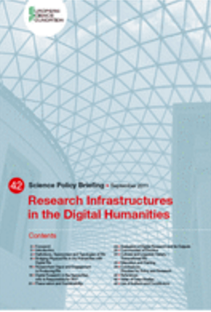
Humanities RIs are nothing new…
“…as early as the 3rd century B.C., the imperative to collect, organise and conserve the knowledge acquired in the service of the advancement of knowledge gave birth to the first ever ‘Information Centre’ in the form of the Mouseion, a cultural centre, university and library founded in Alexandria under the successors of Alexander the Great”

Slide 5
…but they are doing new things
Fostering Interoperability
Building Sustainability
Supporting Methodological Innovation
Building Networks and Collaboration

Slide 6
Underpinned by values… and value
shared access to the resources, expertise and facilities needed to advance knowledge. Not every institution or indeed every country, can justify investing in the specialised knowledge, data, labs and equipment certain disciplines and communities require. By sharing these resources among many partners, a research infrastructure can facilitate access for many researchers.

Slide 7
Interoperability
Silos don’t make for good science: not in terms of knowledge, not in terms of sources
DARIAH promotes
Standards for sharing
Policies for sharing (IPR)
Platforms for sharing
The value of sharing
But integration is hard

Slide 8
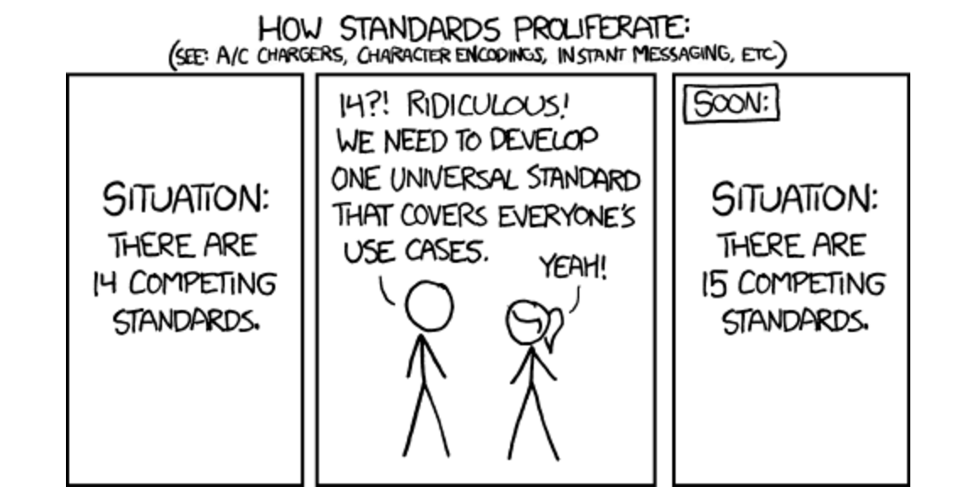
Interoperability
From XKCD, Reused under CC-A-NC 2.5, Original at: http://xkcd.com/927/

Slide 9
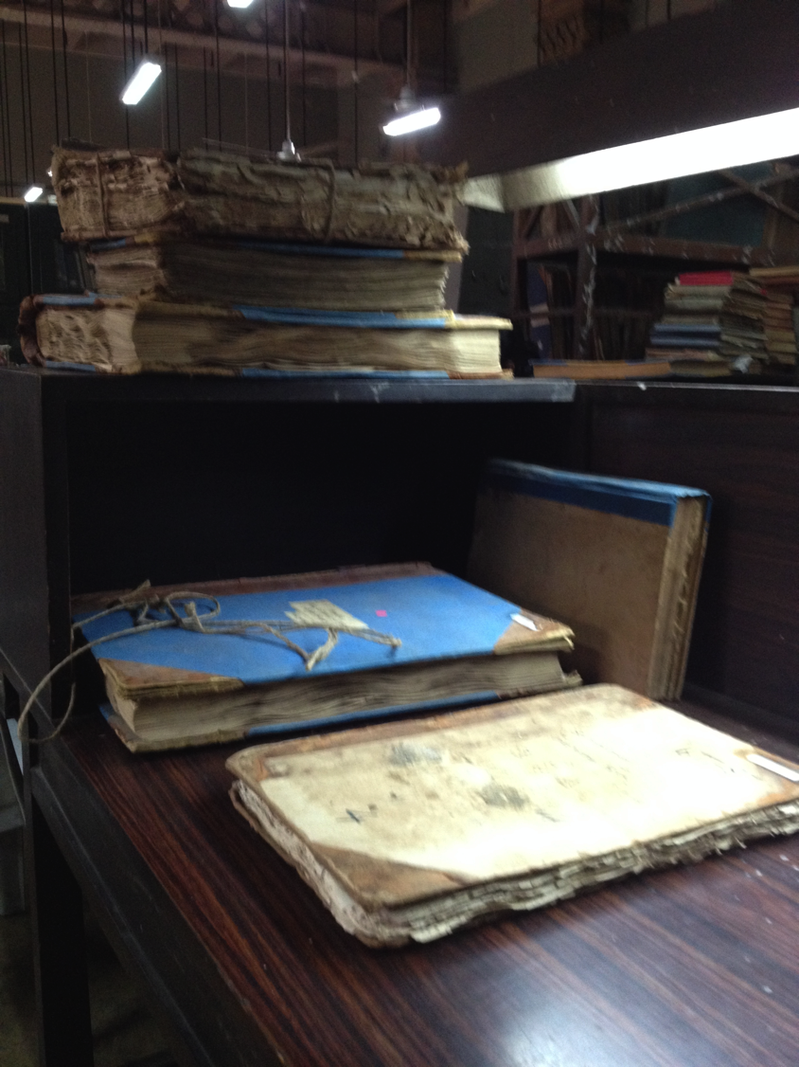
Levels of cataloguing/conservation
Levels of digitisation
Quality of on-line presence
Levels of standardisation
Levels of organisation
Levels of political orientation toward openness
Levels of tacit versus open knowledge
Levels of individual versus institutional control over access/discoverability
Does this mean one collection is less relevant/important than the other?
BNF (or other)
Hungarian State Archives (or other)

Slide 10
Sustainability
Many digital humanities projects have had limited value for later scholars. What went wrong?
Technical problem. RIs provide persistant identifiers and other aids to discoverabilty
Social or cultural problem: Ris support scholarly authority and maintain provenance
Communications problem. Ris increase visibility and impact of humanities scholarship
Align humanities research with Open Science values
cendari.eu

Slide 11
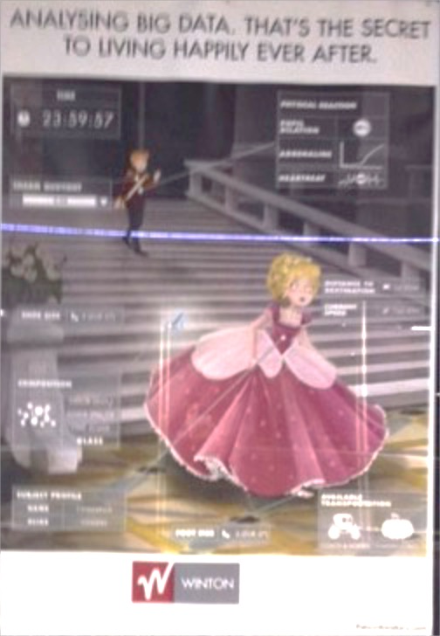
Methodological Innovation
Inspiration, Examples
Information, Advice and Training
Tools, Resources and Platforms
Reassurance, Protection, Policies

Slide 12
Networks and Collaboration
Partners
Knowledge
Access to other disciplines
Access to funding
Mechanisms to formalise collaboration
A voice for (all of) the humanities?
All humanists publish
All humanists used sources

Slide 13
Open Science as an Infrastructural Concern
To make things more concrete, there are eight policy ambitions that need to be addressed in line with these five broad action lines:
1. FAIR open data
2. European Open Science Cloud
3. altmetrics
4. new business models for scholarly communication
5. rewards
6. research integrity
7. open science skills
8. Citizen Science

Slide 14
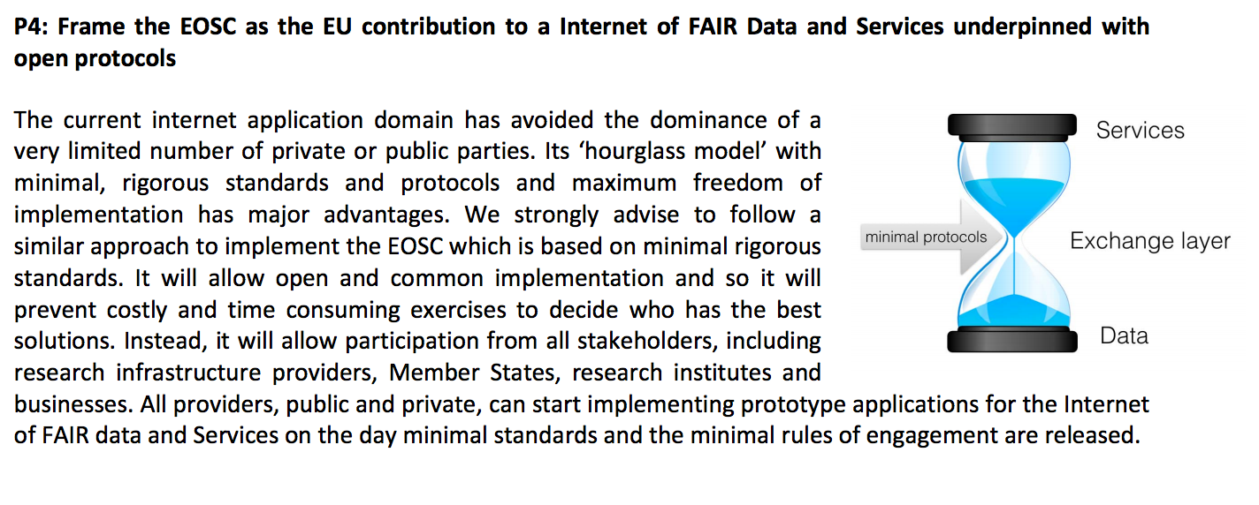
EOSC
But what about OUR data? What about OUR traditions of knowledge creation?
DARIAH as a bidirectional informant in a system tuned to STEM

Slide 15
The benefits?
Investing in shared research infrastructures will give access to networks, data and knowledge for your researchers, leading to:
- greater efficiency and insight in their work
- enhanced pathways for visibility, reuse and impact for their work – enable humanities research that is integrative, collaborative and applied
- better alignment with shared standards and policy frameworks, such as Open Science
- increased opportunities to seek collaborative funding
- better long-term sustainability of research outputs
- increased impact for a strategically challenging area in the university

