Slide 1


A tradition of innovation
General Presentation, December 2025

Slide 2
Commitment
Founded in 1985 the Coimbra Group is an association of long-established European multidisciplinary universities of high international standard.
The Coimbra Group is committed to creating special academic and cultural ties in order to promote internationalisation, academic collaboration, excellence in learning and research, and service to society.
It is also the purpose of the Coimbra Group to influence European education and research policy and to develop best practice through mutual exchange of experience.
One of the pioneering actors in the creation of Erasmus+, the co-creation of the European Universities Initiative, and the development of the European Higher Education Area (EHEA).

Slide 3


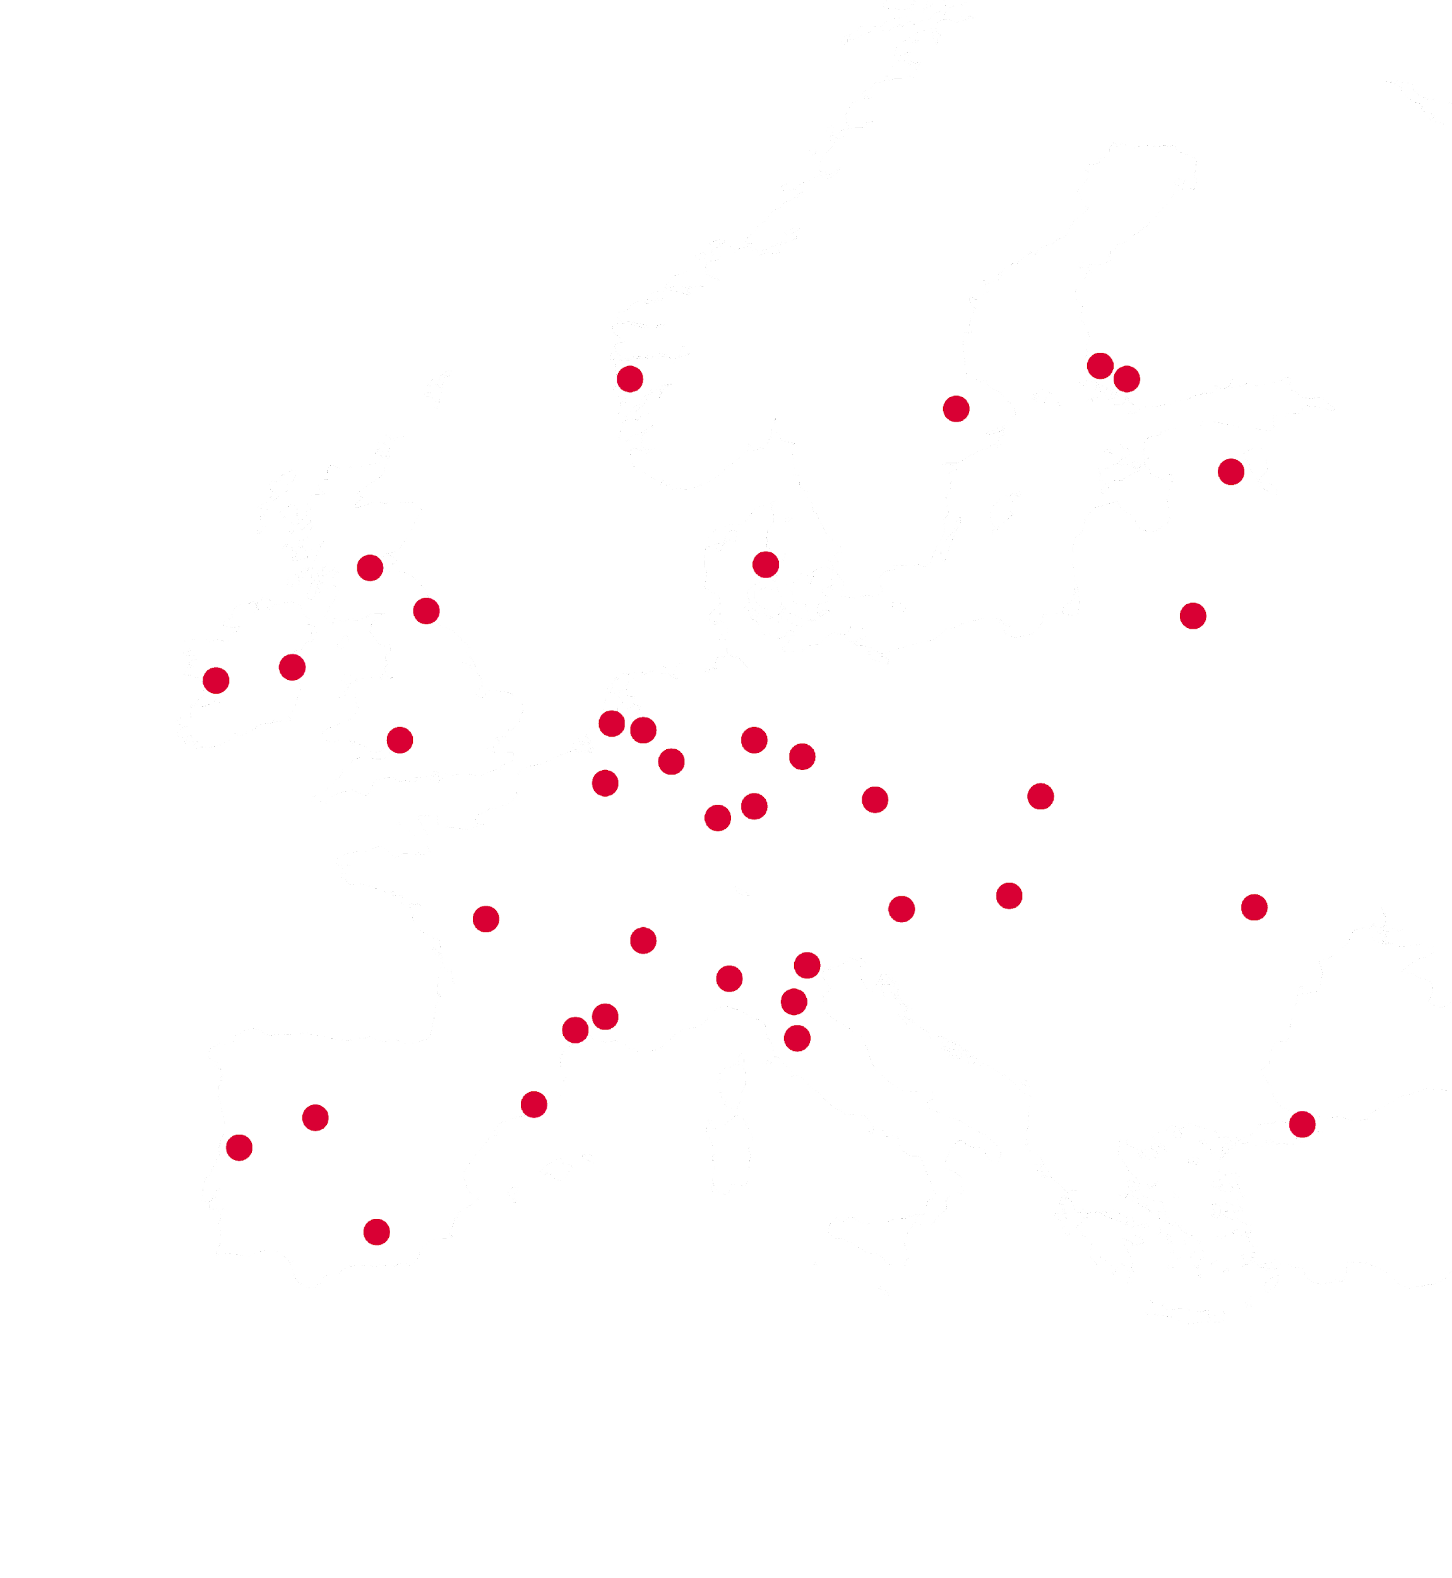
Facts and figures
Founded in 1985
42 Universities from 22 European countries
> 1,4M students / > 232 000 staff members (teaching, research, admin.)
14.4% of all signed grants in H2020:
25% of all RIAs, IAs and CSA projects awarded under Pillar II
12.5% of all ERC funded grants
15.5% of all MSCA funded projects
21% of all signed grants in HEU:
26% of all RIAs, IAs and CSA projects under Pillar II
11,7% of all ERC funded grants
20.85% of all MSCA funded projects
>16% of all Erasmus+ grants to/from CG universities

Slide 4
Organisation Chart
Ludovic Thilly Chair Poitiers | Beatrix Busse Vice-Chair Cologne | Danny Donoghue Treasurer Durham | Antonella Forlino Pavia | Dorota Malec Krakow
Coco Norén Uppsala | João Ramalho-Santos Coimbra | Eva Voldřichová Beránková Prague | Efrem Yildiz Sadak Salamanca
Executive Board
Giovanni Molari CG Honorary President Bologna | Joan Guàrdia Olmos Barcelona | Margareth Hagen Bergen | Marjo Kaartinen Granada
Milena Králíčková Bologna | Karen O’ Brien Durham | Pedro Mercado Pacheco Granada
Rectors’ Advisory
Group

Slide 5
Working Groups
(by pillar of primary interest)
Research | Education | Outreach
Research Support Officers Social Sciences & Humanities Life Sciences Science, Technology, Engineering and Mathematics (STEM) | Doctoral Studies Education Innovation Academic Exchange and Mobility Employability | Heritage Global Partnerships Latin America Equality and Diversity
Coordination by Executive Board members
Support from Policy Officers at CG Office (Brussels)

Slide 6
CG Members involved in Alliances of European Universities
Aarhus (DK)
Barcelona (ES)
Bergen (NO)
Bologna (IT)
Bristol (UK)
Budapest (HU)
Coimbra (PT)
Dublin (IE)
Durham (UK)
Edinburgh (UK)
Galway (IE)
Genève (CH)
Granada (ES)
Graz (AT)
Groningen (NL)
Heidelberg (DE)
Iaşi (RO)
Istanbul (TR)
Jena (DE)
Köln (DE)
Kraków (PL)
Leeds (UK)
Leiden (NL)
Leuven (BE)
Louvain (BE)
Montpellier (FR) Montpellier 3 (FR)
Newcastle (UK)
Padova (IT)
Pavia (IT)
Poitiers (FR)
Prague (CZ)
Salamanca (ES)
Siena (IT)
Tartu (EE)
Turku (FI)
Uppsala (SE)
Utrecht (NL)
Vilnius (LT)
Wrocław (PL)
Würzburg (DE)
Åbo (FI)

Slide 7








Alliances of European Universities with CG Members & CG partnership
^{*-}
Bologna (IT) Edinburgh (UK) Kraków (PL)
Leiden (NL)
KU Leuven (BE)
^{*-}
Barcelona (ES)
Bergen (NO)
Budapest (HU)
Dublin (IE)
Montpellier (FR)
Utrecht (NL)
Würzburg (DE)
Åbo Akademi (FI)
^{*-}
Coimbra (PT)
Iaşi (RO)
Jena (DE)
Pavia (IT)
Poitiers (FR) Salamanca (ES)
Turku (FI)
Galway (IE)
Groningen (NL)
Tartu (EE)
Uppsala (SE)
^{*-}
Durham (UK)
Granada (ES)
Graz (AT)
Padova (IT)
Vilnius (LT)
Wrocław (PL)
^{*-}
Cologne (DE)
Heidelberg (DE) Prague (CZ)
Geneva (CH)
^{*-}
Aarhus (DK) Louvain (BE)
* With CG as Associated Partner

Slide 8
Executive Board Priorities & Forthcoming Events
2025-2026

Slide 9

Executive Board Priorities 2025-2026
Keeping thought leadership and shared values at the core:
Campus democracy and civic engagement
Societal innovation
Open Science
Artificial Intelligence
Climate Action

Slide 10
Executive Board Priorities 2025-2026
Policy shaping and strategic advocacy:
FP10 and Erasmus+ programme 2028-2034, in relation to the next MFF
Fifth freedom, future ERA Act
European Education Area and progress towards a European Degree
European Universities Initiative
Dual-use research, Research Security, Science Diplomacy
Research Careers and Research Assessment
Full academic and scientific cooperation with the UK and Switzerland

Slide 11
Executive Board Priorities 2025-2026
Strengthening the Coimbra Group as a catalyst for change and collaboration:
40th Anniversary celebrations :
Climate Symposium (2025)
Forty Years of Impact: Universities and Cities Shaping a Sustainable Future (June 2025
Reinventing Campus Democracy: Bridging Divides and Advancing Solutions (Nov 2025)
Central role of our twelve thematic and sectoral Working Groups

Slide 12
Recent Meetings & Events
Horizon Europe project launch “Colonial Legacies of Universities: Materialities and New Collaborations - COLUMN” (Heritage WG) 15 October 2025, Charles University
STEM Working Group Workshop “The Reform of Research Assessment” 20 November 2025, UCLouvain
🎂 CG 40th Anniversary Celebratory Reception 20 November 2025, BOZAR, Centre For Fine Arts, Brussels
🎂CG 40th Anniversary High-Level Seminar: “Reinventing Campus Democracy - Bridging Divides and Advancing Solutions” 21 November 2025, Brussels
Global Partnerships Working Group Symposium on “Africa-Europe Research Collaboration” 3 December 2025, University of Bergen (link to replay)

Slide 13

Upcoming Meetings & Events
Coimbra Group 2026 Annual Conference & General Assembly “Transforming the local and social environment through Research and Innovation” 16-19 June 2026, University of Granada

Slide 14

Institutional Partnerships
AUGM - Asociación de Universidades Grupo Montevideo since 2006
GCUB - Grupo Coimbra de dirigentes de Universidades Brasileiras since 2012
OAS - General Secretariat of the Organization of American States since 2017
UDUAL - Association of Universities of Latin America and the Caribbean since 2017
CLACSO - Latin American Council of Social Sciences since 2024
ESN - Erasmus Student Network International since 2021
ESU - European Students’ Union NEW - November 2025

Slide 15

EU Projects
EUNIVERSE (2023-2026) European Universities United in / for Values and Diversity https://www.euniverse-project.org
This Erasmus+ project aims at improving students’ mobility and integration by implementing European values and civic engagement initiatives into learning activities that boost student skills and intercultural understanding.
Green Erasmus 2.0 (2025-2028)
This Erasmus+ project aims to drive sustainable behaviour change in mobile students by providing effective tools to bridge the attitude-behaviour gap. By establishing the Green Erasmus label, it will encourage institutional change for sustainable internationalisation.

Slide 16
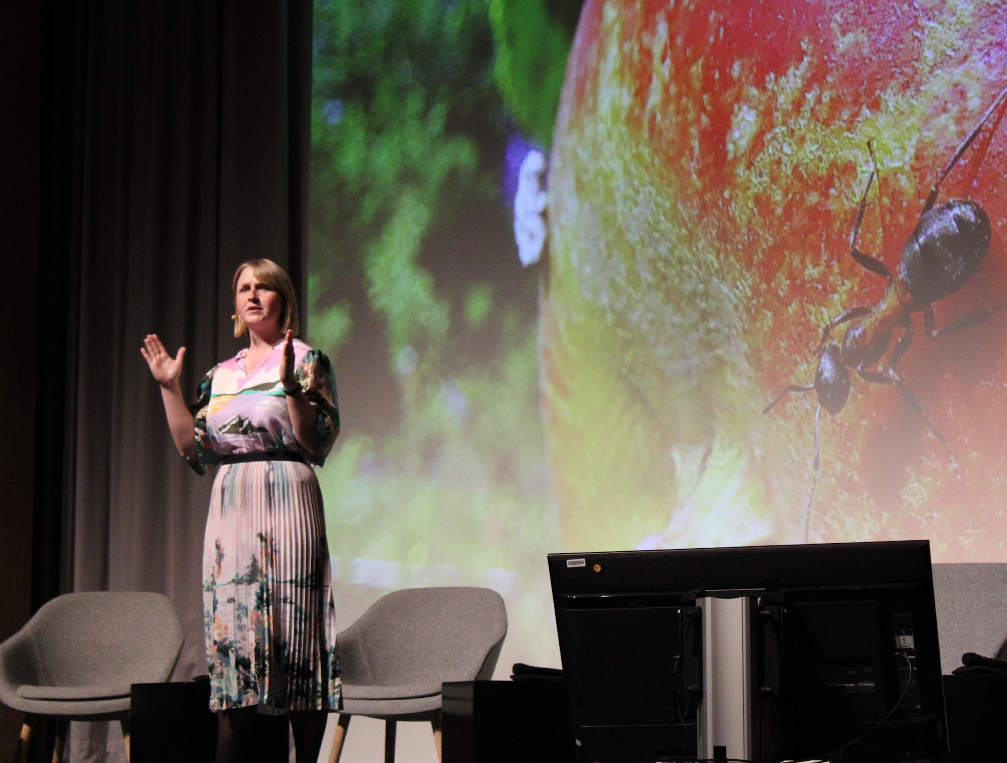
Three-Minute Thesis (3MT) Competition
Since 2017 the Coimbra Group has organised a 3MT competition at network level.
The 3MT challenges PhD students to describe their research to a general audience in English in less than three minutes.
In 2025, the video entries of PhD students from 29 CG Universities competed in the first virtual round (the winner of their own institutional competition).
Three finalists are then shortlisted among all winners. They compete during the CG live final taking place at the CG Annual Conference in June.

Slide 17
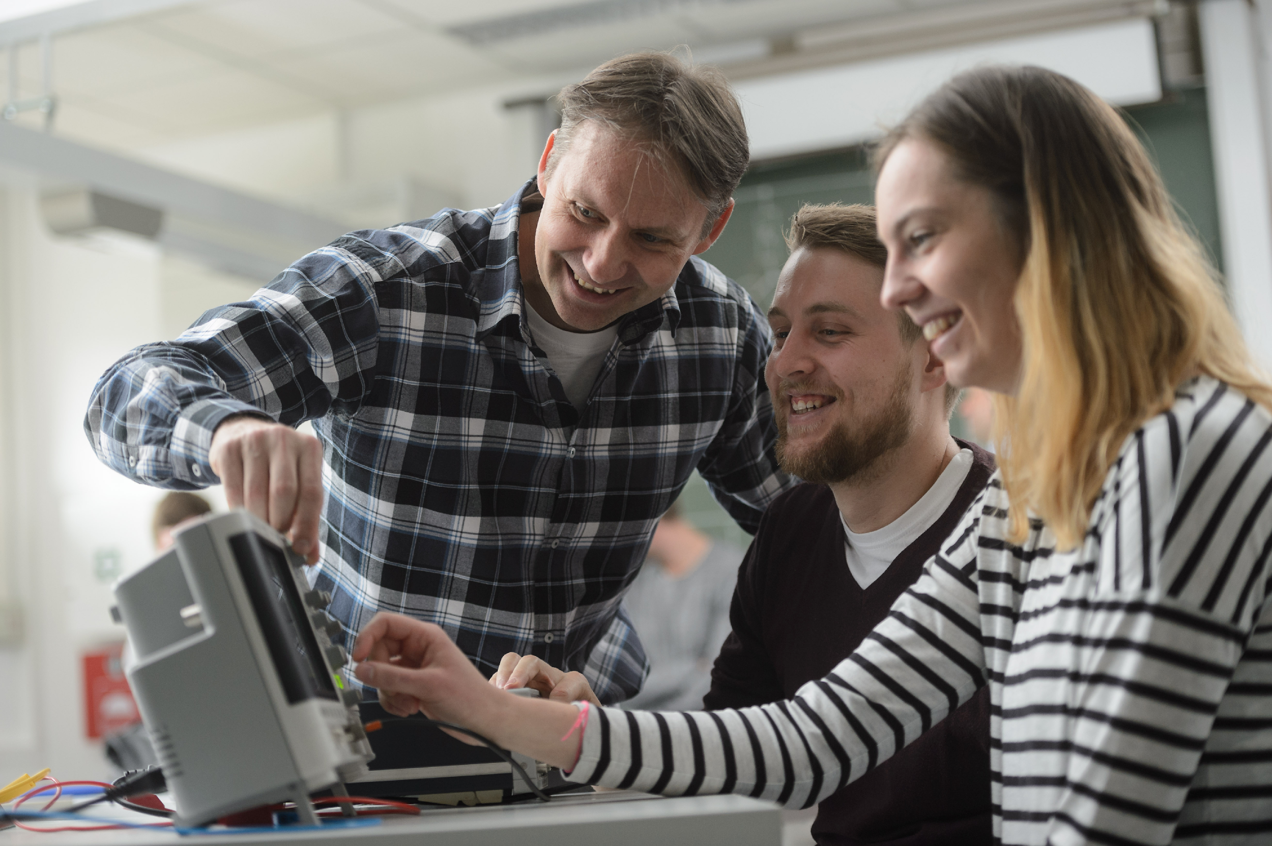
Scholarship Programmes
Background: Since 1999 the Coimbra Group has offered young researchers from outside the EU the opportunity to carry out part of their research for a period of one to three months at a Coimbra Group University.
The CG scholarship programme for short research stays in Europe is intended for early-career researchers and staff from universities in Latin America, Sub-Saharan Africa and the European Neighbourhood.
2025-2026 Key Figures:
76 scholarships awarded (30 LA, 31 Africa, 15 EN)
440 applicants
21 CG host universities
Next Call for applications: End January 2026
©University of Würzburg

Slide 18








Contact us!
Coimbra Group Office
11, rue d'Egmont, Brussels
+3225138332
www.coimbra-group.eu
info@coimbra-group.eu
@coimbragroup
@coimbragroup
Monthly newsletter: subscribe!

