Slide 1
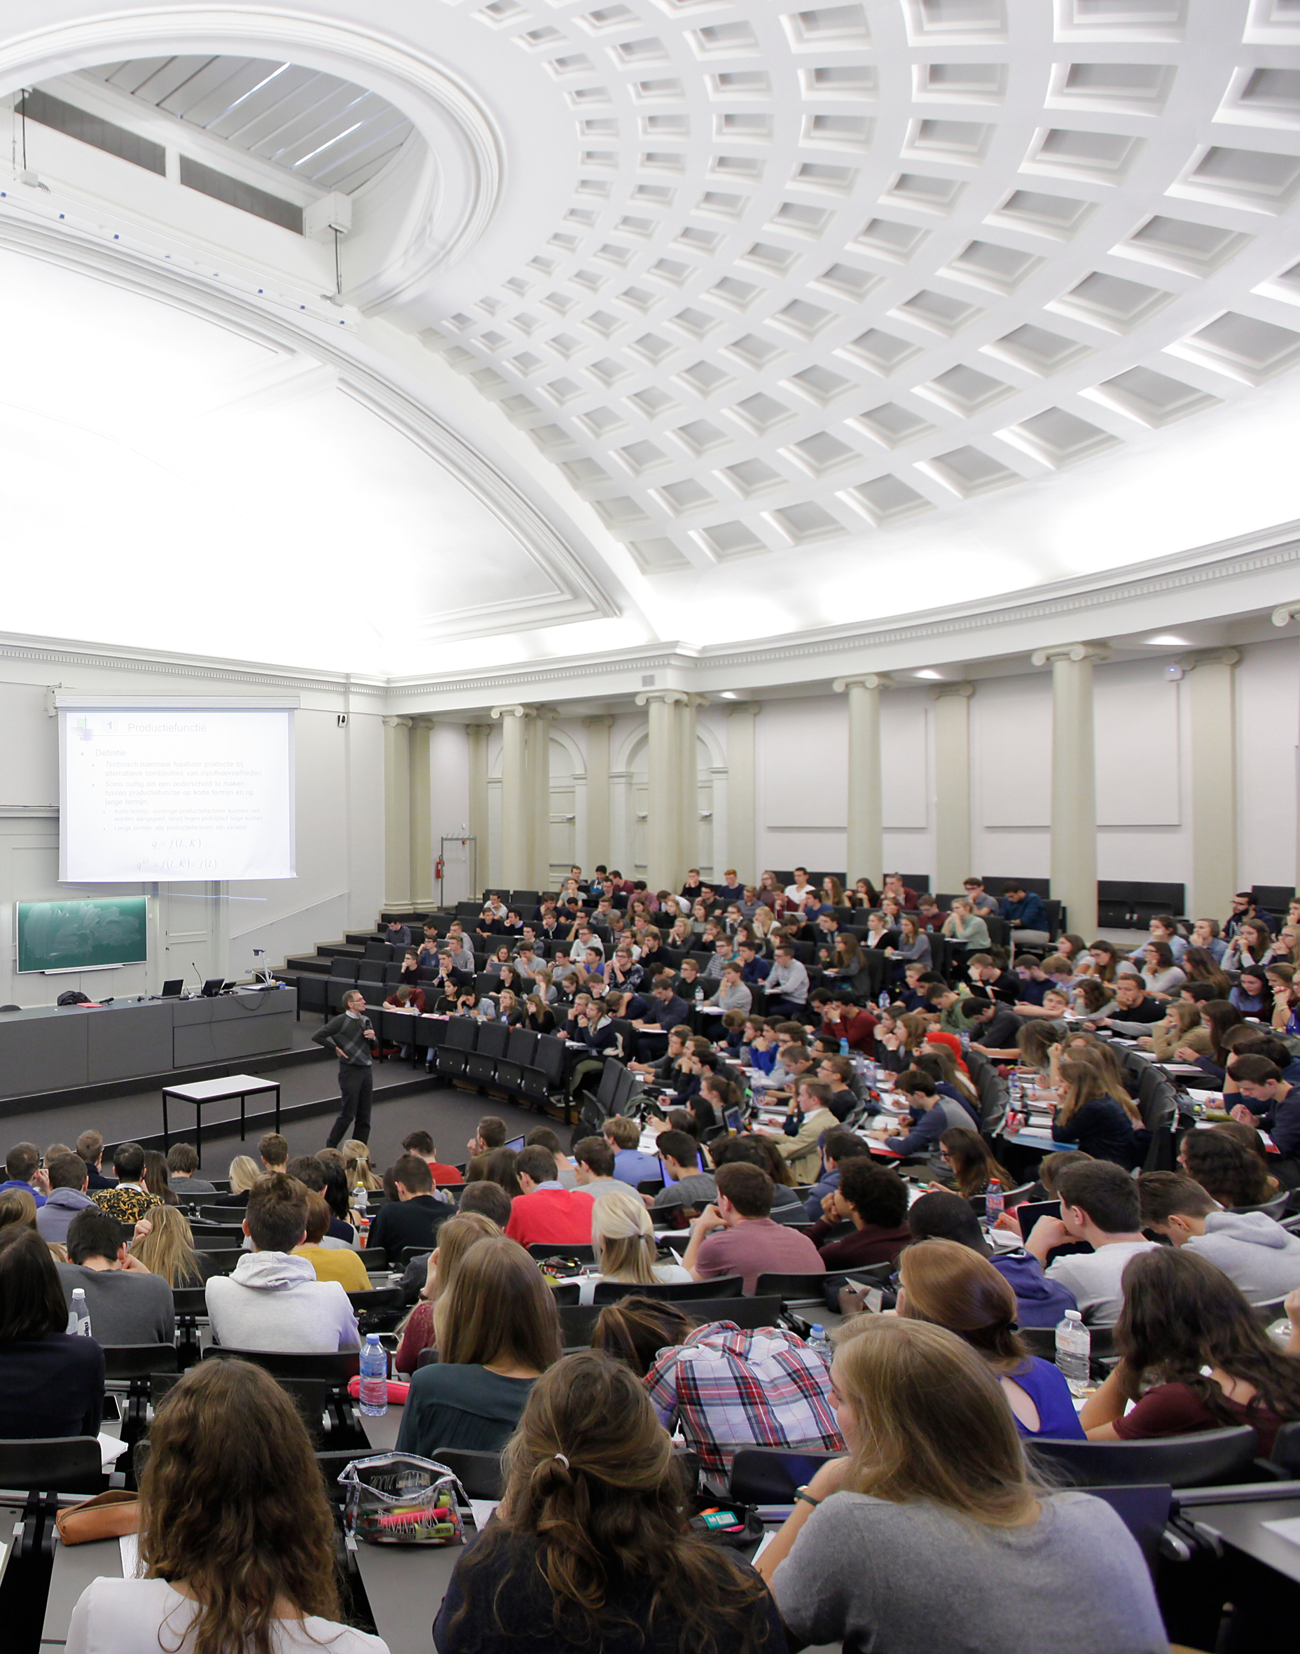
Coimbra Group 40th Anniversary Climate Symposium
24th-26th March 2025, Durham University

Slide 2
Universities as Innovators
Professor Annetje Ottow
President, Leiden University

Slide 3
Leiden University as innovator
Prof. Annetje Ottow| Coimbra Group Climate Symposium - Durham

Slide 4
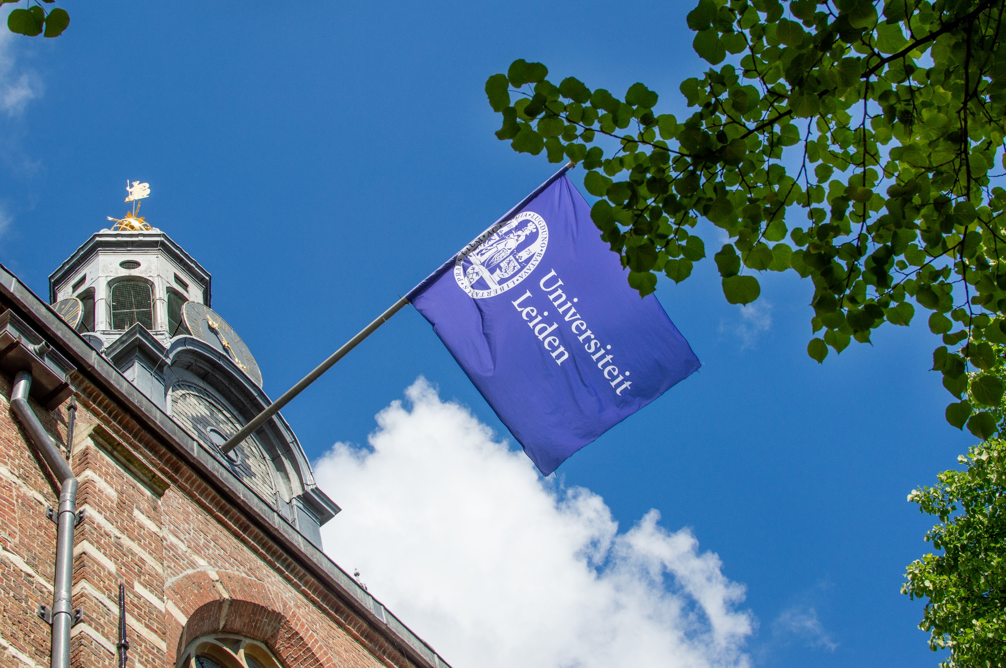

Slide 5
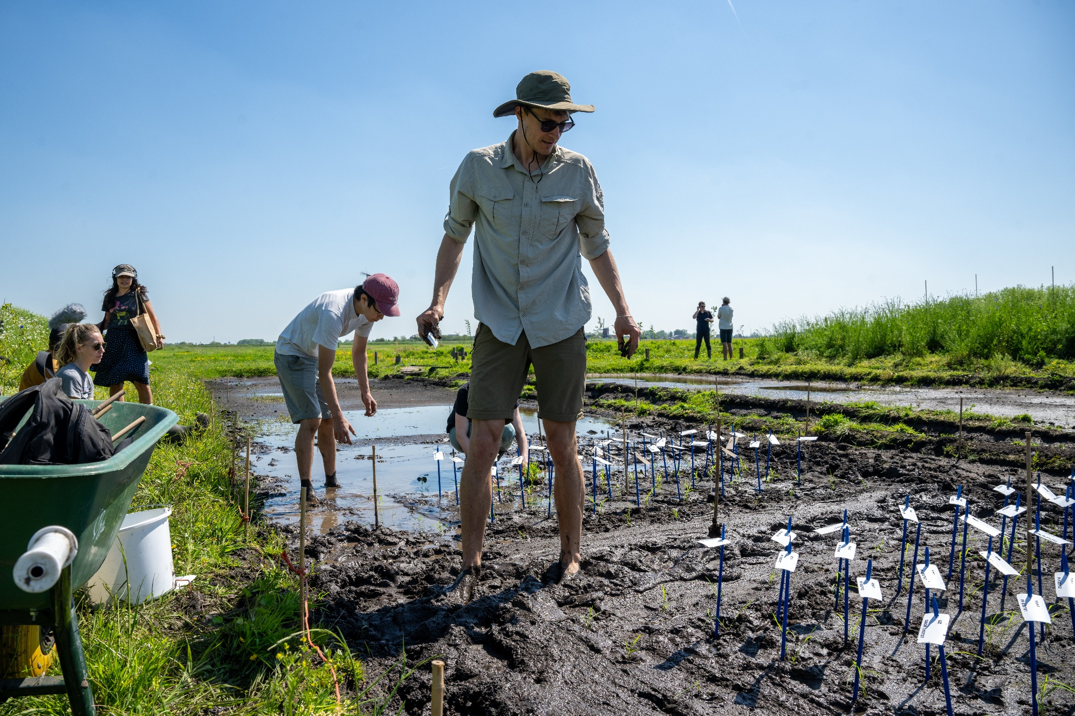

Slide 6
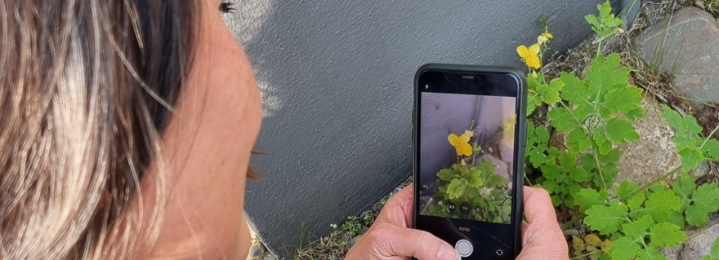

Slide 7
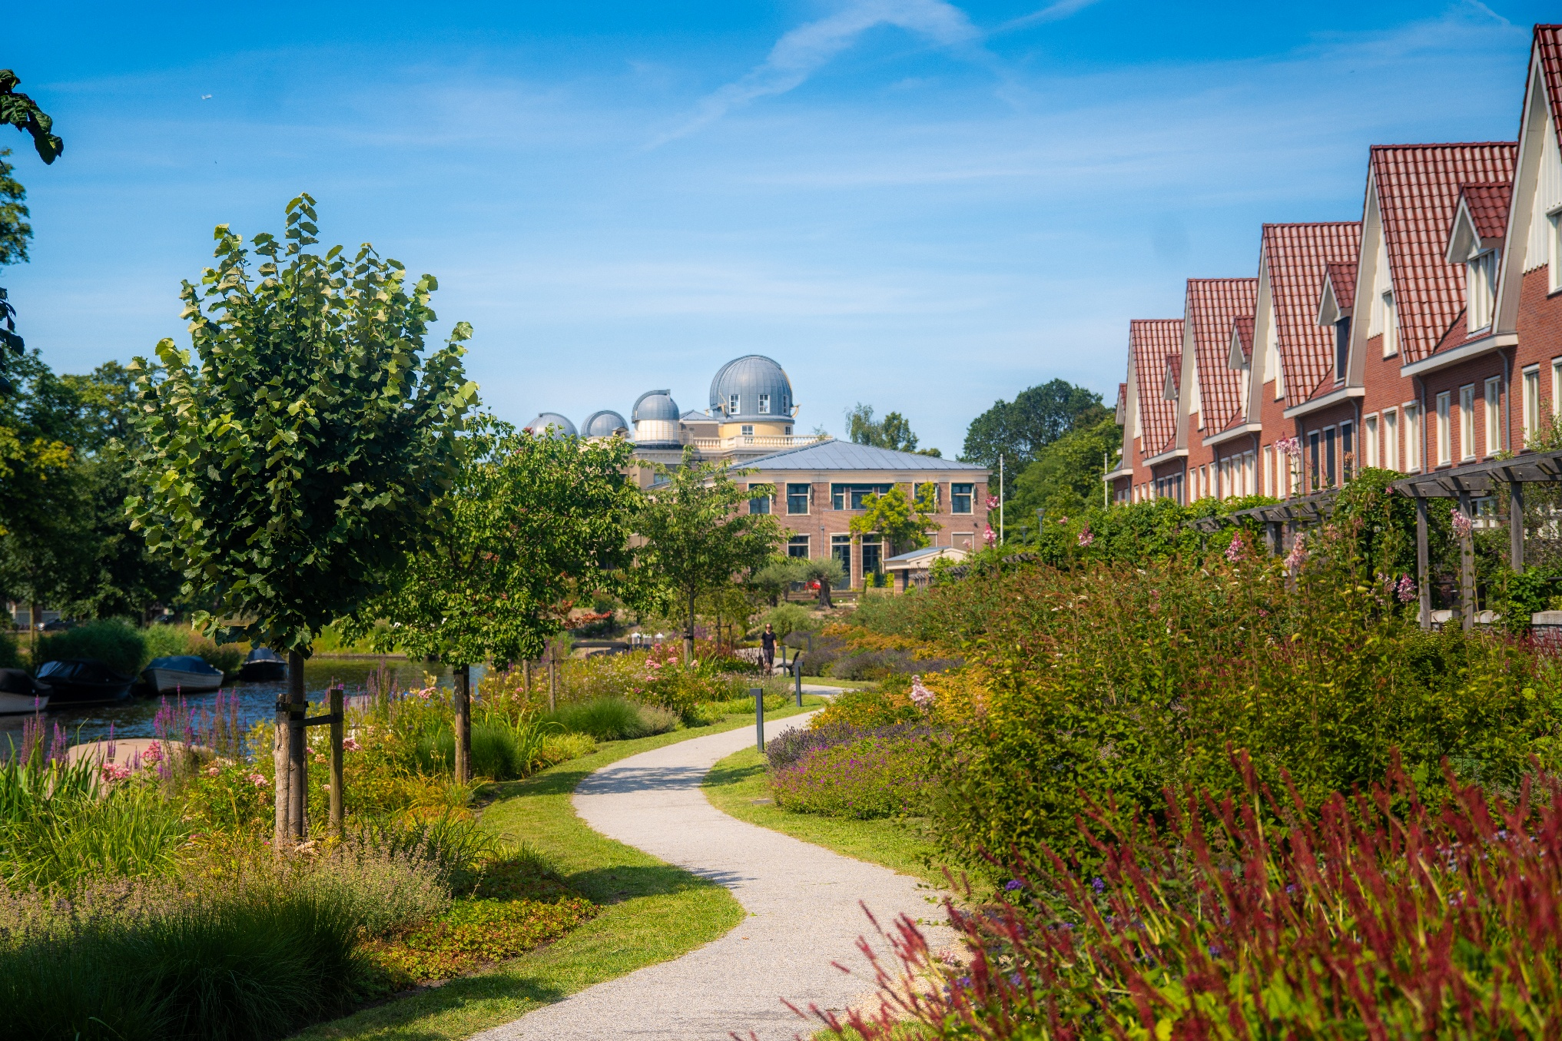

Slide 9
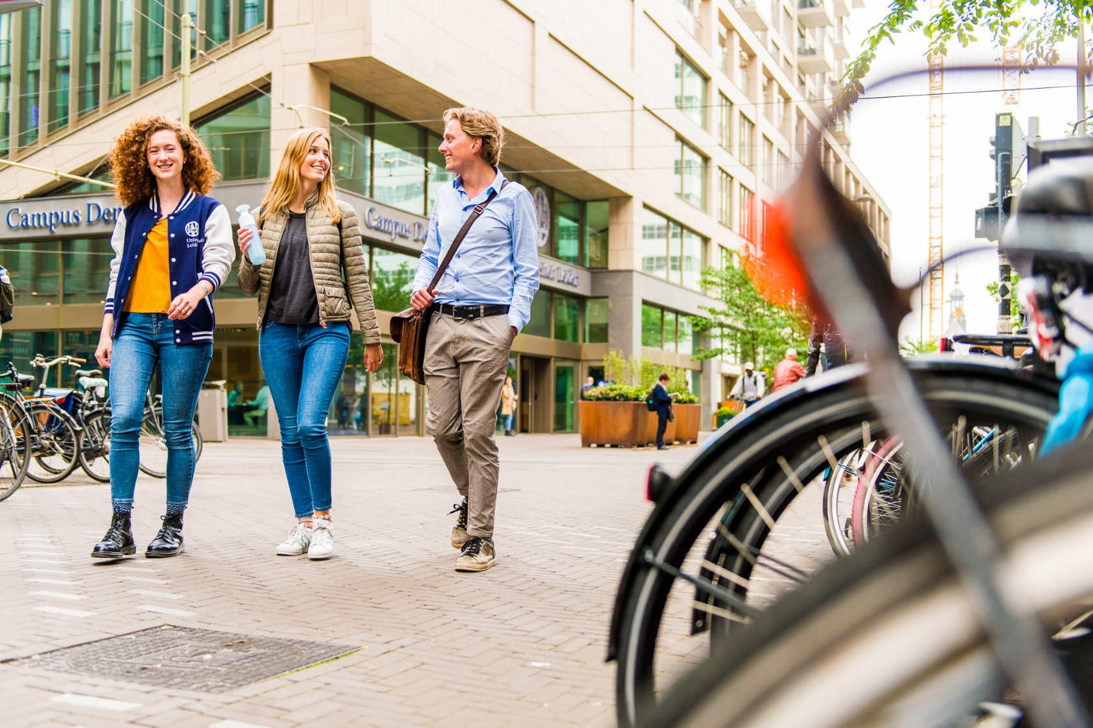

Slide 10
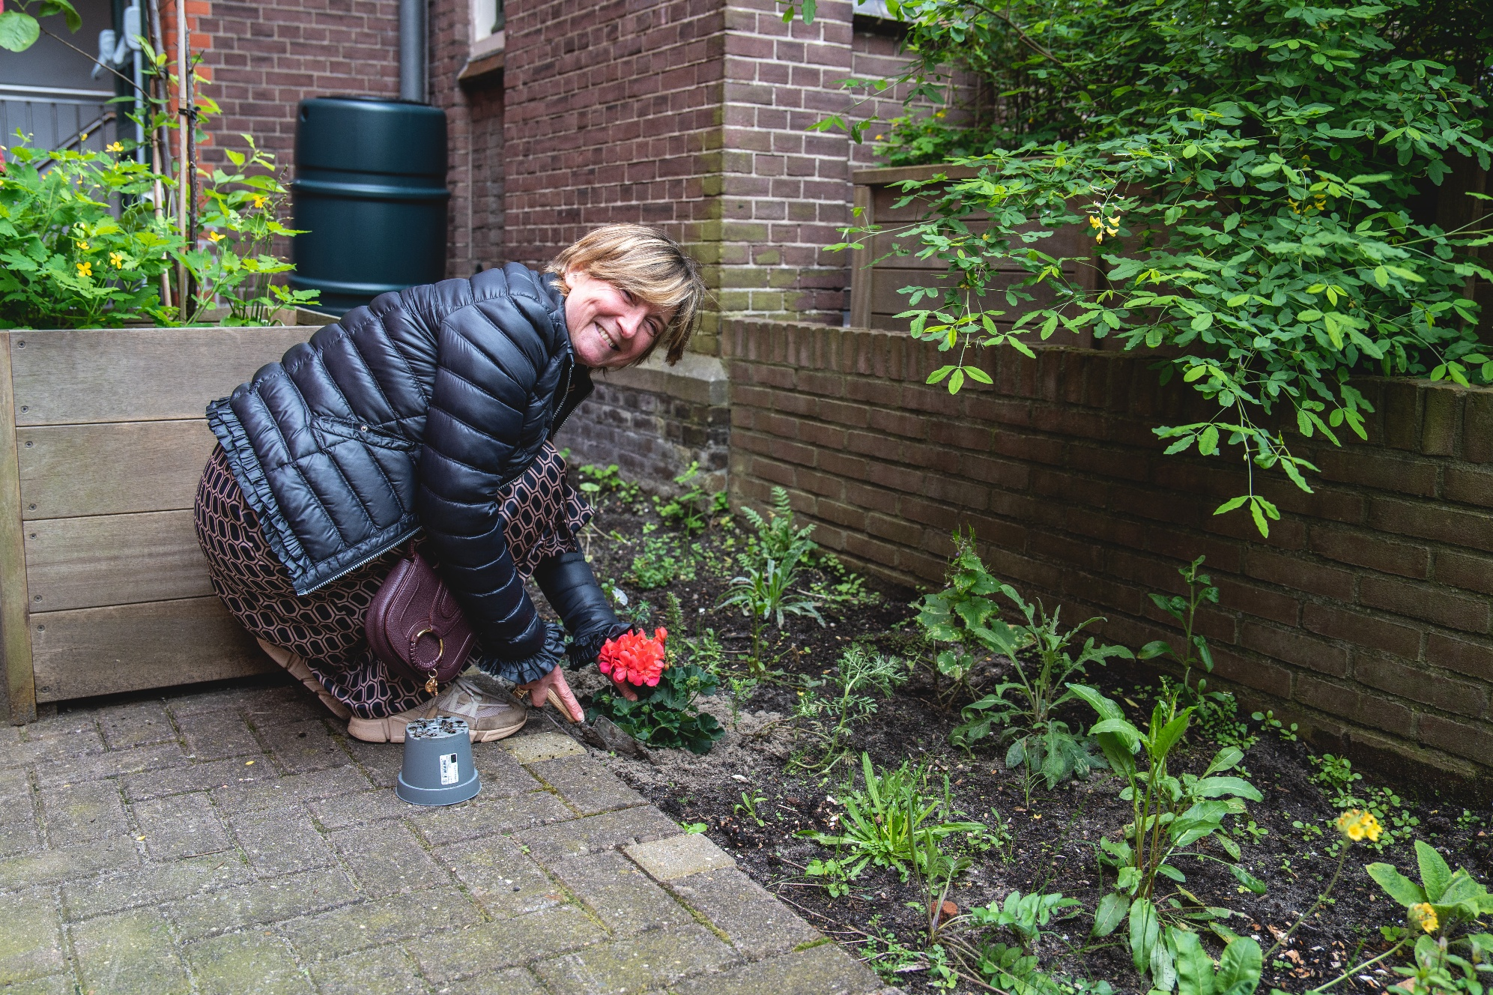

Slide 11
Thank you

Slide 12
Universities as Innovators
Professor Jane Stout
Vice President for Biodiversity and Climate Action, Trinity College Dublin

Slide 13
Universities as Innovators
Dr. Max Jungmann
Managing Director of the Heidelberg University Center for the Environment

Slide 14
Universities as Innovators
Professor Zamorano Toro
Vice-Rector for Infrastructure and Sustainability, University of Granada

Slide 15
Commitment
Founded in 1985 the Coimbra Group is an association of long-established European multidisciplinary universities of high international standard.
The Coimbra Group is committed to creating special academic and cultural ties in order to promote internationalisation, academic collaboration, excellence in learning and research, and service to society.
It is also the purpose of the Coimbra Group to influence European education and research policy and to develop best practice through mutual exchange of experience.
One of the pioneering actors in the creation of Erasmus+, the co-creation of the European Universities Initiative, and the development of the European Higher Education Area (EHEA).

Slide 16
Facts and figures
Founded in 1985
40 Universities from 22 European countries
> 1,4M students / > 232 000 staff members (teaching, research, admin.)
14.4% of all signed grants in H2020:
25% of all RIAs, IAs and CSA projects awarded under Pillar II
12.5% of all ERC funded grants
15.5% of all MSCA funded projects
21% of all signed grants in HEU:
26% of all RIAs, IAs and CSA projects under Pillar II
11,7% of all ERC funded grants
20.85% of all MSCA funded projects
>16% of all Erasmus+ grants to/from CG universities

Slide 17
Executive Board Priorities & Forthcoming Events
2024-2025

Slide 18
Executive Board Priorities 2024-2025
Continue playing the role of a scientific theme-setter and articulating a solid vision based on our values
Civic and societal engagement and shared values
Innovation and the implications of the Draghi Report
Open Science and Open Research Information
Artificial Intelligence
Climate Change

Slide 19
Contact us!
Coimbra Group Office
11, rue d'Egmont, Brussels
+3225138332
www.coimbra-group.eu
info@coimbra-group.eu
@coimbragroup
@coimbragroup
Monthly newsletter: subscribe!

